Slide 1


SIFA PROJECT - GROUP YBBS

Slide 2
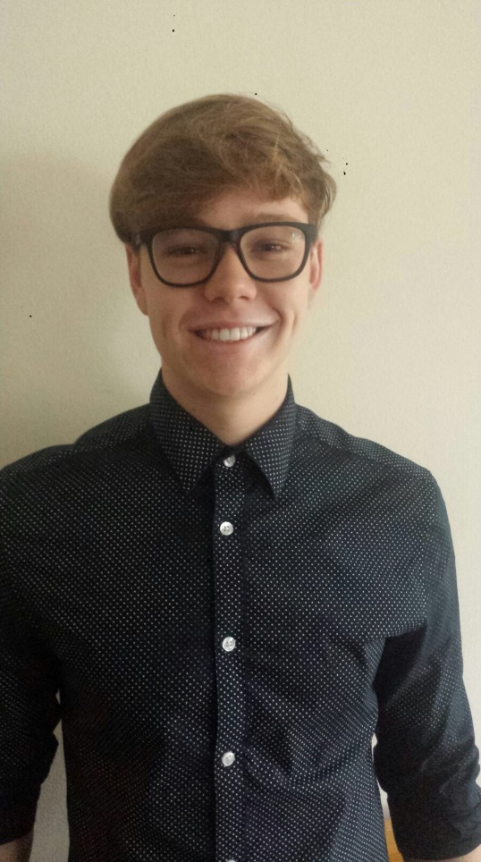
NICO FAHRNGRUBER
17 years
Texing
Tennis and golf

Slide 3
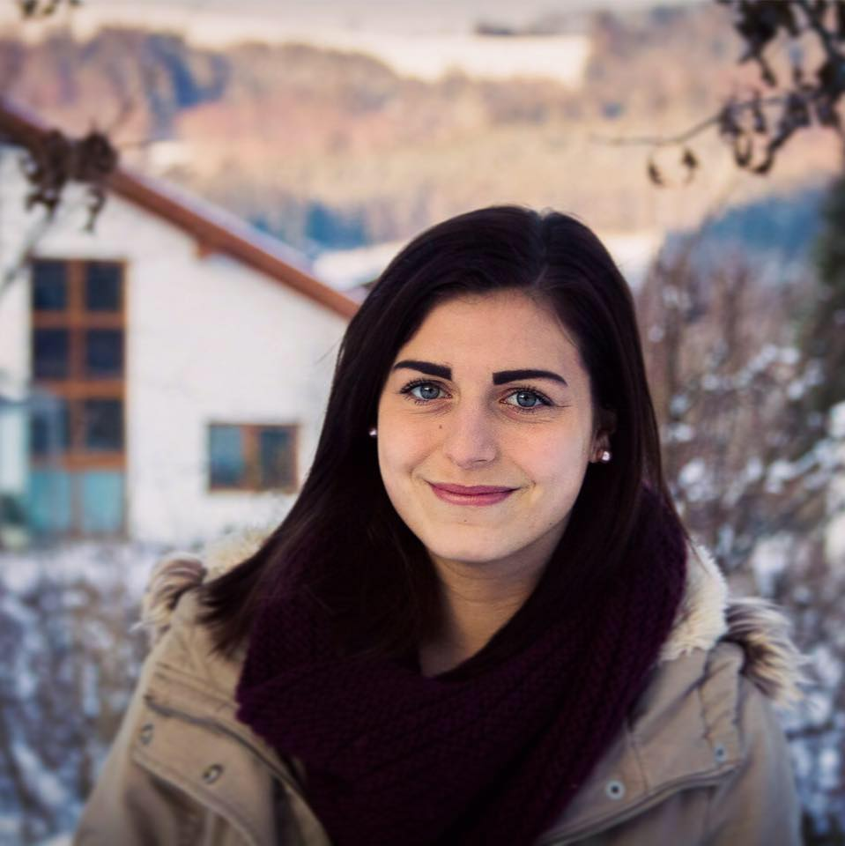
LENA NIKOU
16 years
Gresten
Dog sport and horse riding

Slide 4
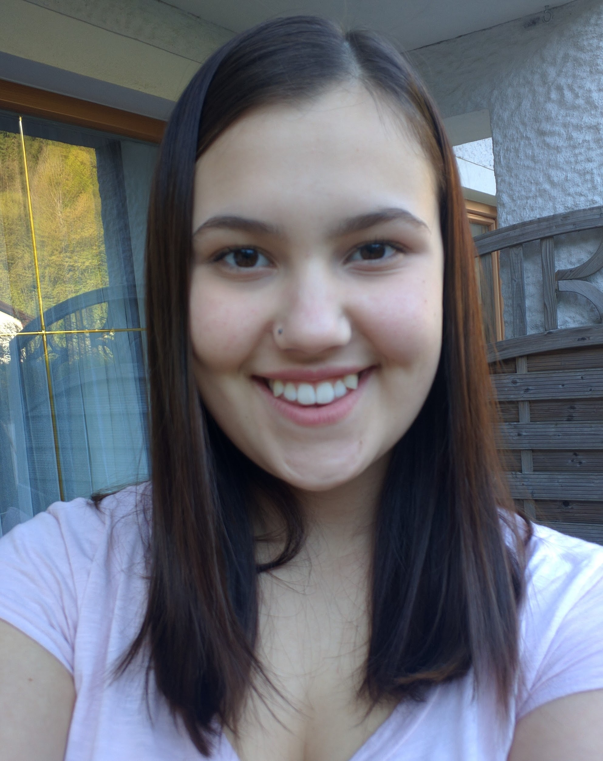
JASMIN SCHAGERL
16 years
St. Anton
Music and sports

Slide 5

DANIEL MOLNAR
21 years
Wieselburg
Music

Slide 6
CONTENTS
Ybbs and its neighbourhood
  Location of Ybbs
  Ybbs an der Donau
  Melk
  Wachau
  Vienna
Presentation of our school by our colleagues

Slide 7
YBBS AND ITS NEIGHBOURHOOD

Slide 8
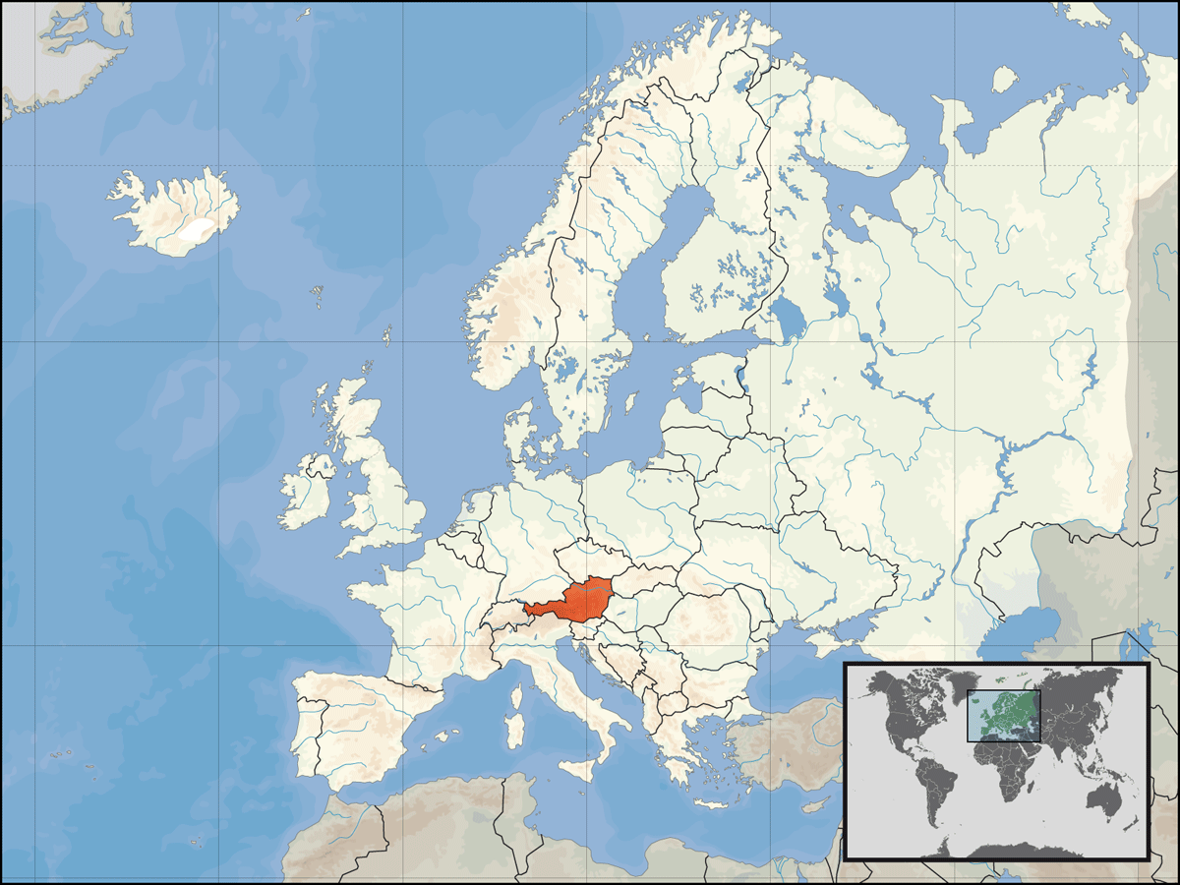
LOCATION
Central Europe
Lower Austria
110 km to Vienna

Slide 9
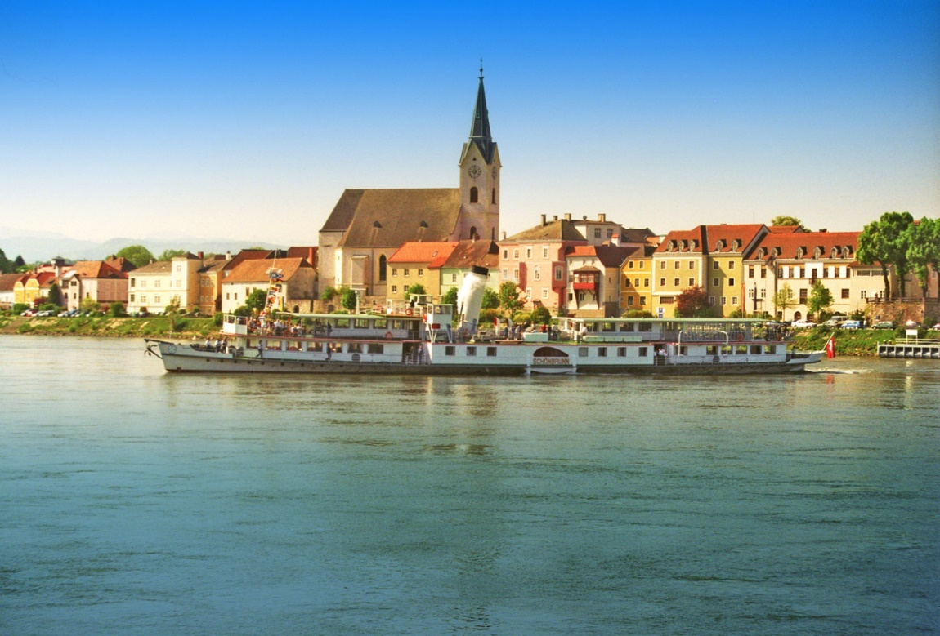
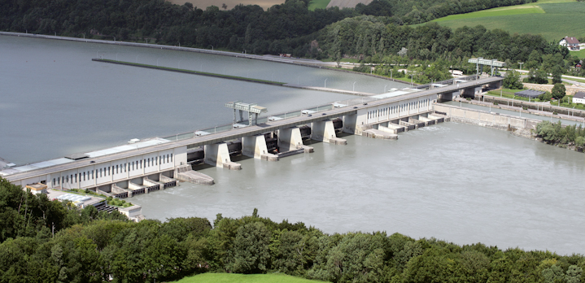
YBBS AN DER DONAU
Inhabitants: 5,600
224 m above sea level
first river power plant on the Danube in Austria

Slide 10
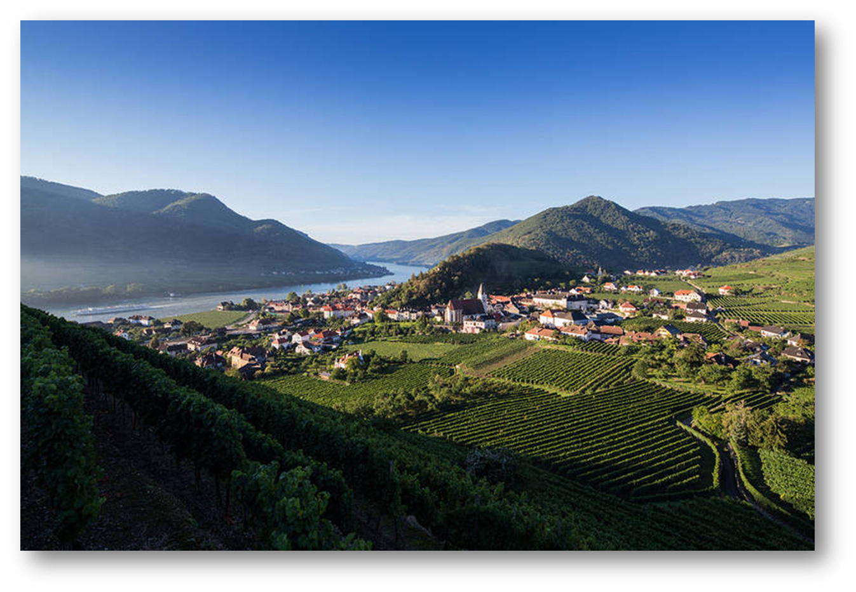
WACHAU
valley with a marvelous landscape formed by the Danube river
located midway between the towns of Melk and Krems
40 kilometres length
in UNESCO List of World Heritage Sites
famous for white wine production

Slide 11
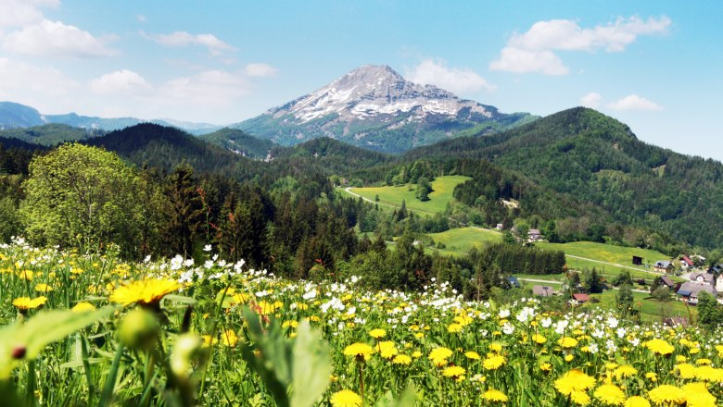
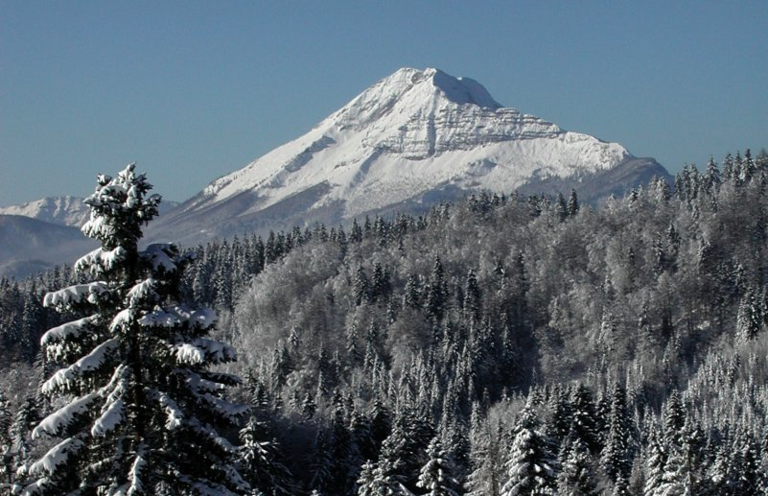
ÖTSCHER
nearby mountain
1893 m
Summer: perfect for hiking
Winter: perfect for skiing
popular destination

Slide 12
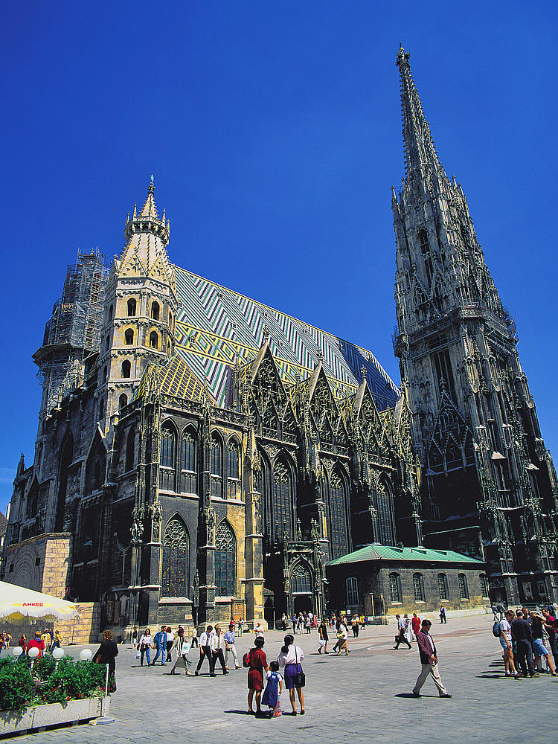
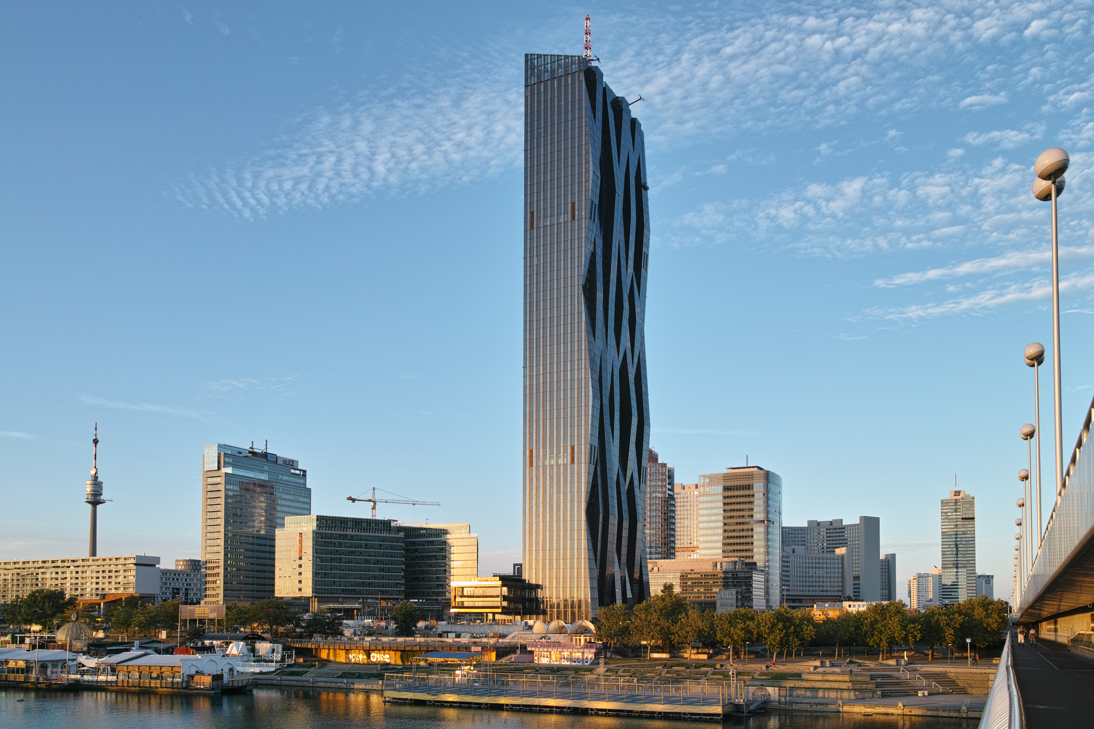
VIENNA
Stephansdom
DC Tower

Slide 13
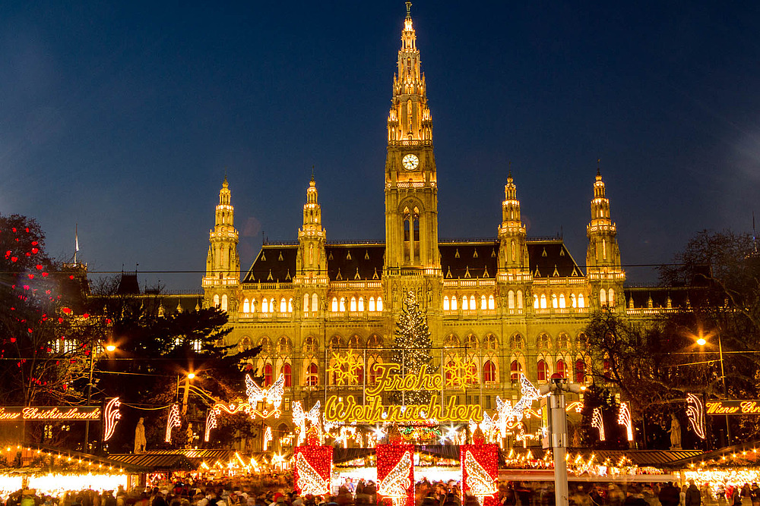
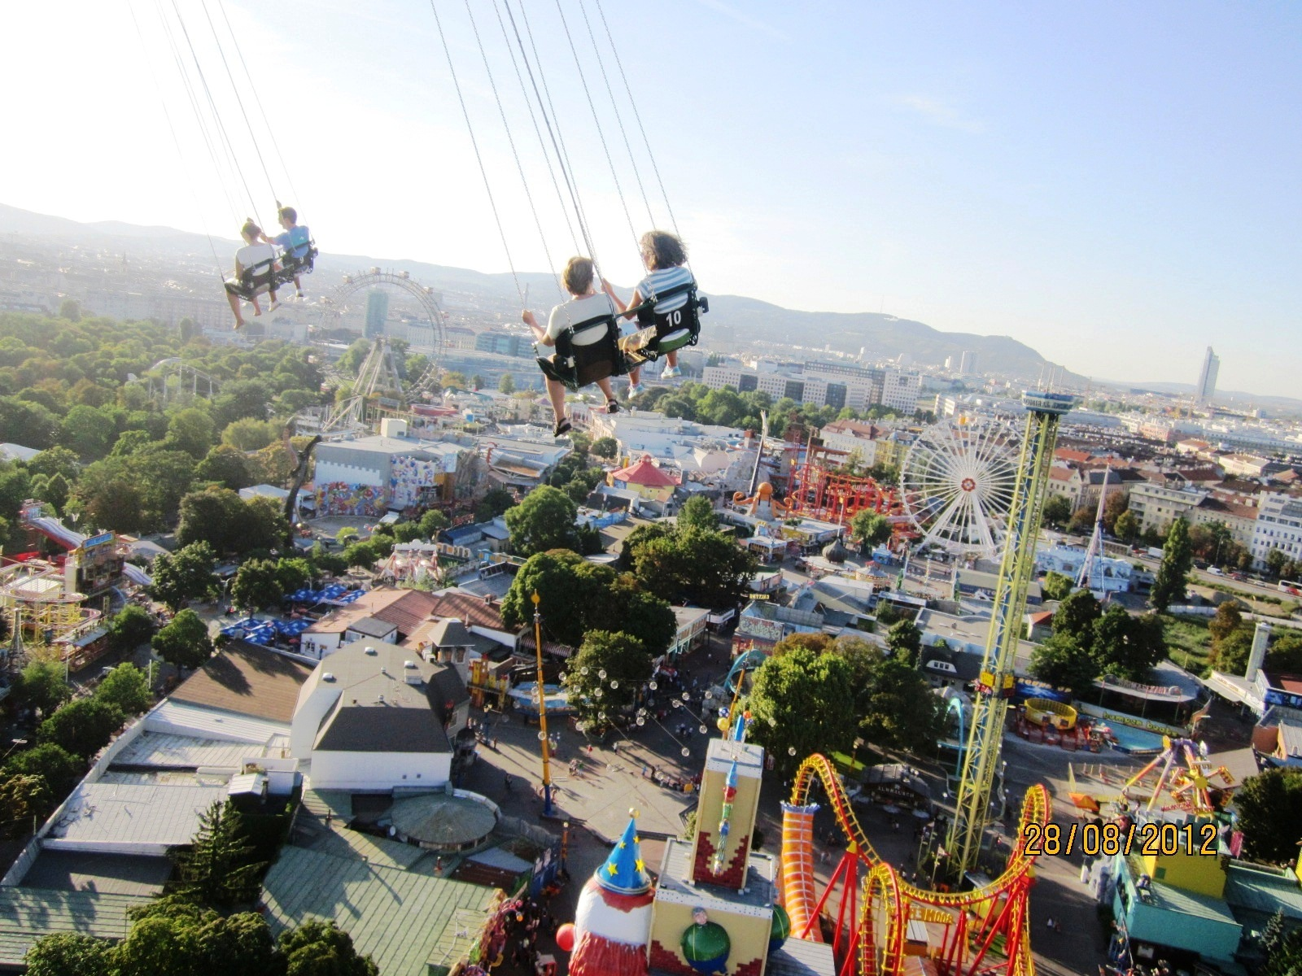
Christmas Markets
Prater (established in 1766)

Slide 14
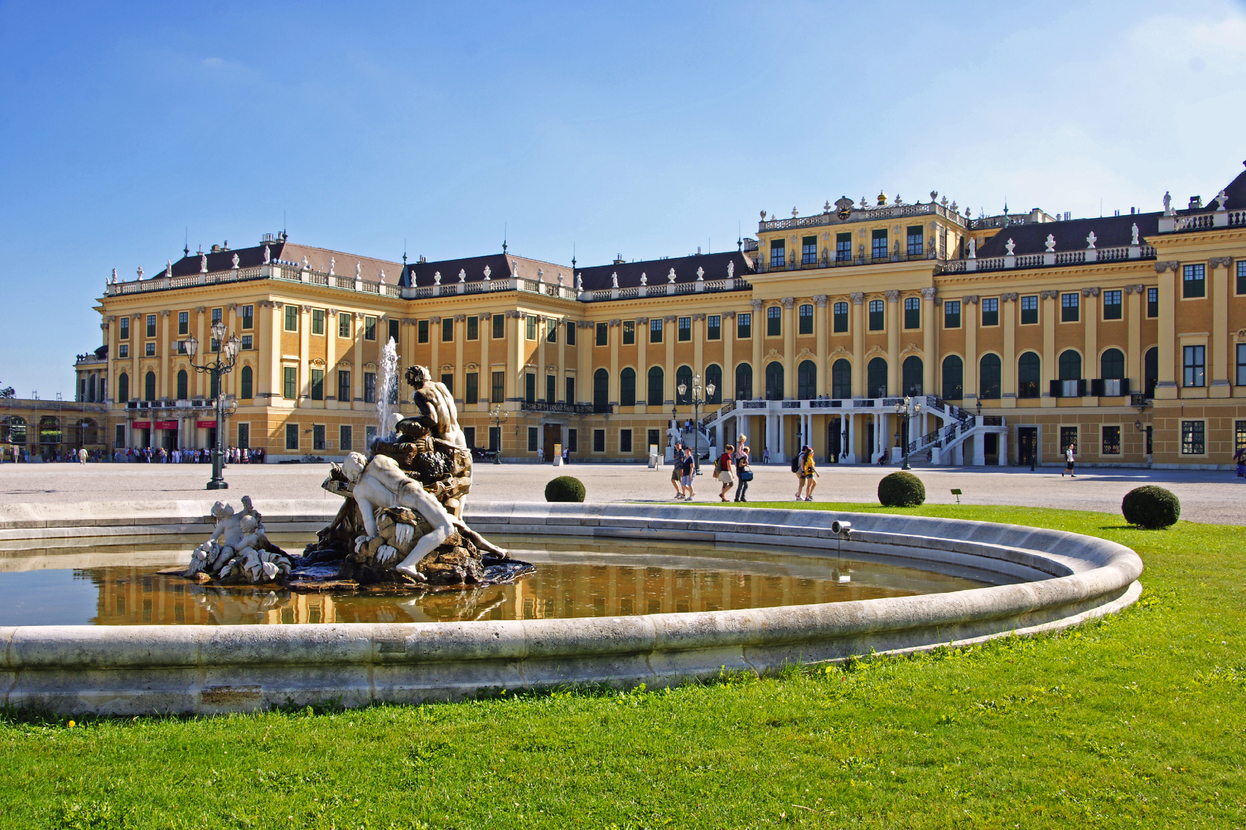
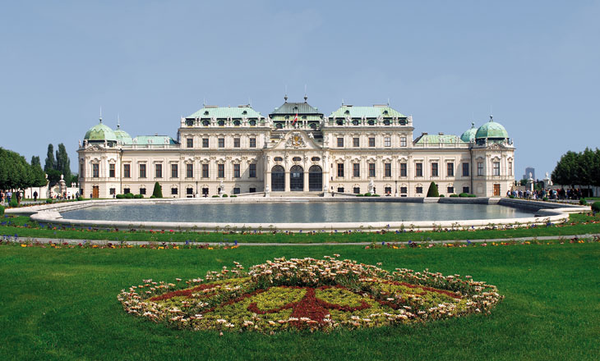
Schönbrunn Palace
Schloss Belvedere

Slide 15
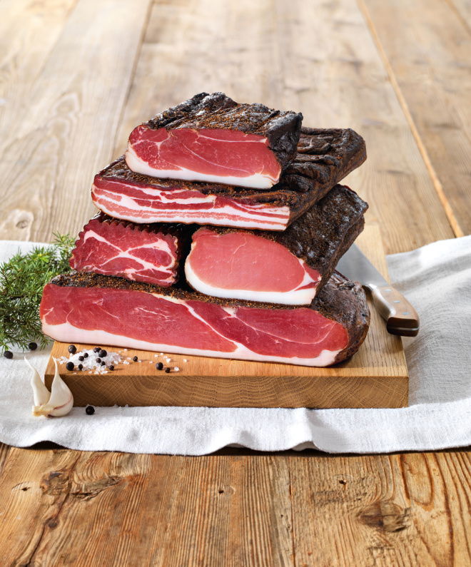
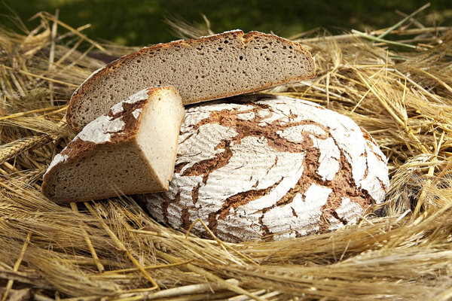
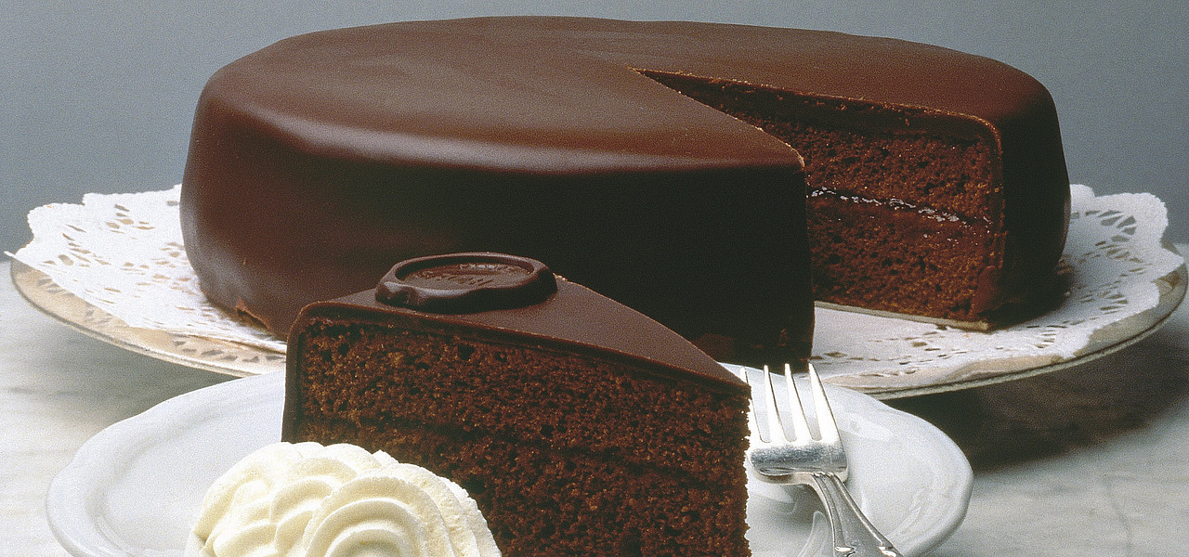
TYPICAL AUSTRIAN FOOD
coarse rye-bread (“Bauernbrot”)
bacon (“Speck”)
typical chocolate gateau (“Sachertorte”)

Slide 16
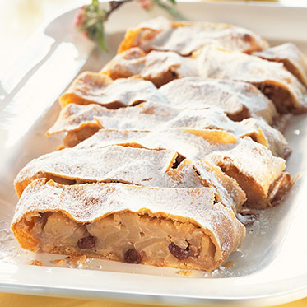
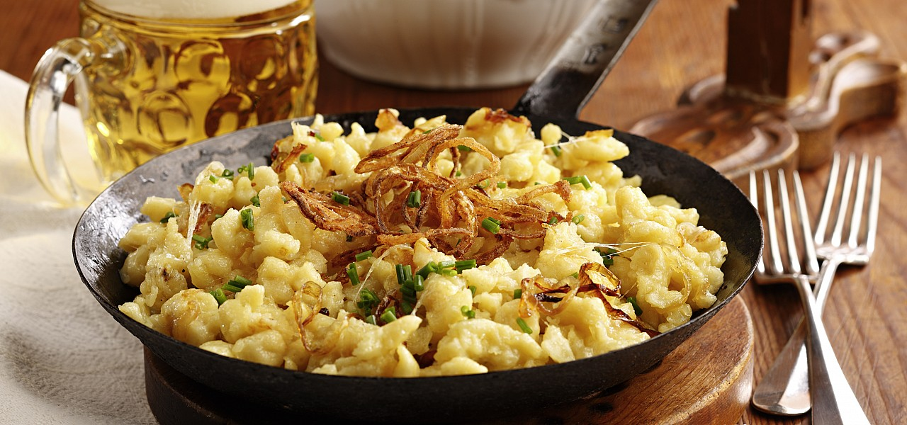
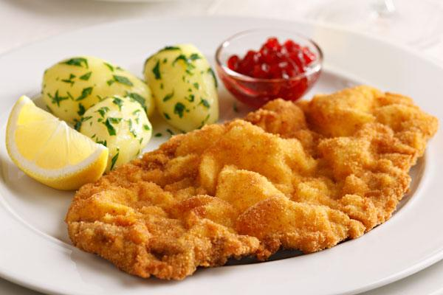
TYPICAL AUSTRIAN FOOD
“Wiener Schnitzel”
“Käsespätzle”
“Apfelstrudel”

Slide 17


Slide 18
CONTENTS
general facts about the school
3 kinds of school
buildings

Slide 19
GENERAL FACTS ABOUT THE SCHOOL
school center Ybbs on the Danube is a private school
Strong contacts to local business, to European institutions and to the working world
Around 70 teachers
Around 600 students
3 types of school: Academy of Commerce (HAK)
Trade School (HAS)
Higher School of Information Technology (IT-HTL)

Slide 20
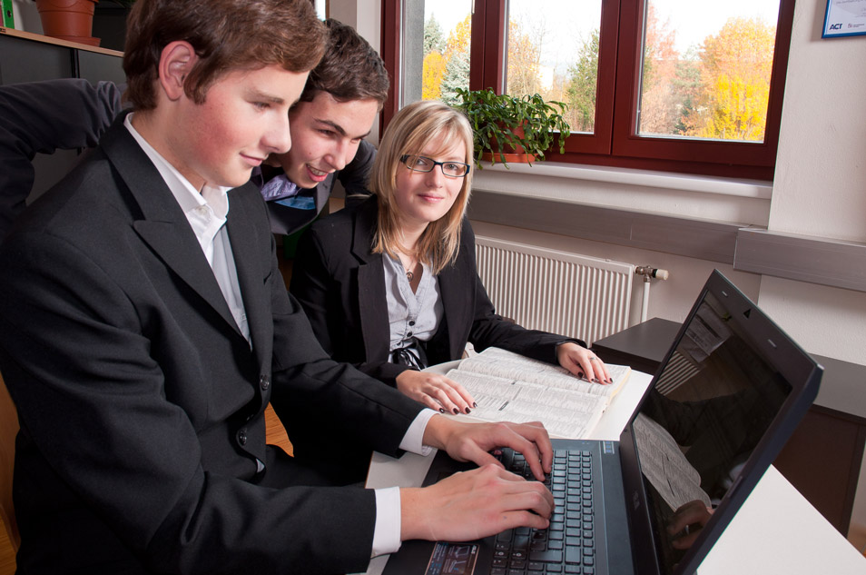
HAK
takes 5 years
A-Levels
educational goals: Managerial expertise General education Language skills
Social education
3 types of classes: Notebook
Classic
International

Slide 21

HAS
takes 3 years
final exam
educational goals: up-to-date technology
teamwork
practical training

Slide 22
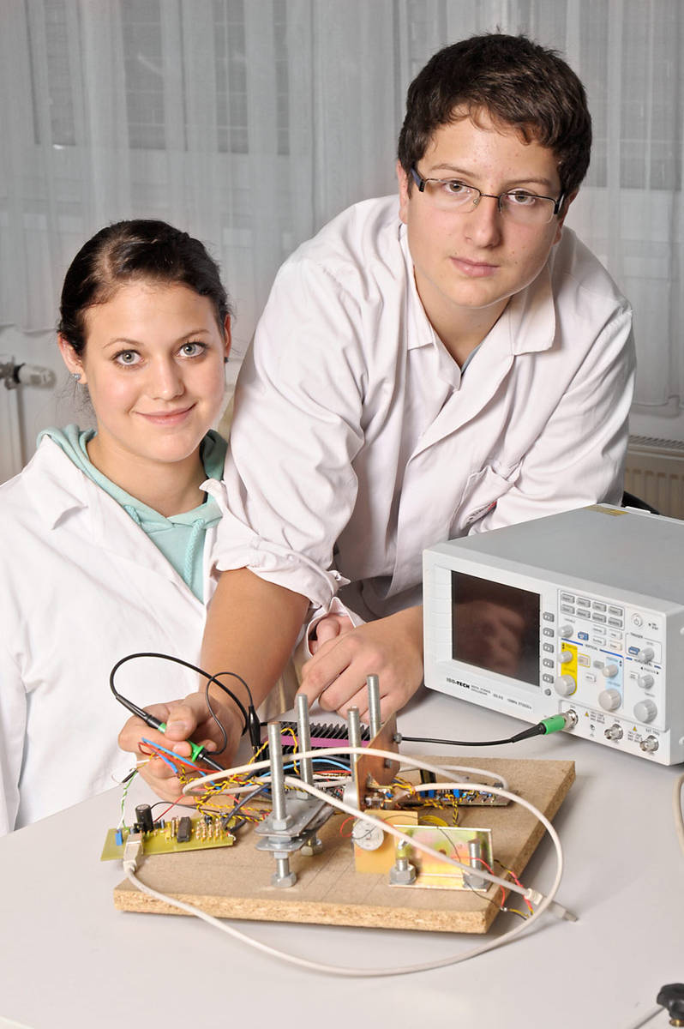
IT-HTL
takes 5 years
A-Levels
2 types of classes: media technology
network technology

Slide 23
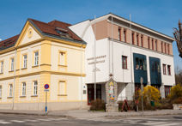
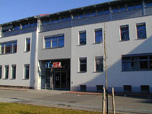
BUILDINGS

Slide 24
THANKS FOR YOUR ATTENTION!

