Slide 1
Online Gaming Addiction

Slide 2



What is online gaming?
Online Game = video game played over a computer network

Slide 3


First signs
Anger, frustration
Depression, anxiety
Justifying excessive use
Cravings
Physical symptoms

Slide 4
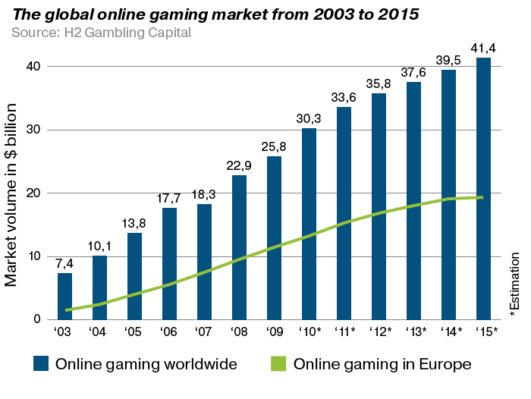
Statistics

Slide 5
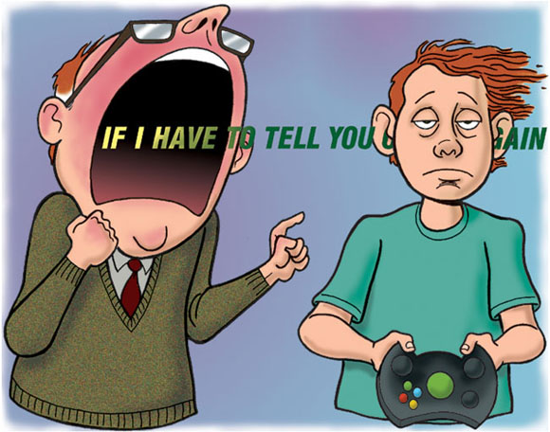
Online junkie
Constant irritation
Addiction to visual illusion
Cravings
Physical stress

Slide 6
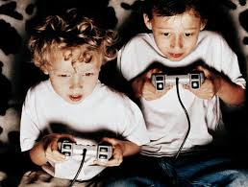
Things addicts do:
They find a game that interests them
They play it as often as possible
Playing is their most important duty
They try to be the best at it
They don‘t worry about anything else

Slide 7
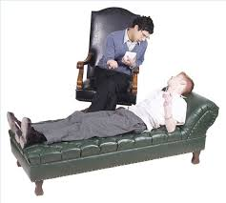
How to get help
Talking to someone
Finding hobbies
Gradually decrease

Slide 8
Sources
Hjelpelinjen.no
Video-game-addiction.org
H2 Gambling Capital

Slide 9
Thank you for your attention!

