Slide 1
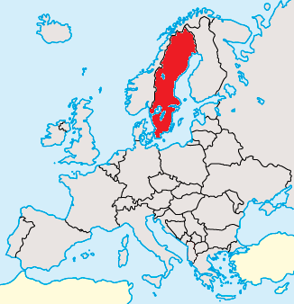
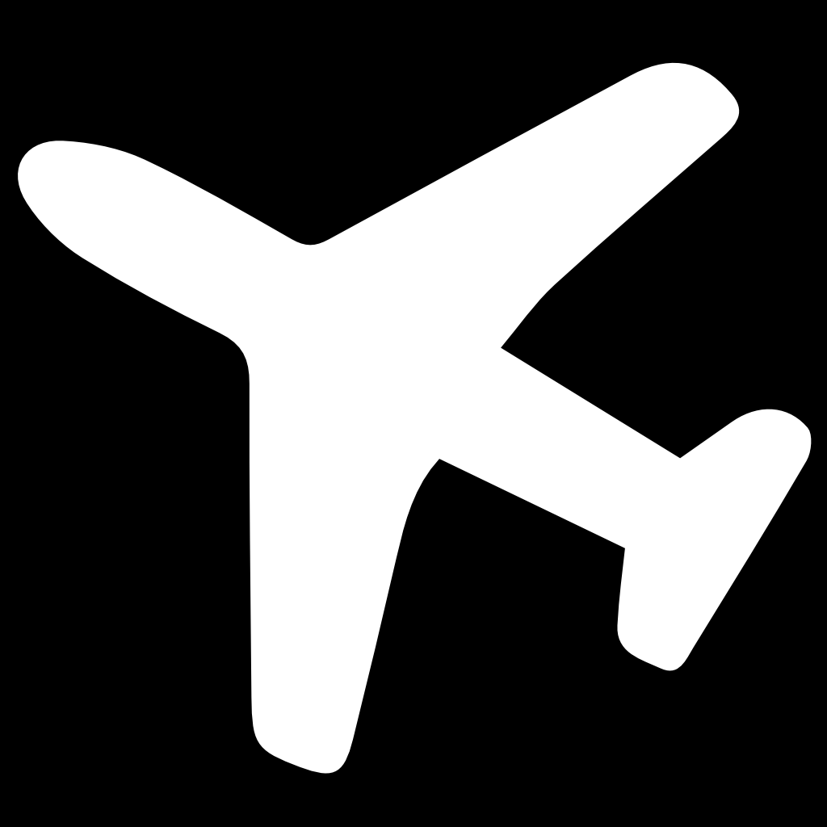
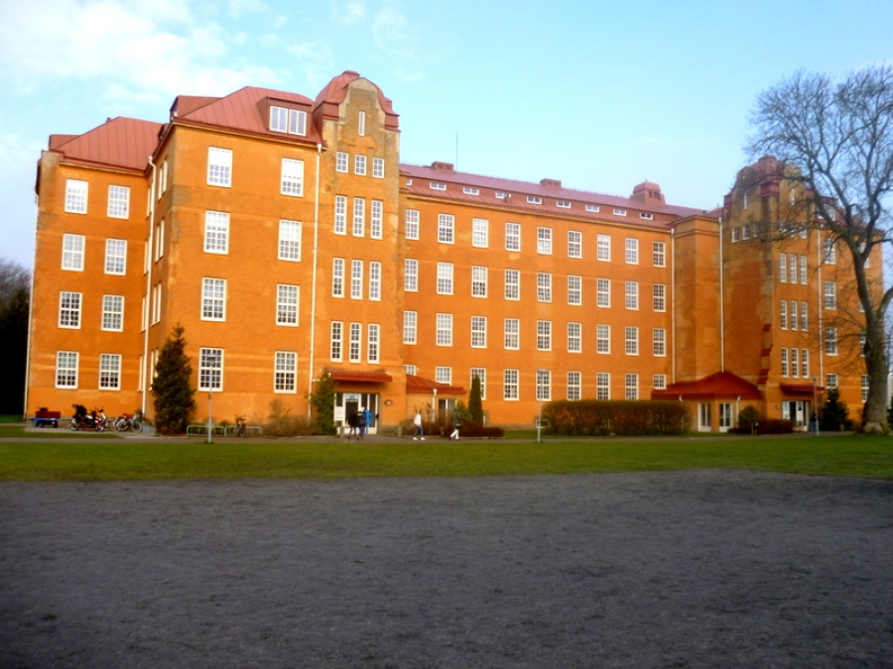
This is us

Slide 2
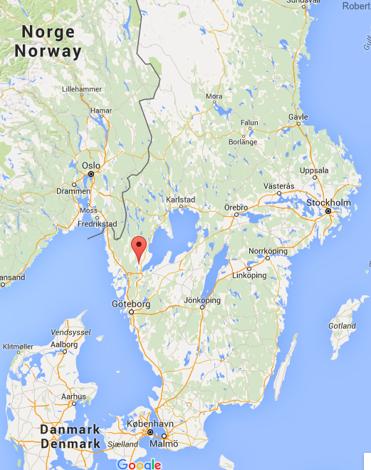
Vänersborg - sweden
38 381 inhabitants in the municipality
Situated by Lake Vänern

Slide 3

Fridagymnasiet
Vänersborg, Sweden
150 students
20 teachers
We prepare our pupils for the university
We have four programs:
Social studies, Natural science, Language studies, Economic
Sweden
Vänersborg

Slide 4
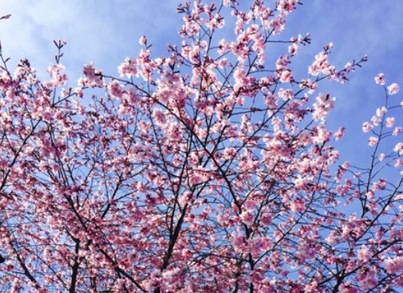
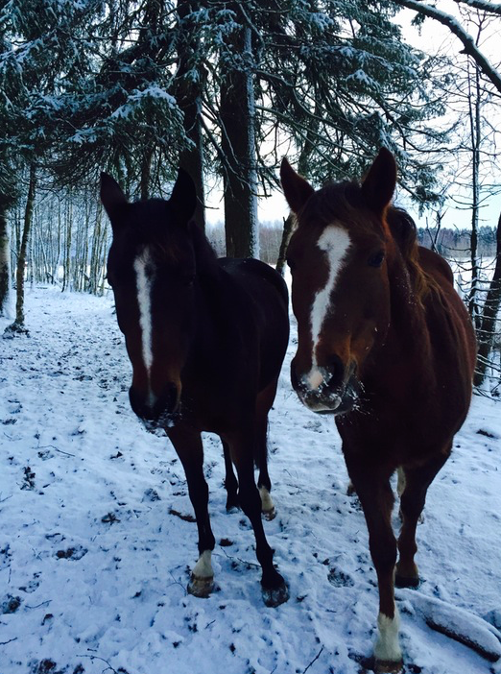
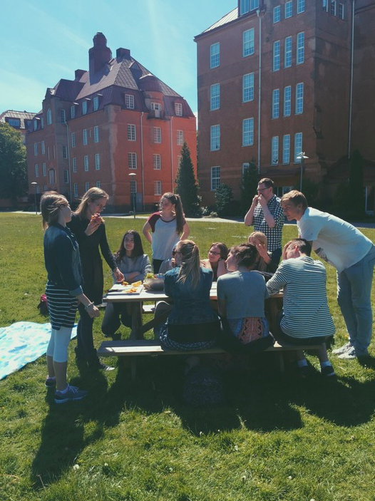
Hanna-Klara
17 years old
Science program
Family
Future plans
I like to..

Slide 5
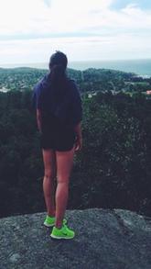
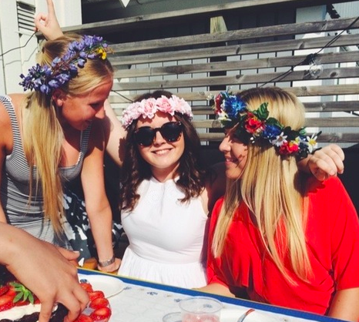
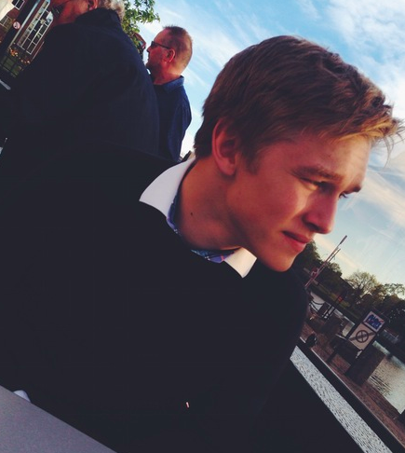
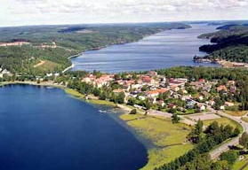
Brittan
18 years old
Dals Ed, Sweden
Mother & two sisters
Sport, being with friends & boyfriend
Social Science Program
Becoming a psychologist

Slide 6
Wilma
18 years old
Science program
In the future…
My family
I like to:
Be with friends
Be creative
Travel and see new things

Slide 7
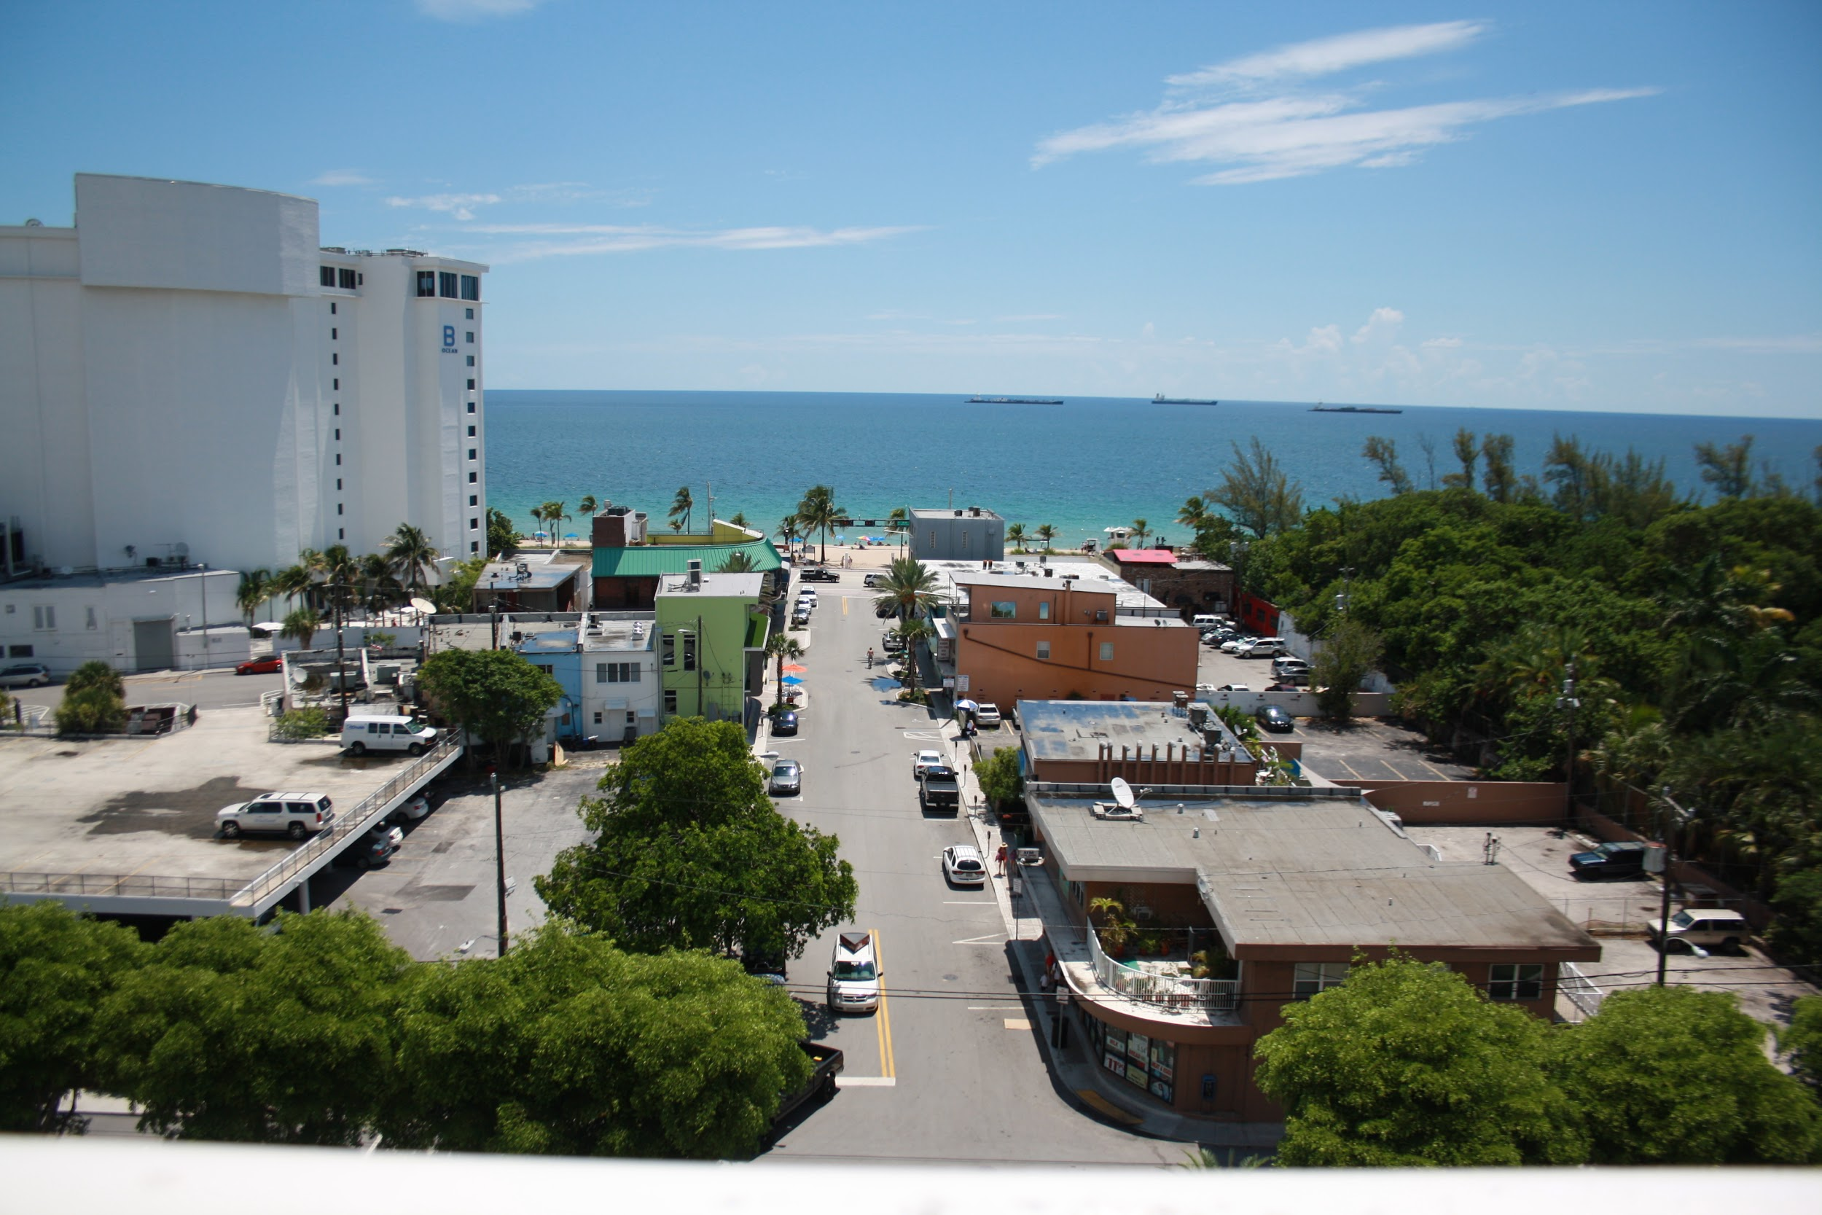
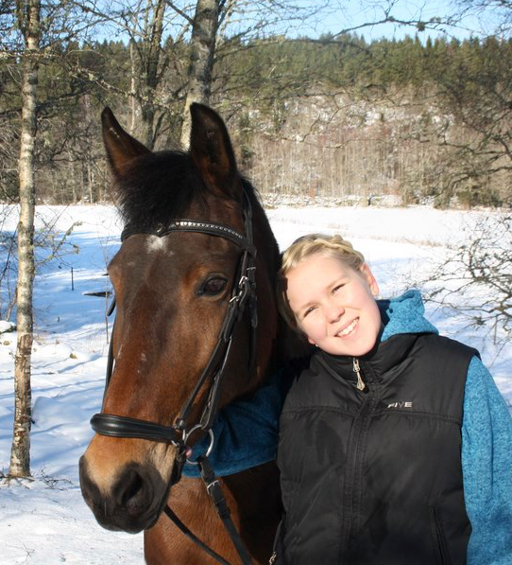
Filippa
18 years old
Social science program
Family
Interests
My plans after school

Slide 8
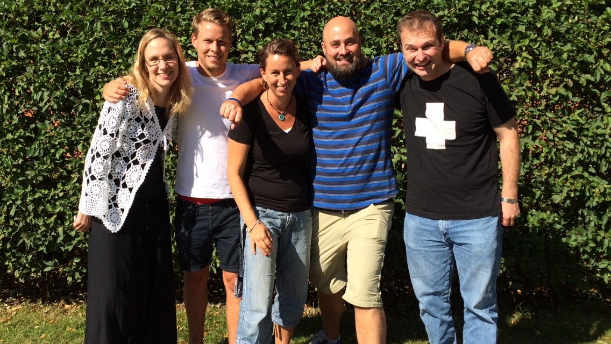
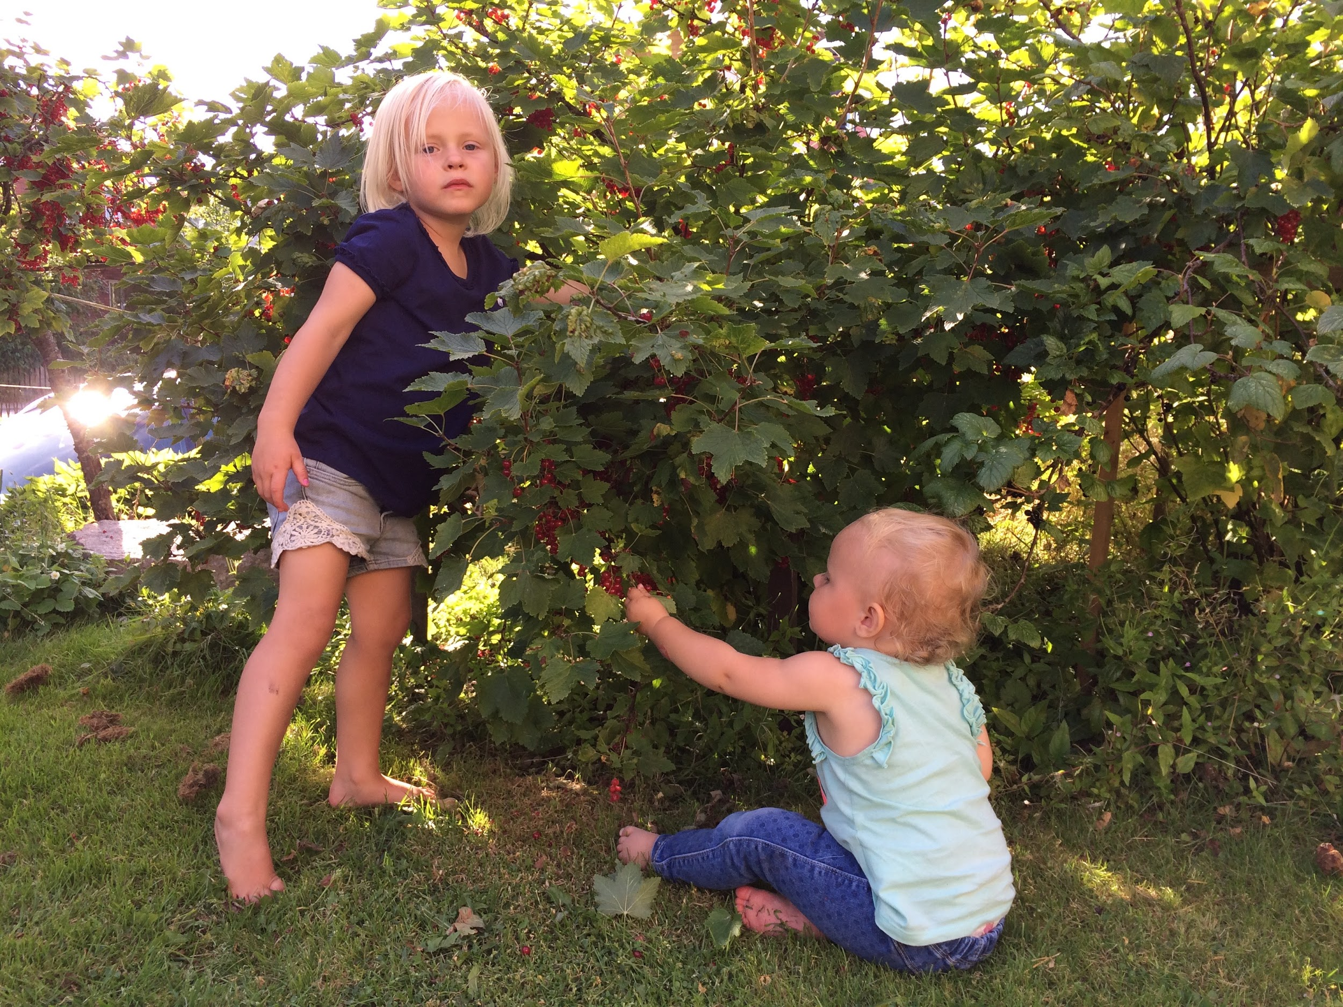
Erik
32 years old
Teacher: Social studies, history & Swedish language
My family: My wife Pernilla and two child Elsa 4 years and Oliva 2 years
I like to travel and i realy like to practising, i do some running and som football.

Slide 9
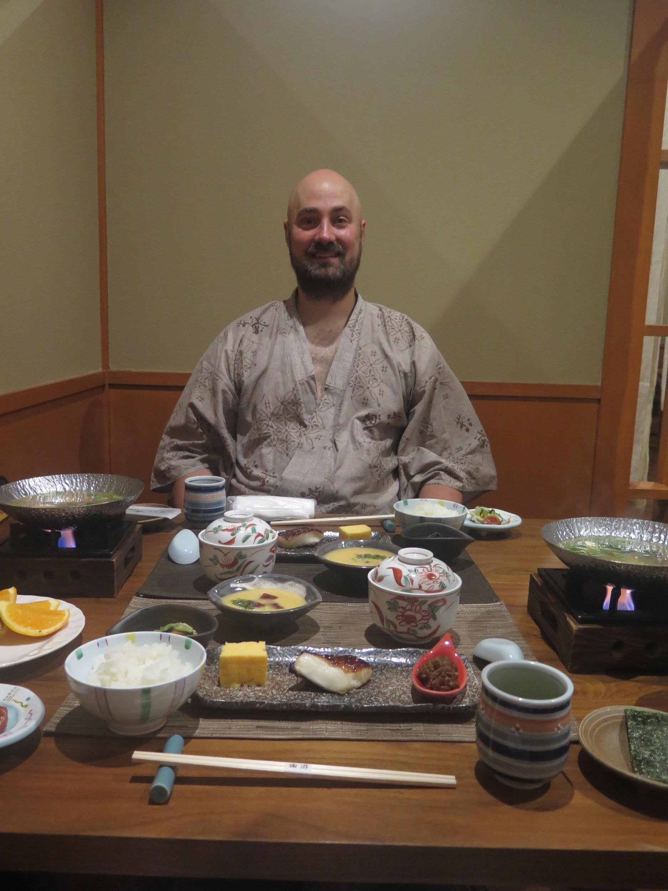
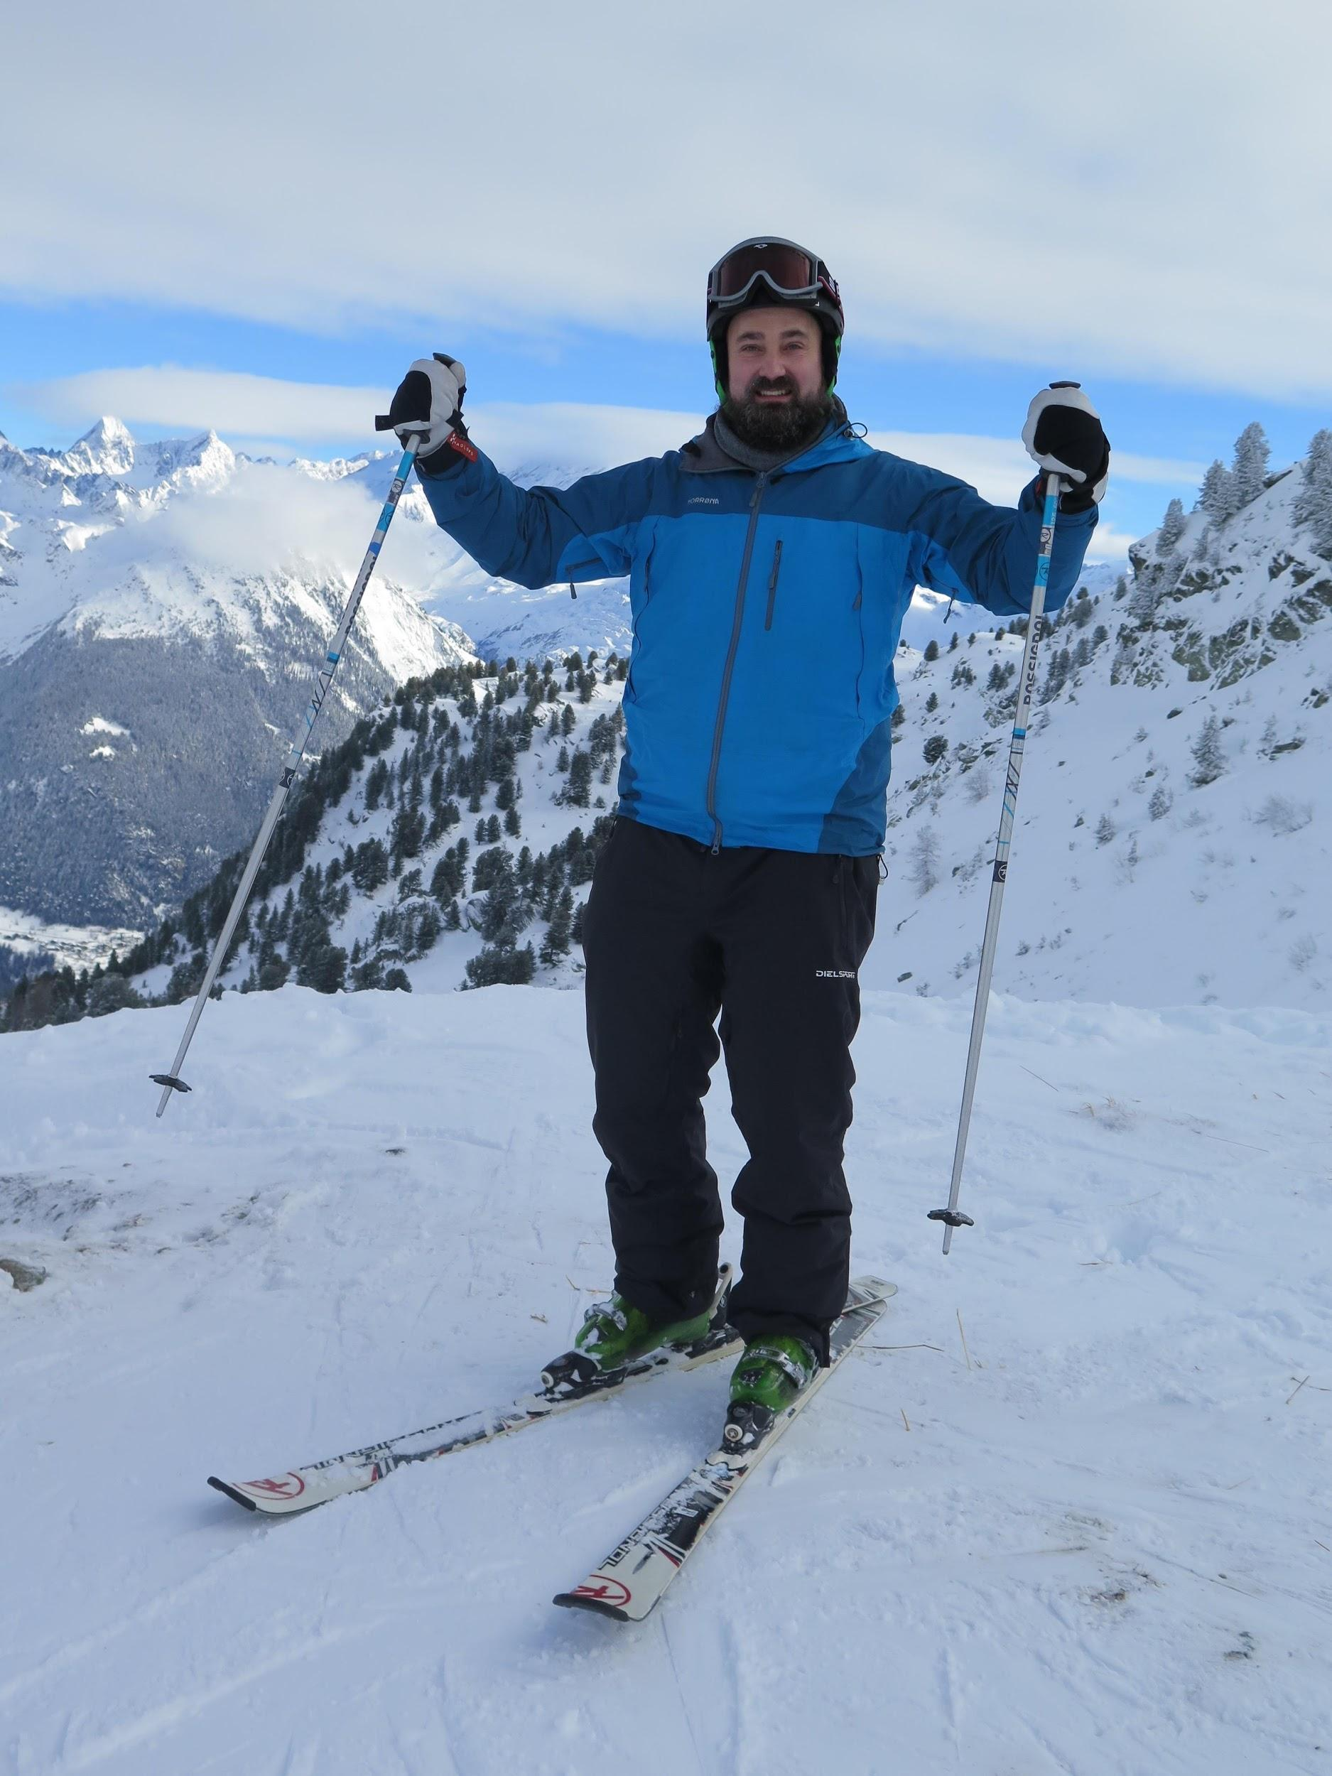

Robert
43 years old
Teacher: Swedish, Religious studies, English, Economics
Textbook author
My family: Silke from Germany
I enjoy travelling and birding around the world, skiing and practising taekwondo

