Slide 1
POLAND
MEETING IN GREECE –
September – October 2015

Slide 2
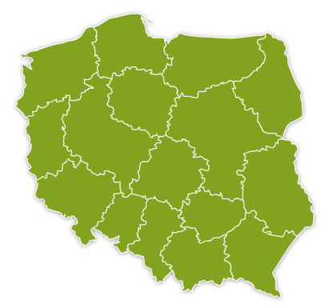
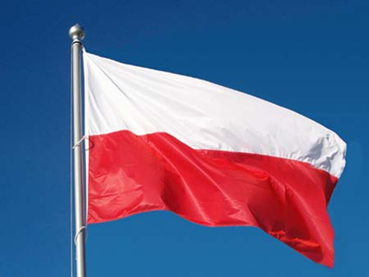
POLAND
Warsaw
National Emblem
Grójec
Map of Poland
Flag

Slide 3
REGION
Administrative Unit Grojec is situated in Mazowieckie Province, 45 km south of the Polish capital Warsaw. The District of Grojec is called ”The biggest orchard in Europe” since it is a fruit-growing area.
Warszawa
Grójec

Slide 4
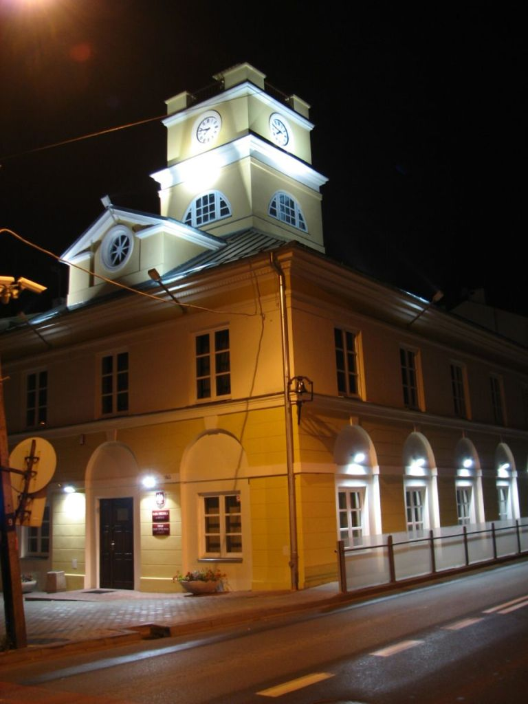
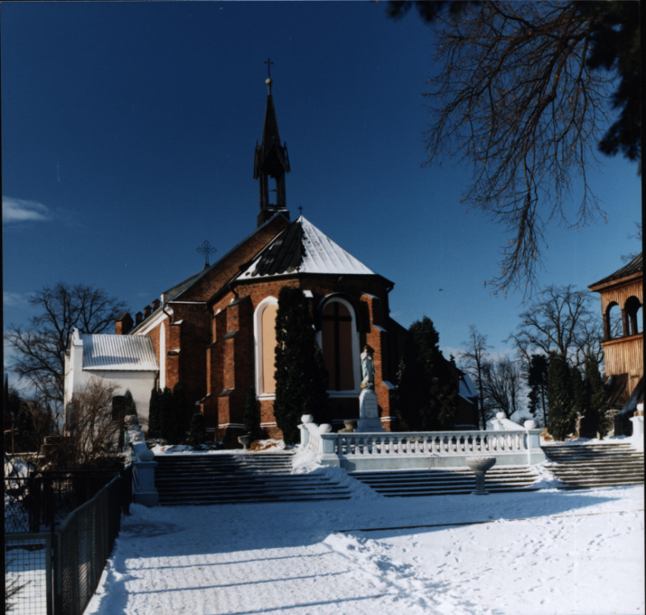
GROJEC:
town in Mazowsze District
civic rights since 1419
population 17 thousand

Slide 5
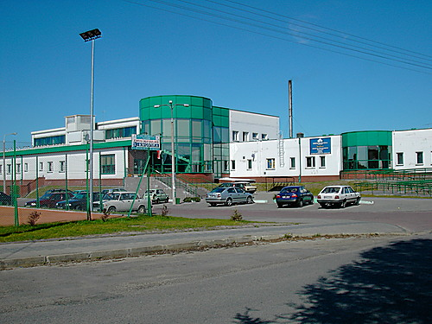
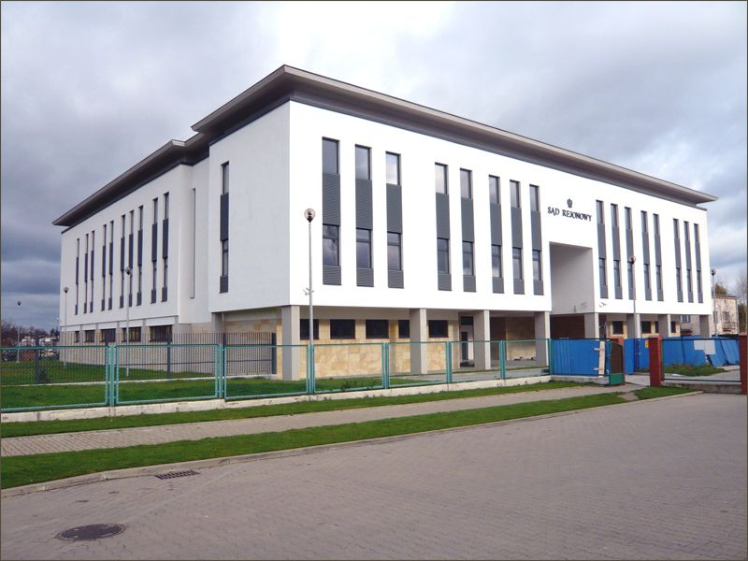
Swimming Pool
Court Building

Slide 6
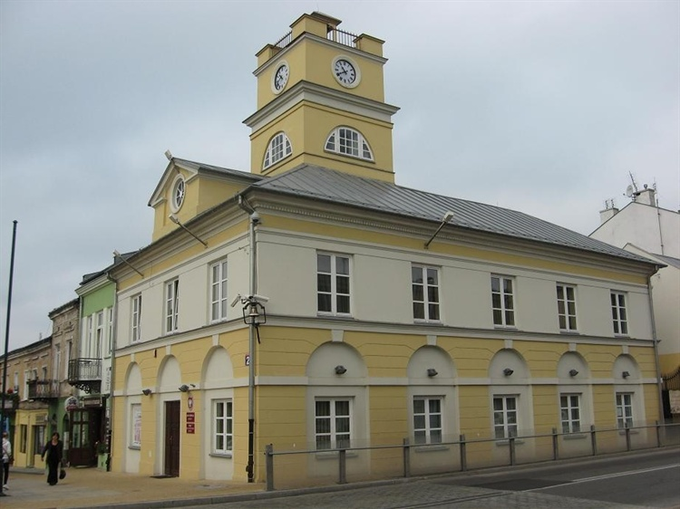
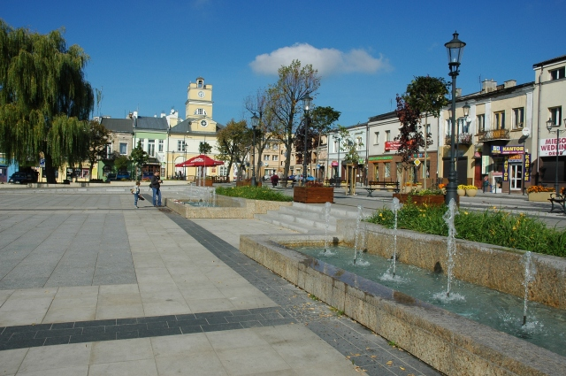
Town Hall
The Main Square

Slide 7
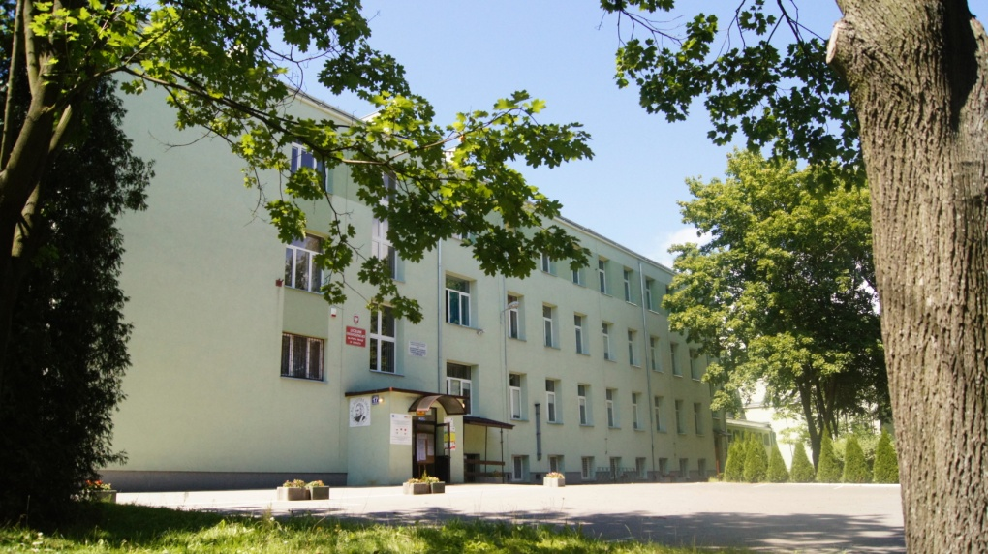
PIOTR SKARGA’S
SECONDARY SCHOOL
IN GROJEC

Slide 8
SYSTEM OF EDUCATION IN POLAND
PRIMARY SCHOOL
age : 6-12
LOWER SECONDARY SCHOOL
age: 13 – 15
VOCATIONAL SCHOOL
age:16-18
PROFILE SECONDARY SCHOOL
age: 16-19
UPPER SECONDARY SCHOOL
age: 15-19
TECHNICAL SCHOOL
age: 16-19
PIOTR SKARGA’S SECONDARY SCHOOL IN GROJEC
UNIVERSITY

Slide 9
SCHOOL HISTORY
1952
Our school is one of the oldest in the District of Grojec and in Mazowieckie Province. It was founded in 1912. The present building was built before II World War, in 1928.
1979
2009

Slide 10
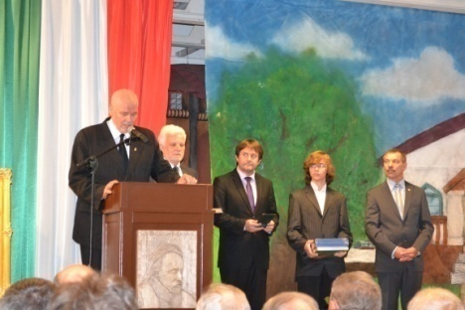
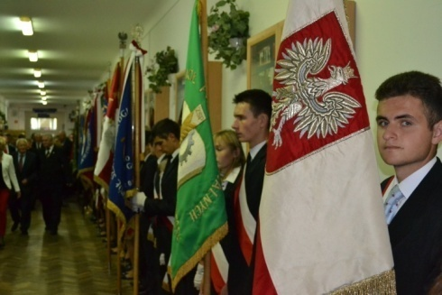
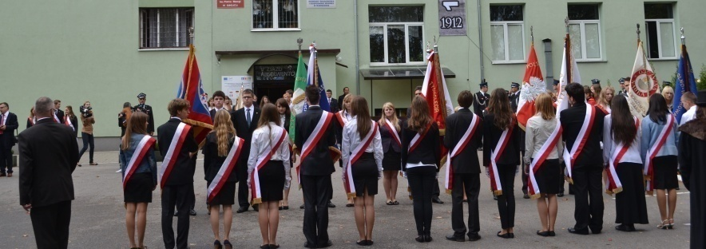
100th School Anniversary 1912-2012
In September 2012 the school celebrated its 100th anniversary

Slide 11
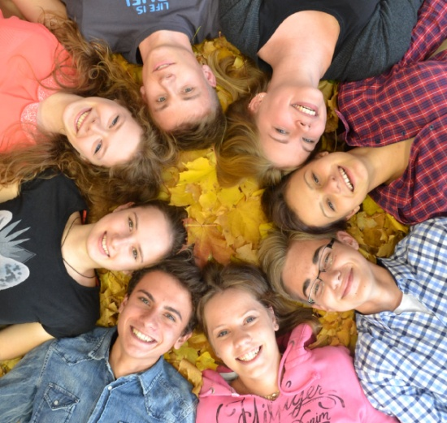
SCHOOL IN NUMBERS
-540 students -51 teachers -22 classrooms

Slide 12
PROFILES
HUMANISTIC
MATHS-GEOGRAPHY
MANAGERIAL
BIOLOGY-CHEMISTRY
MATHS-PHYSICS-IT

Slide 13
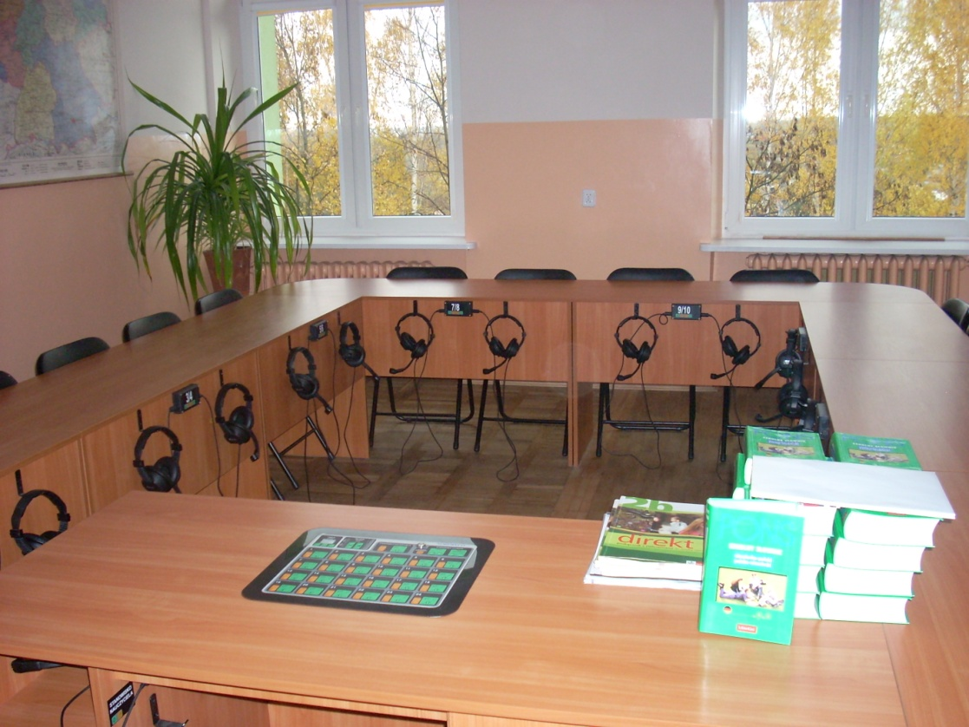
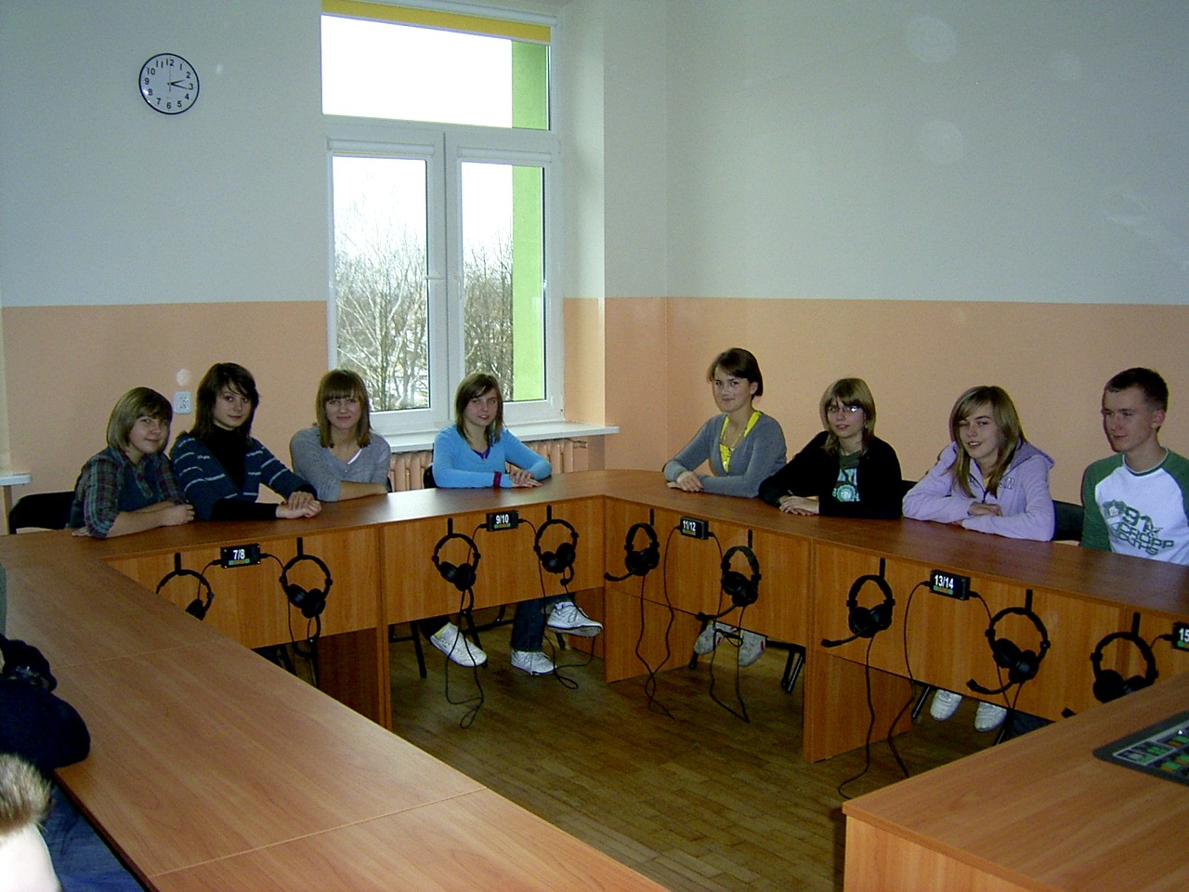
CLASSROOMS
GERMAN CLASSROOM

Slide 14
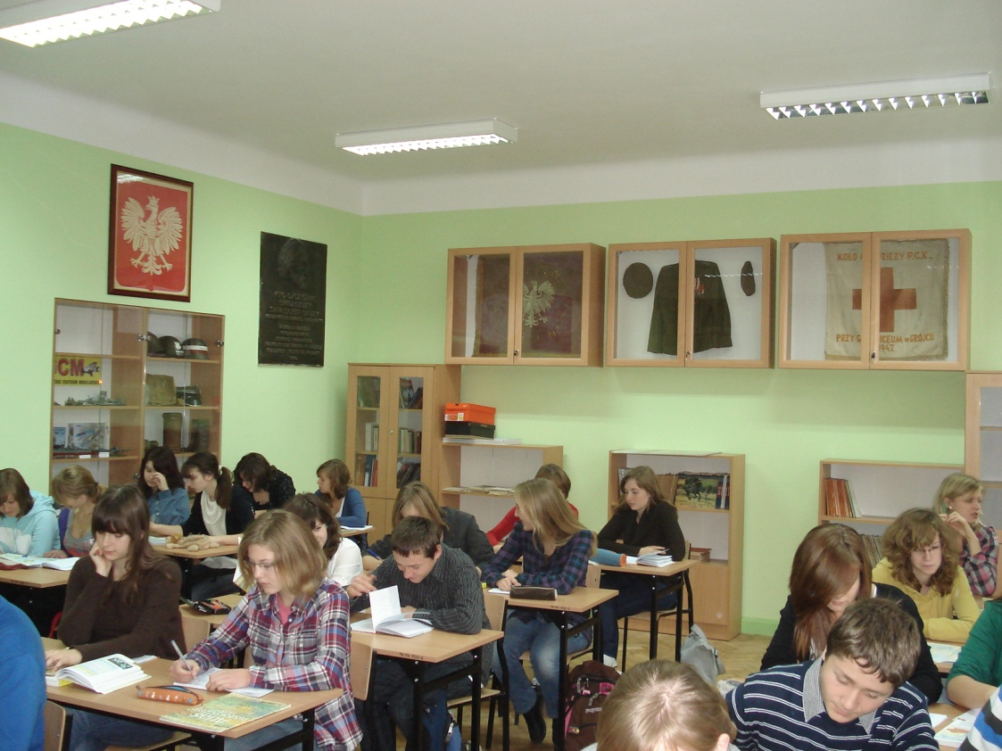
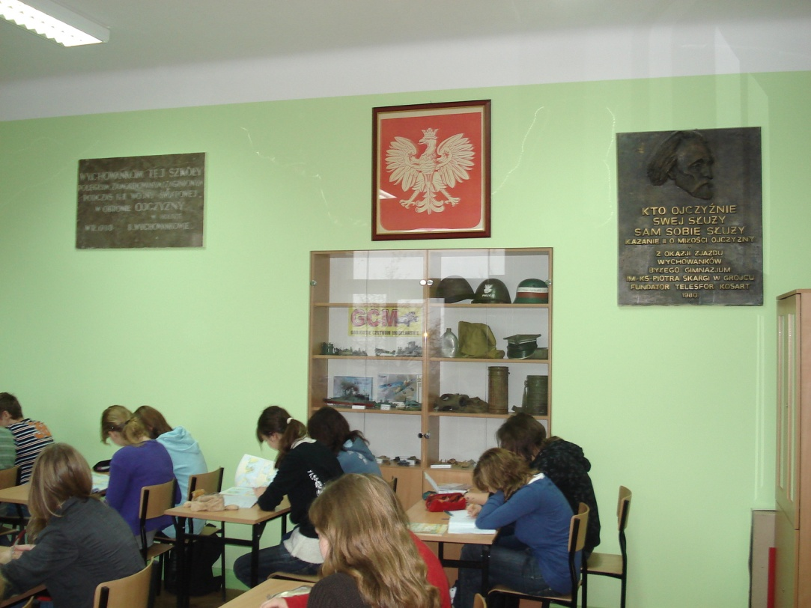
CLASSROOMS
HISTORY CLASSROOM

Slide 15
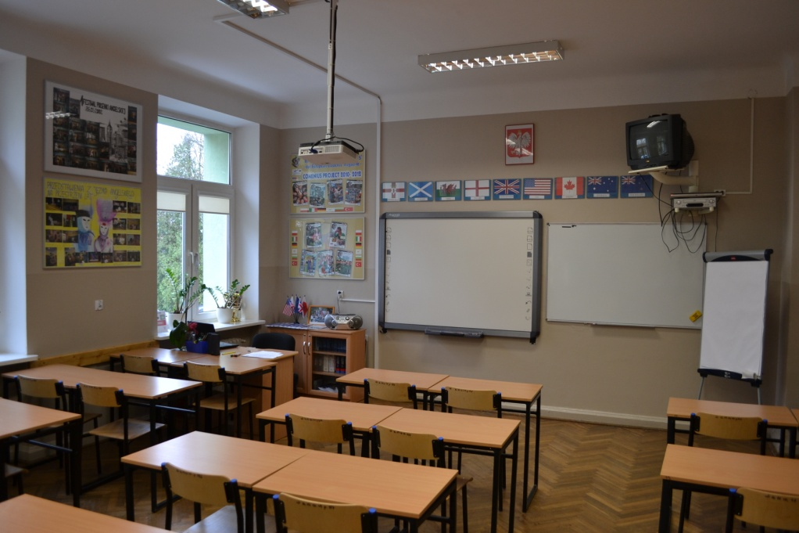
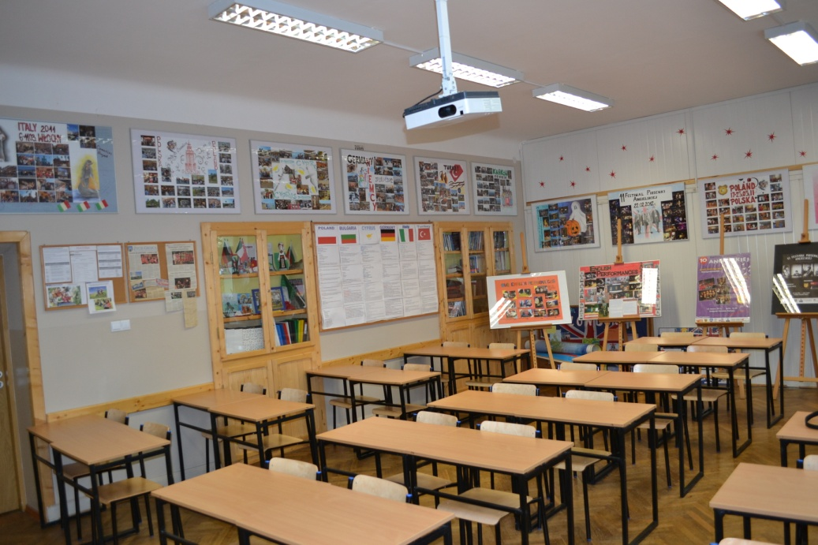
CLASSROOMS
ENGLISH CLASSROOM

Slide 16
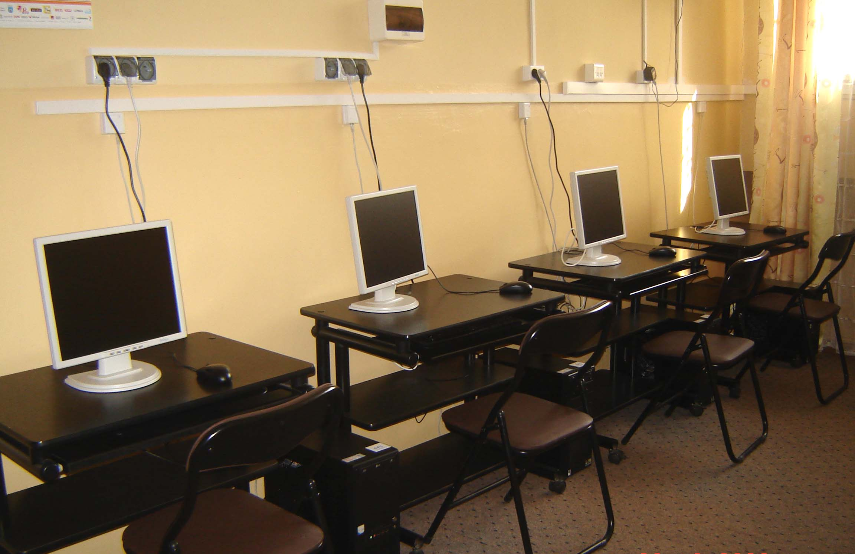
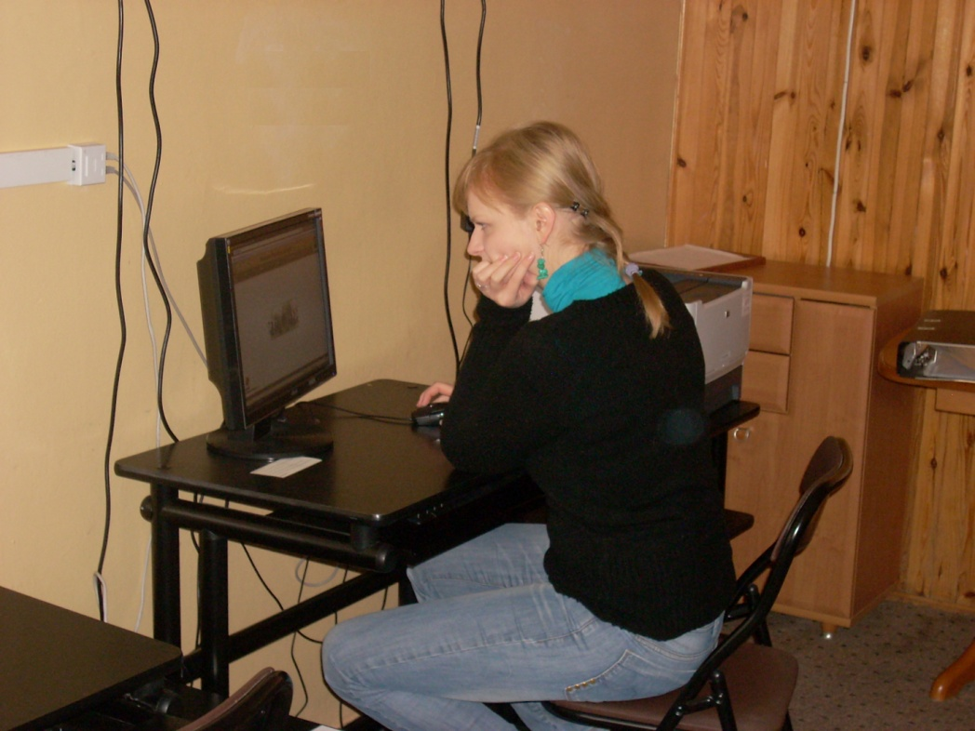
FACILITIES
MULTIMEDIA LIBRARY CENTRE

Slide 17
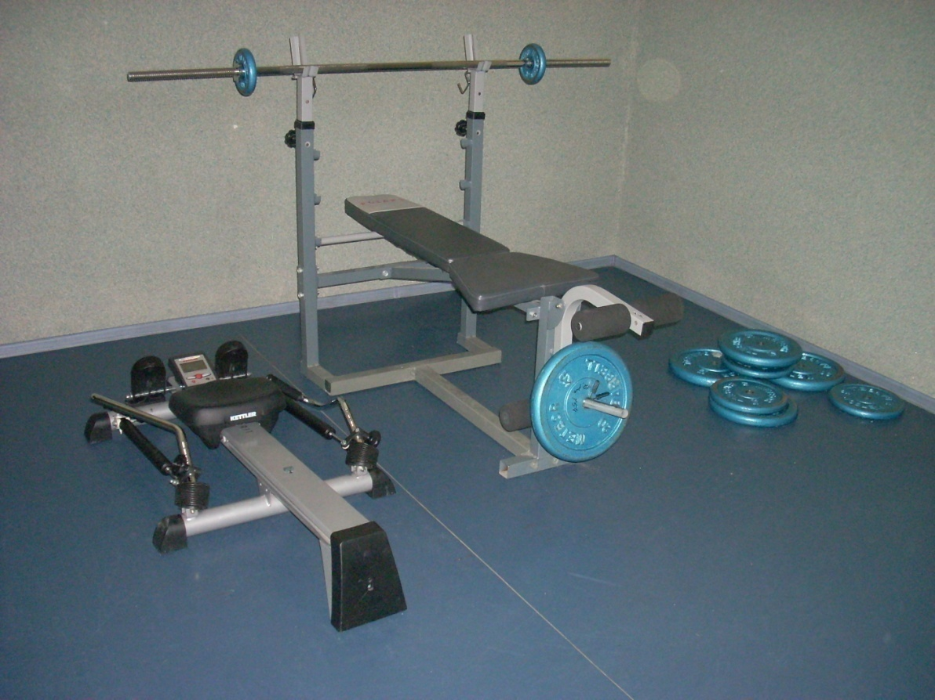
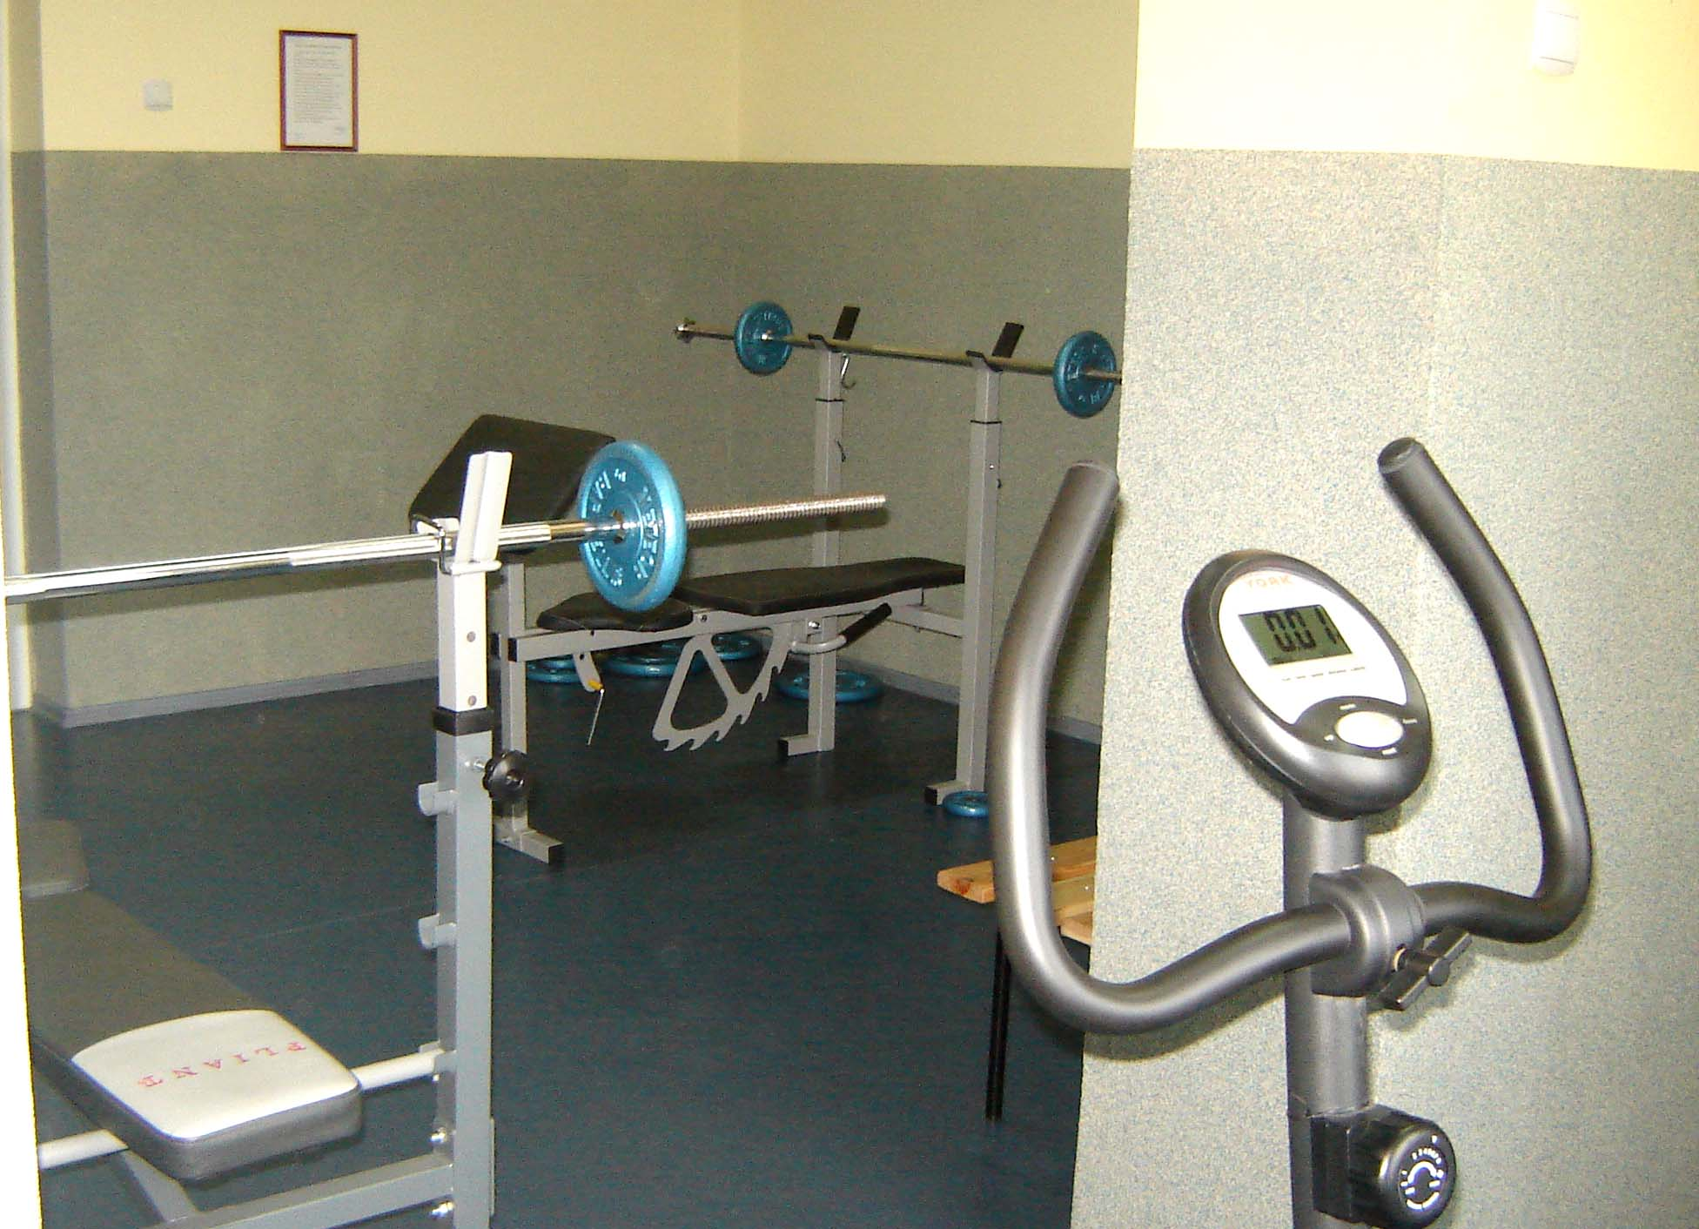
FACILITIES
GYM

Slide 18
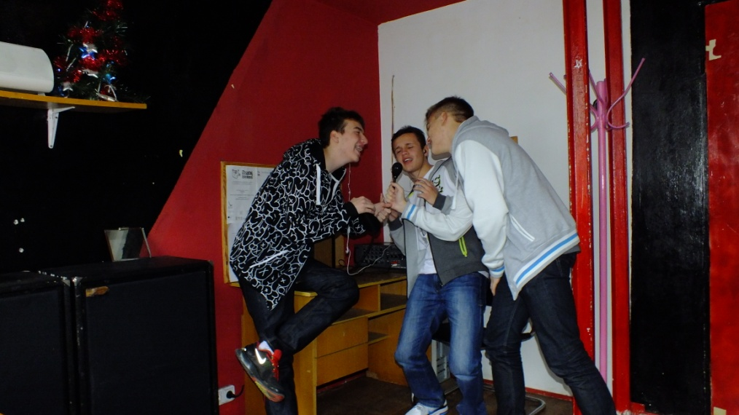
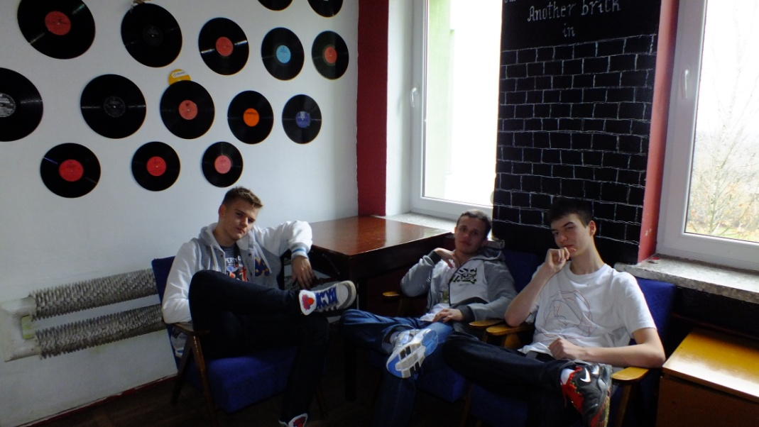
FACILITIES
SCHOOL RADIO „Górka FM)))”

Slide 19
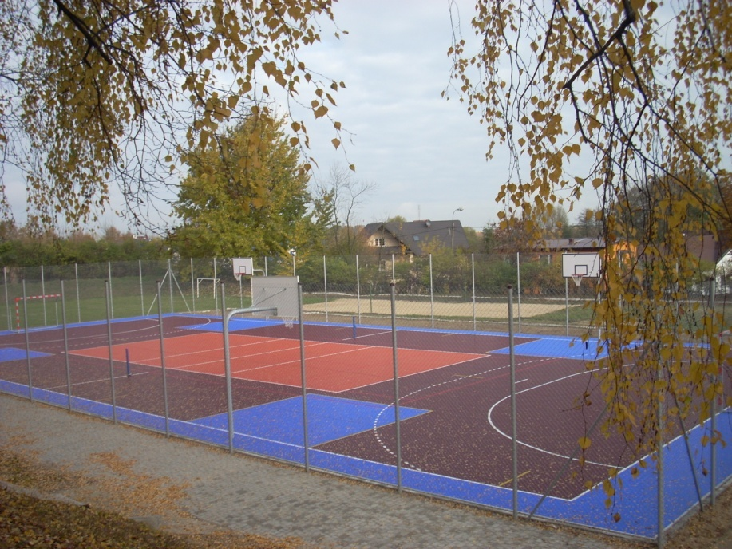
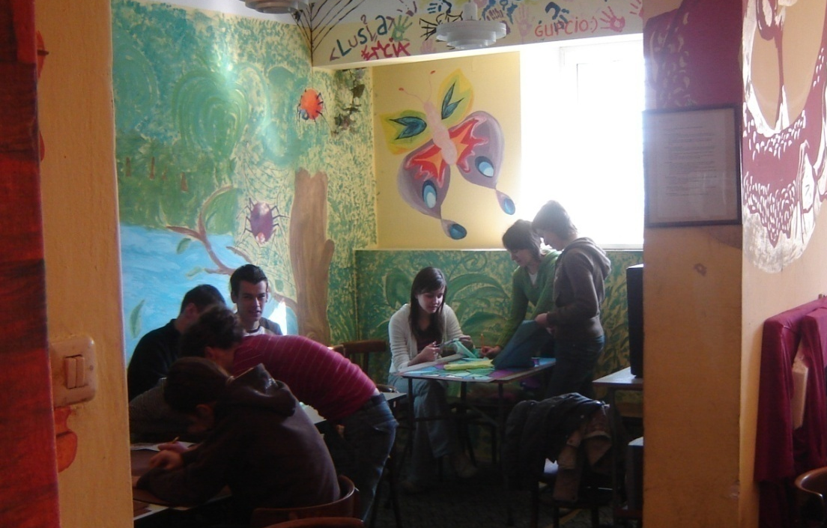
FACILITIES
STUDENTS’ CLUB
OUTDOOR SPORTS FIELD

Slide 20
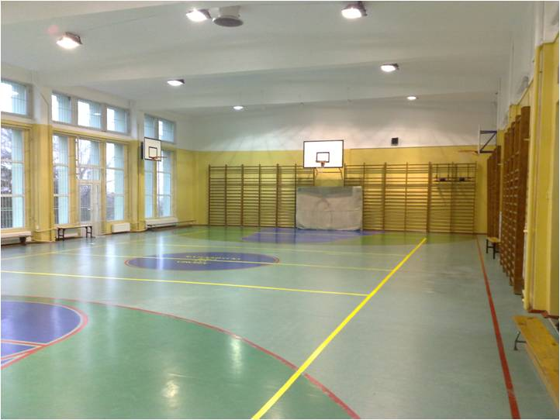
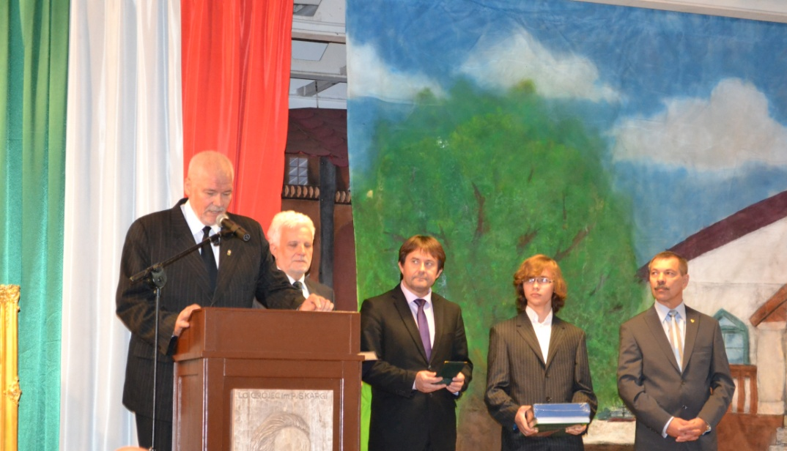
FACILITIES
LECTURE HALL
GYMNASIUM

Slide 21
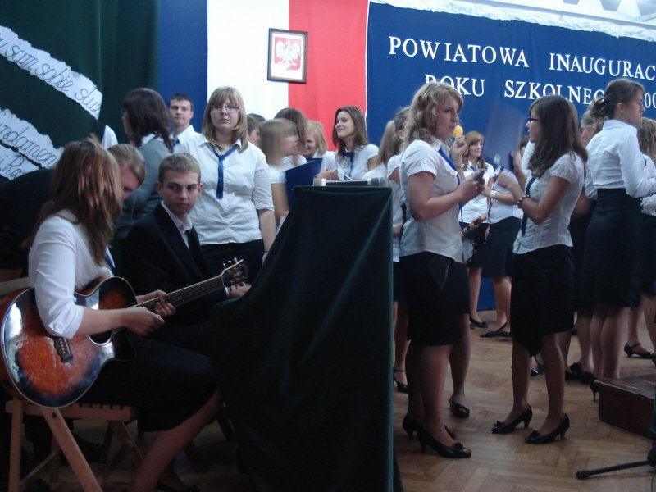
ADDITIONAL CLASSES
- Sports Club ( football, volleyball, basketball, handball, table tennis)
- Extra classes (all subjects)
- Choir
- Theater club
- Film club

Slide 22
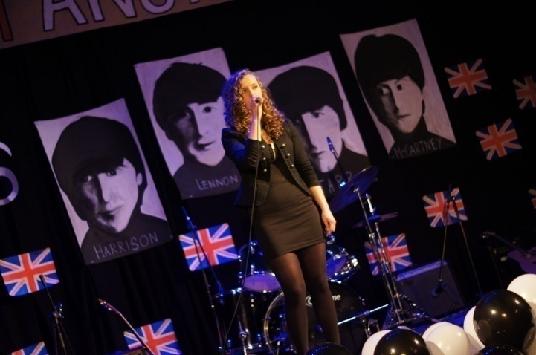
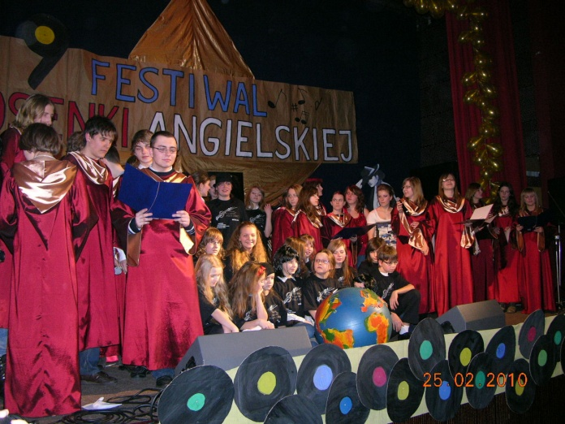
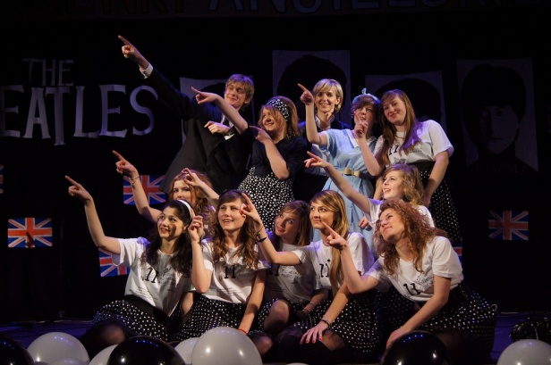
English song festival

Slide 23
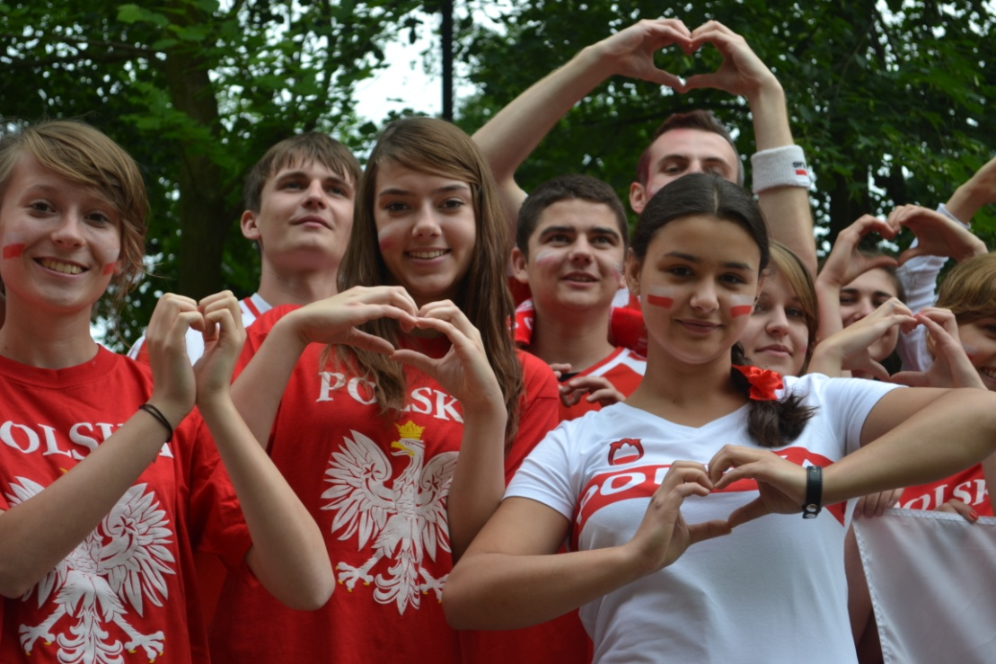
Comenius programme
2010 – 2012
Participating countries: Poland, Italy, Cyprus, Bulgaria, Turkey, Germany

Slide 24
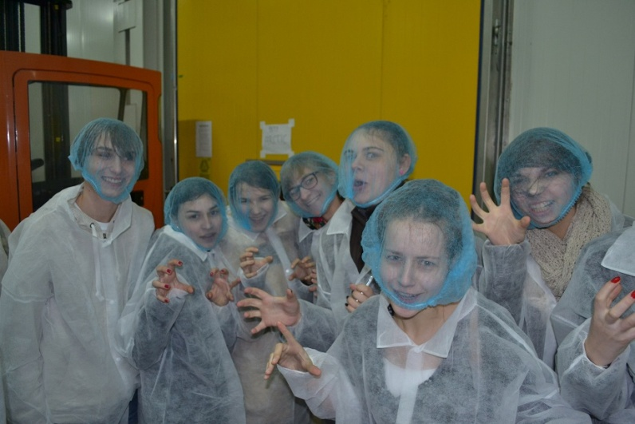
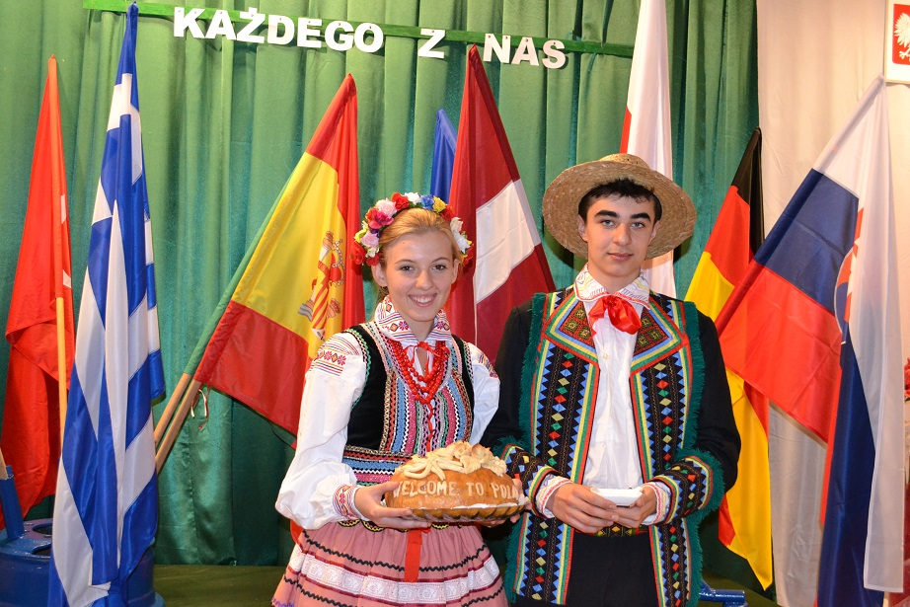
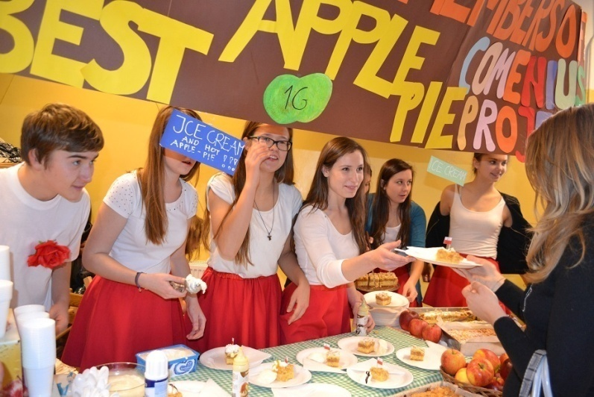
Comenius programme
2013 – 2015
Participating countries: Poland, Greece, Italy, Spain, Turkey, Germany, Portugal, Latvia, Hungary, Slovakia, France

Slide 25
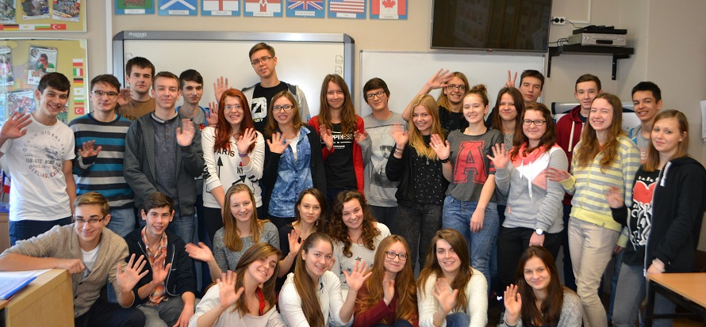
ERASMUS+ programme
2014 – 2016
Participating countries: Greece, Sweden, Norway, Austria, Poland

Slide 26
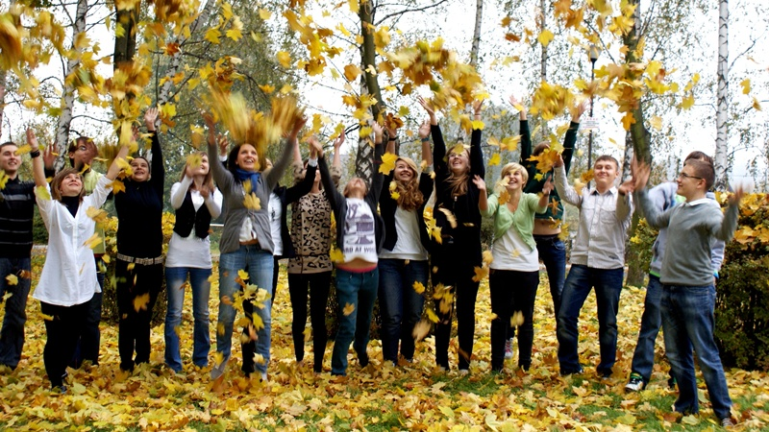
SEE YOU AT ”GORKA” (”THE HILL”)

