Slide 1
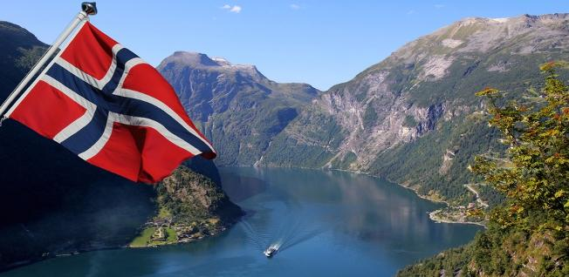
Norway

Slide 2




Us from Norway!
Leon
Maren
Stine
Henrik

Slide 3
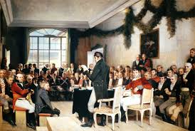
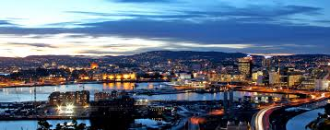
Facts about Norway
Oslo
5 million
National day 17.may
Constitution, Eidsvoll 1814
Independent from Sweden
7.June 1905

Slide 4
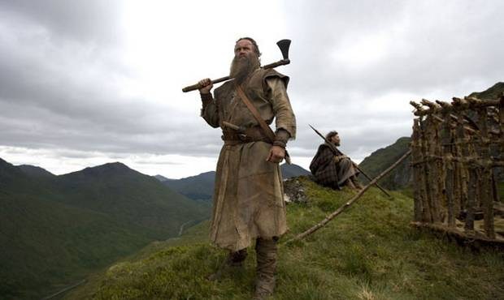
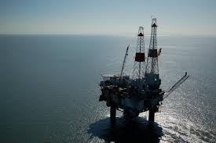
Facts about Norway
UN named Norway the best Country to live in
Norway is rich in Oil, Gas, Minerals and seafood
Earned much money in Oil industry
Currency Norwegian Krone
Known for Vikings
Known for fjords

Slide 5
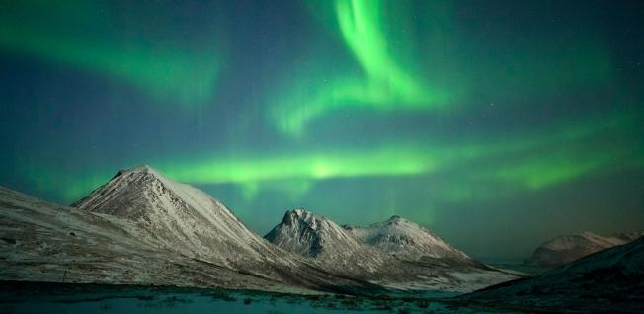
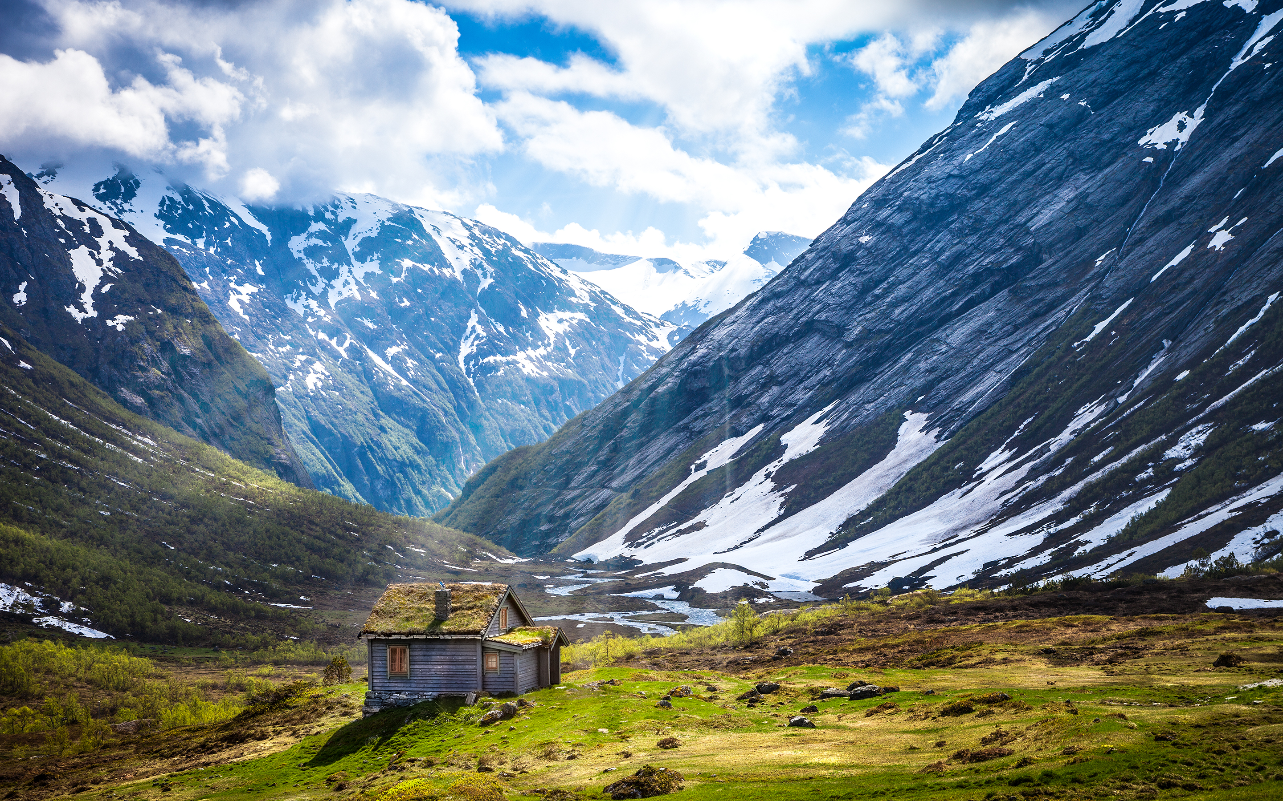
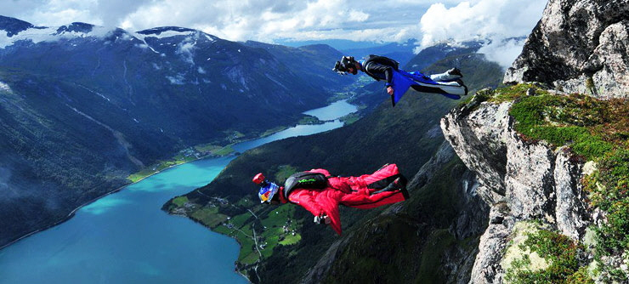
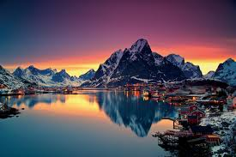
Beautiful pictures from Norway

Slide 6
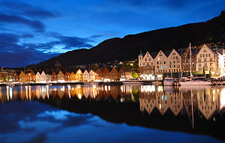
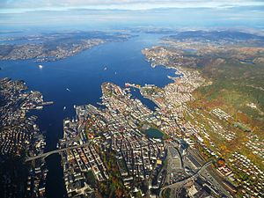
Bergen
An hour drive
Seven mountains
Bryggen
Ulriken and Fløyen
275 000
Bergen is the second biggest city in Norway

Slide 7
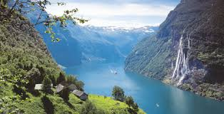
Thanks for listening!

