Slide 1
WELCOME TO POLAND
MEETING IN NORWAY – February 2015
‘SAFE INTERNET FOR ALL’
‘HEALTH’

Slide 2
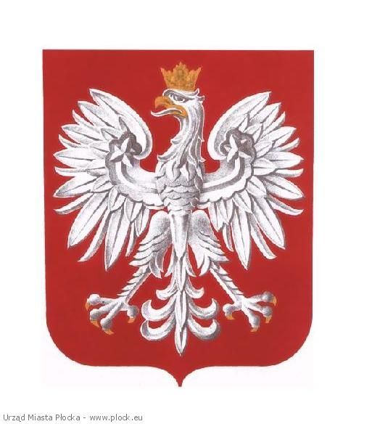
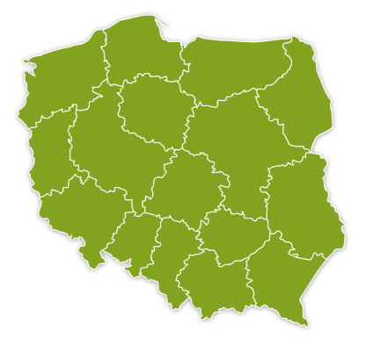
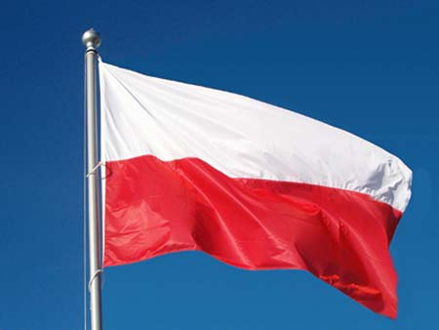
POLAND
Warsaw
National Emblem
Grójec
Map of Poland
Flag

Slide 3
POLAND
Population: 38 mln (358 peple fewer daily)
Political system: parliamentary representative democratic republic
Prime Minister – head of government of a multi-party system
President – head of state
Poland divided into 16 Provinces
Bordering countries: Czech Republic, Slovakia, Ukraine, Germany, Belarus, Russia (Kaliningrad Oblast), Lithuania, the Baltic Sea.
Unemployment rate: 11.5% (December 2014)
National Emblem
Flag

Slide 4
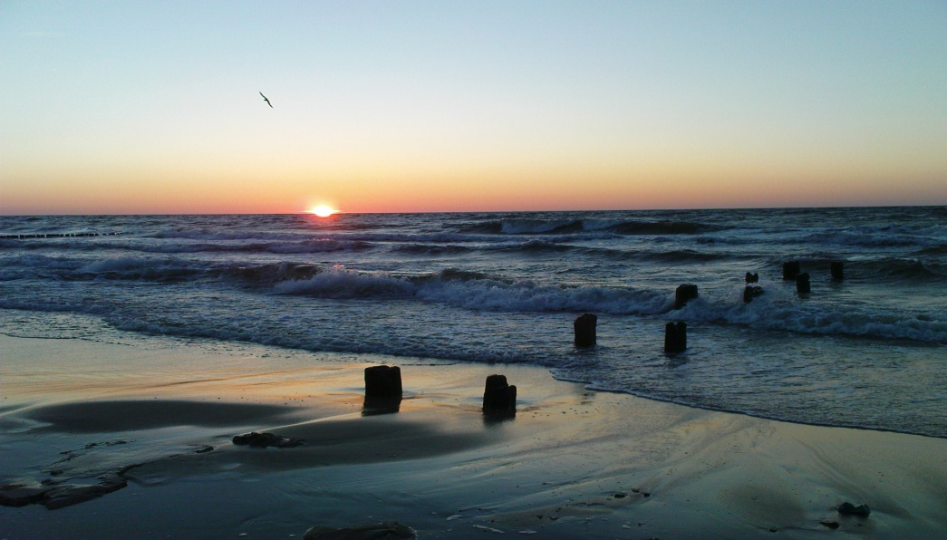
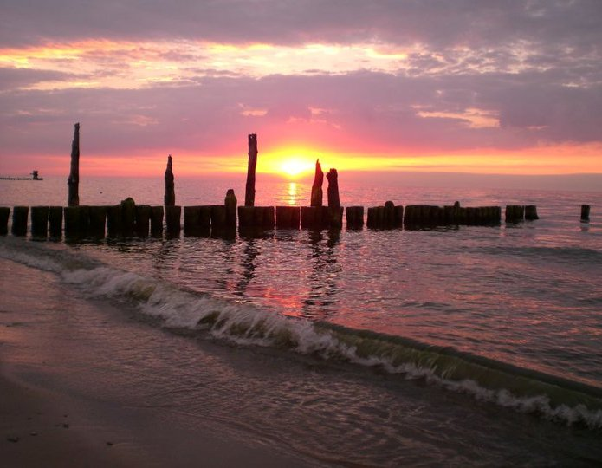
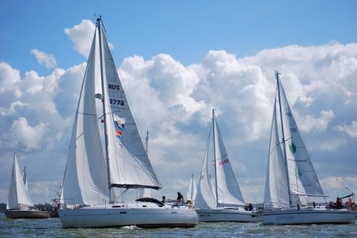
LANDSCAPES
THE BALTIC SEA
(North of Poland)

Slide 5
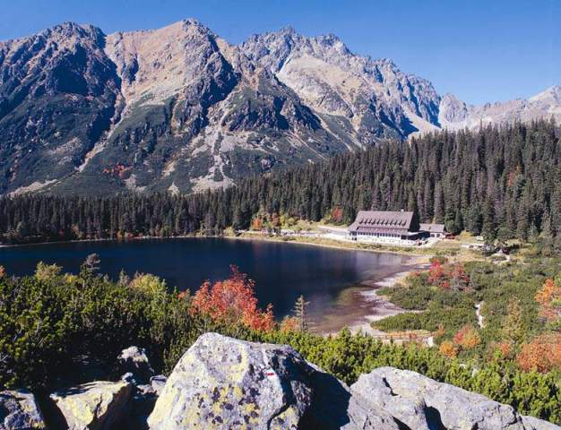
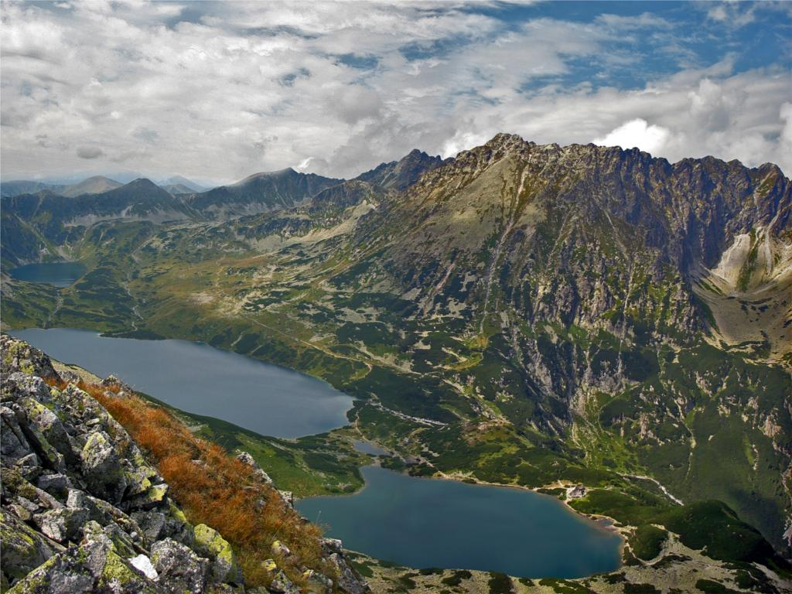
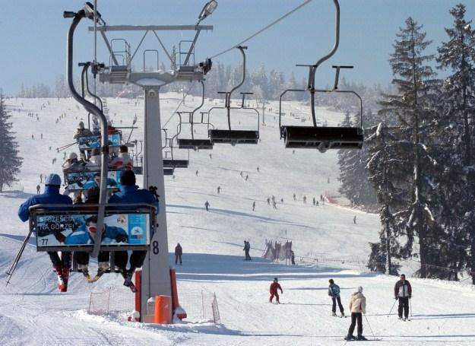
LANDSCAPES
THE TATRA MOUNTAINS
(South of Poland)

Slide 6
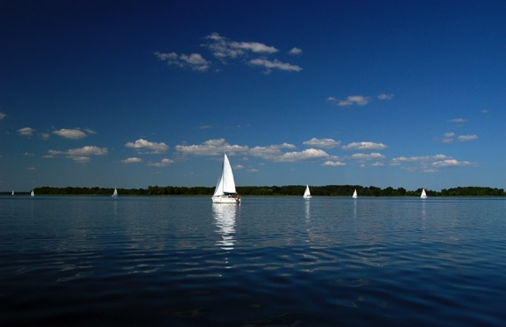
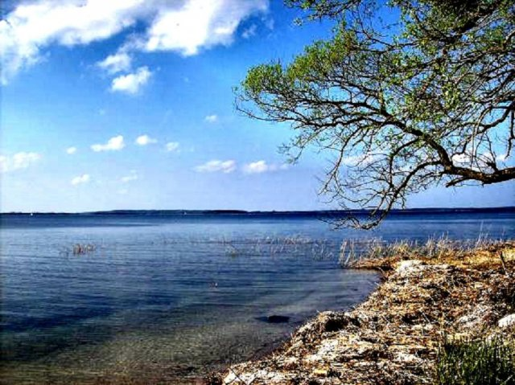
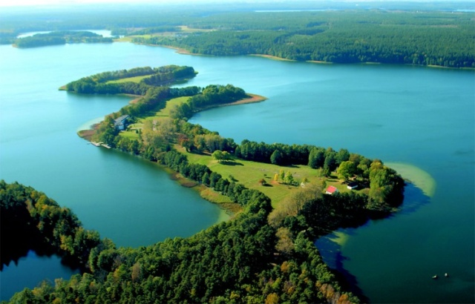
LANDSCAPES
THE ‘MAZURIA’ LAKE DISTRICT
(North-East of Poland)

Slide 7
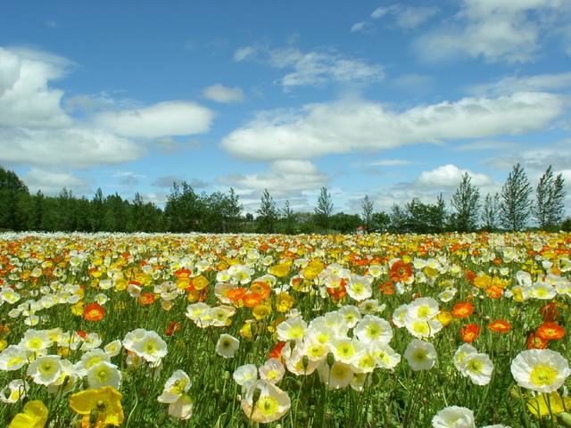
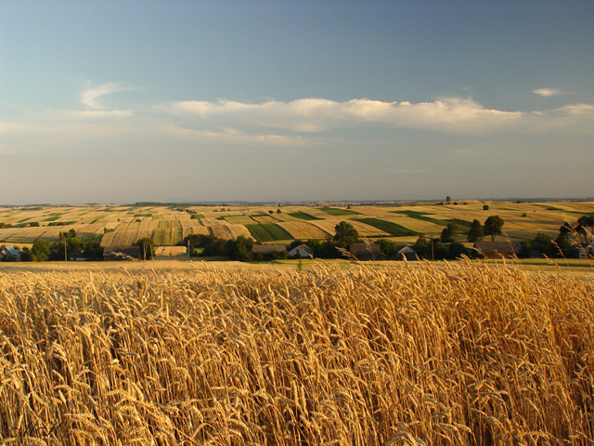
LANDSCAPES
THE PLAINS
(the centre of Poland)

Slide 8
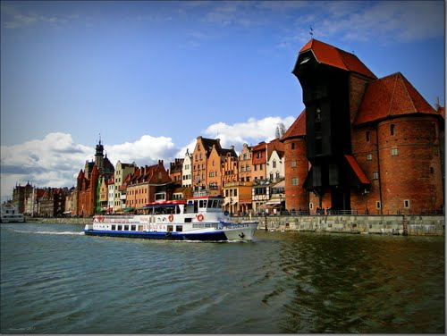
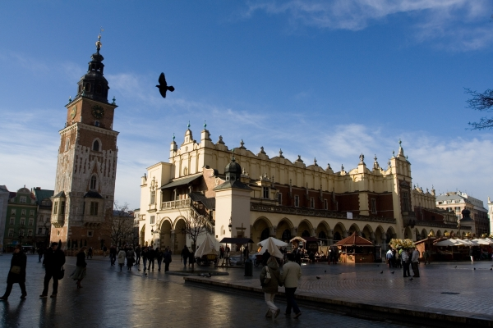
BIG CITES
WARSAW – the capital of Poland
GDANSK
CRACOW

Slide 9
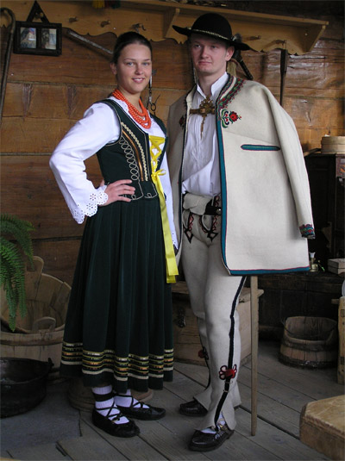
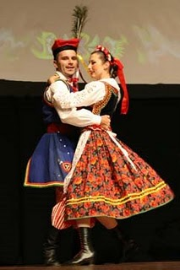
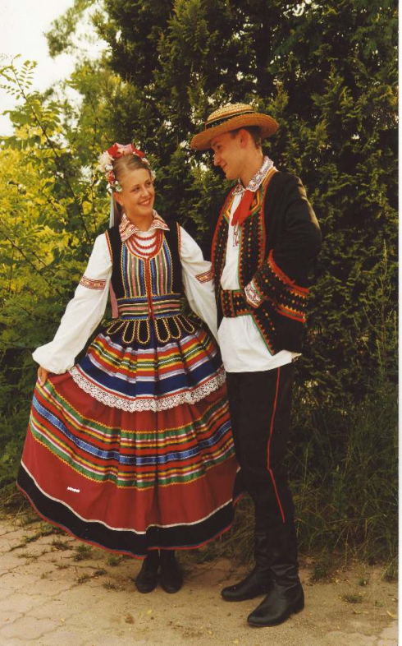
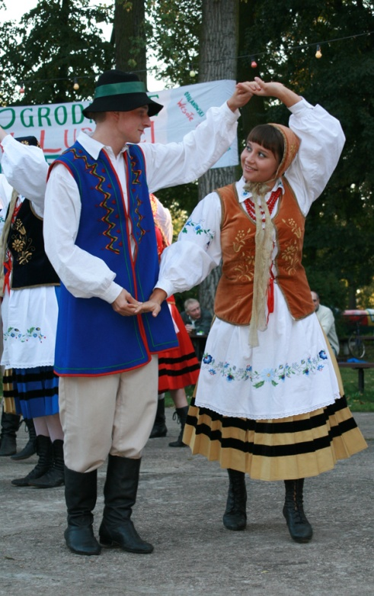
FOLK CLOTHES
(traditional)

Slide 10
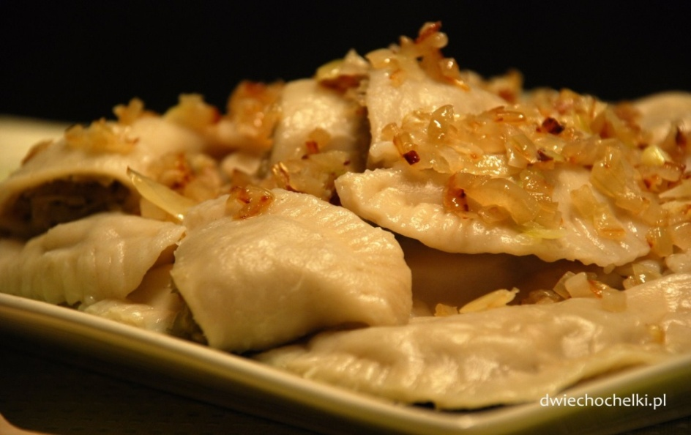
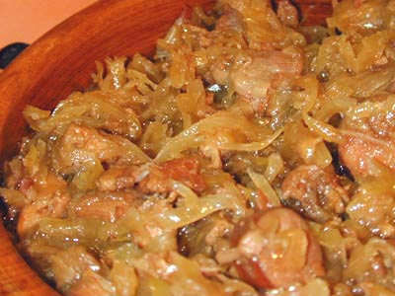
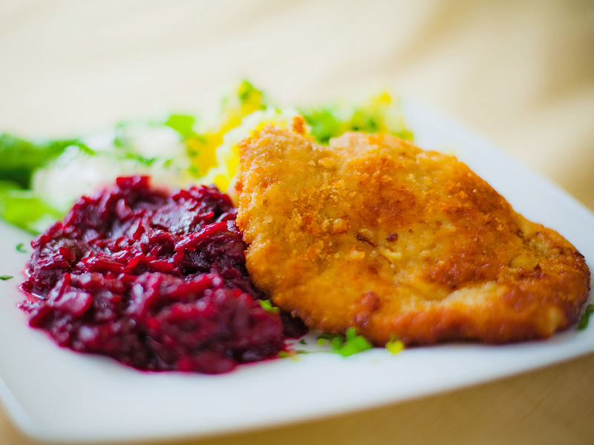
POLISH CUISINE – traditional dishes
Dumplings
Red Borscht
‚Bigos’ – Cabbage Stew
Pork Chop

Slide 11
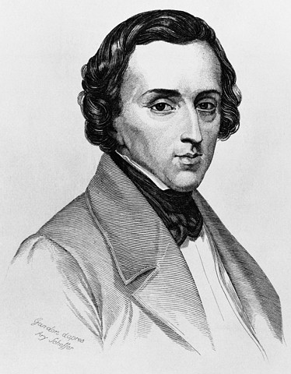
NATIONAL HEROES
Fryderyk Chopin – composer (1810-1849)
Nicolas Copernicus – astronomer (1473-1543)

Slide 12
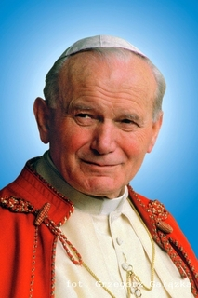
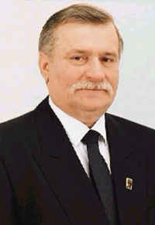
NATIONAL HEROES
John Paul II – The Pope (1920-2005)
Lech Walesa – Nobel Peace Prize Winner

Slide 13
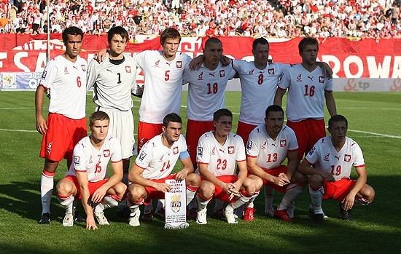
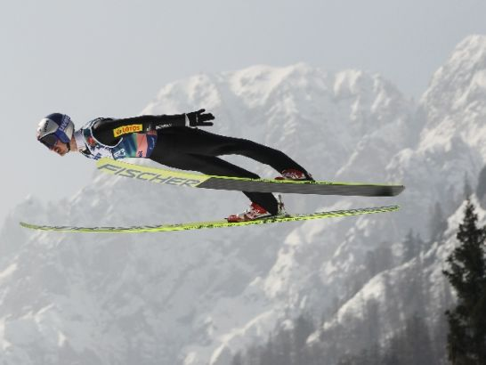
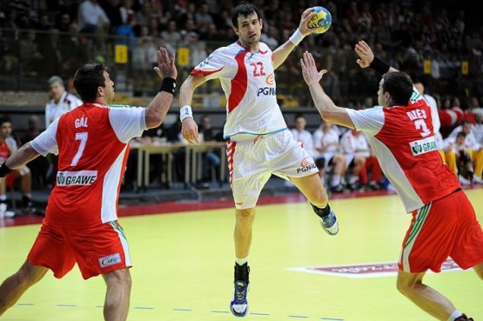
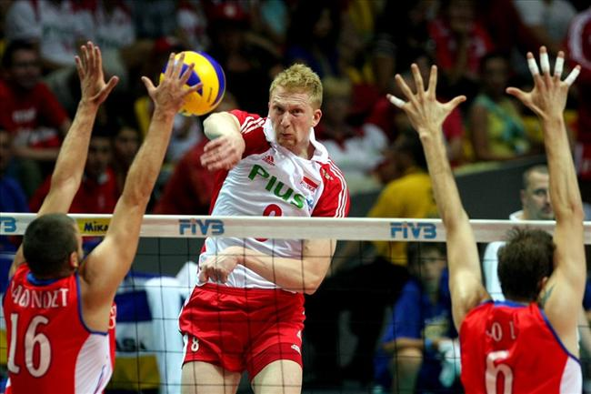
POPULAR SPORTS
Football
Ski jumping
Handball
Volleyball

Slide 14
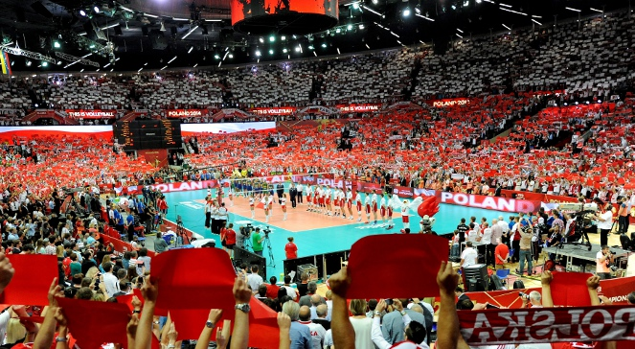
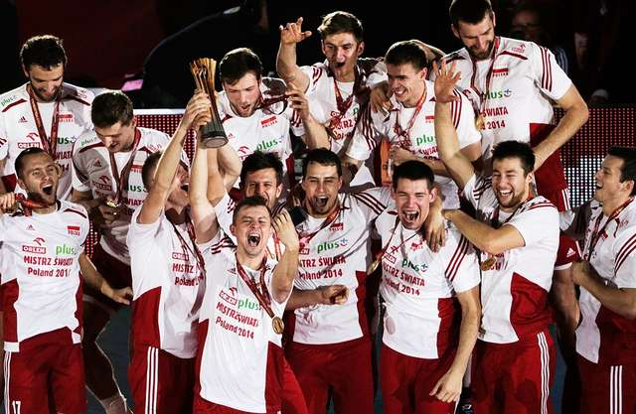
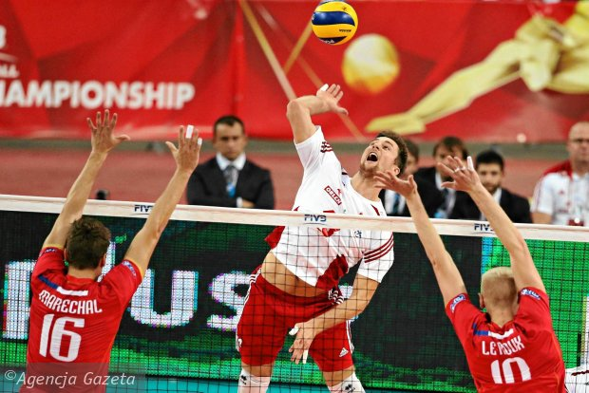
POLAND WORLD CHAMPIONS 2014
Volleyball

Slide 15
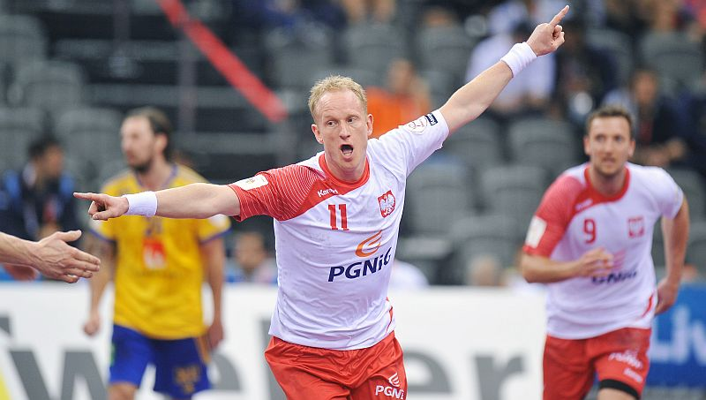
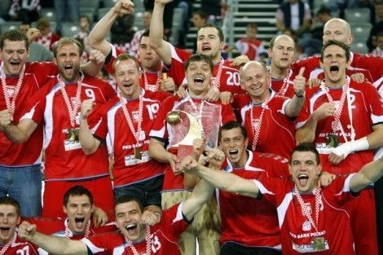
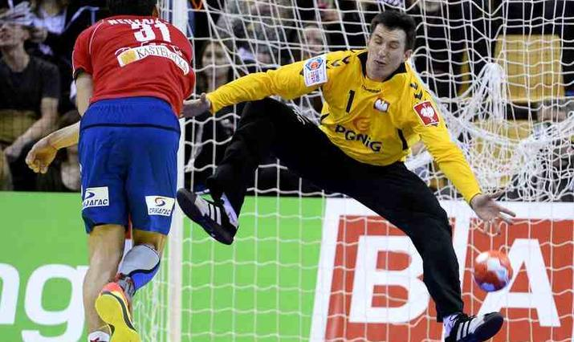
POLAND BRONZE MEDALISTS WORLD CHAMPIONSHIP 2015
Handball

Slide 16
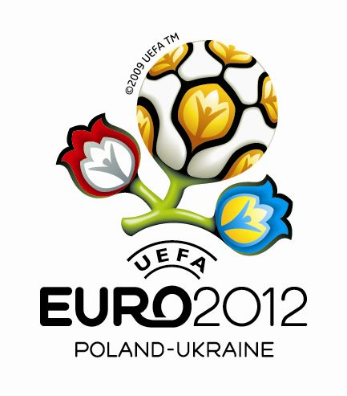
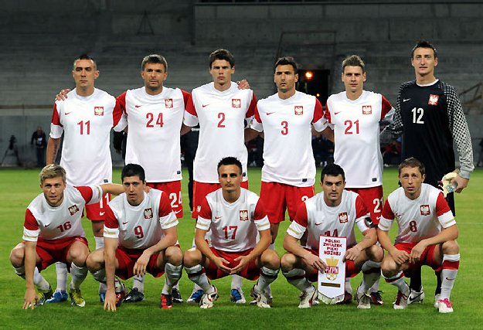
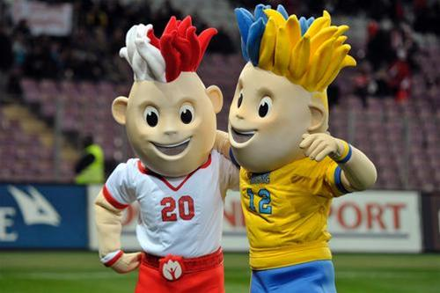

Slide 17
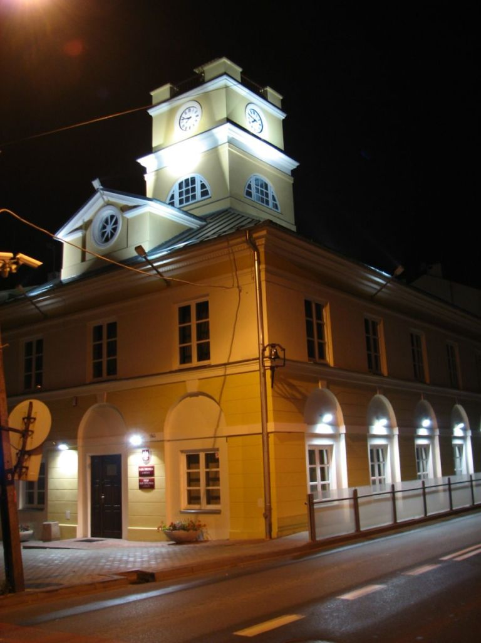
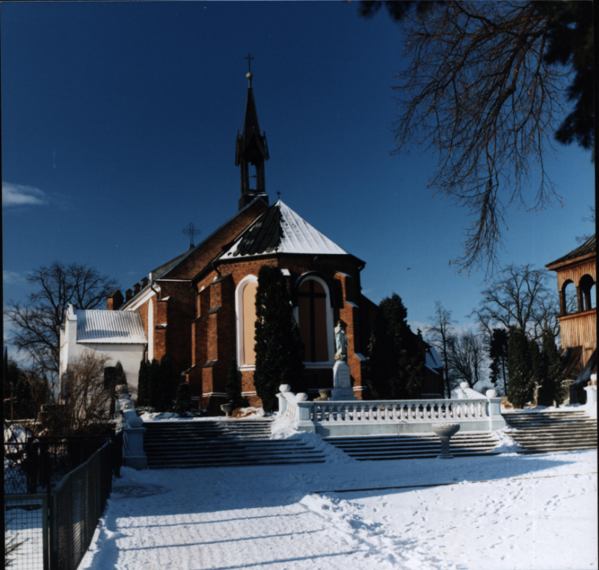
GRÓJEC:
town in Mazowsze Province
40km south of Warsaw
civic rights since 1419
population 16 thousand

Slide 18
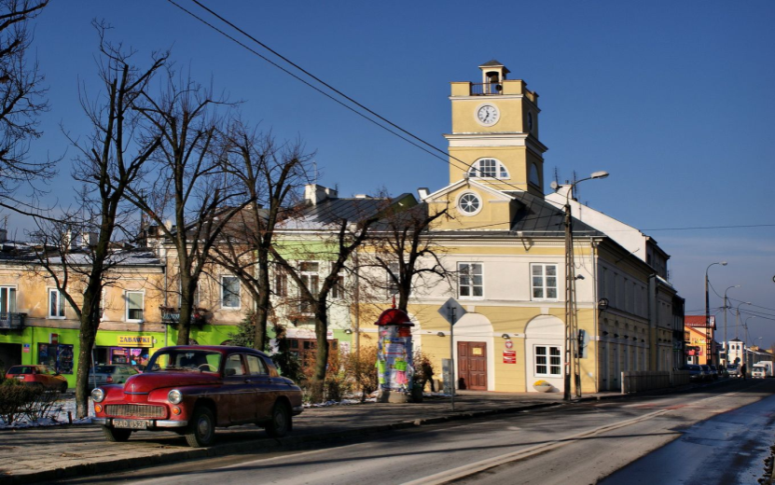
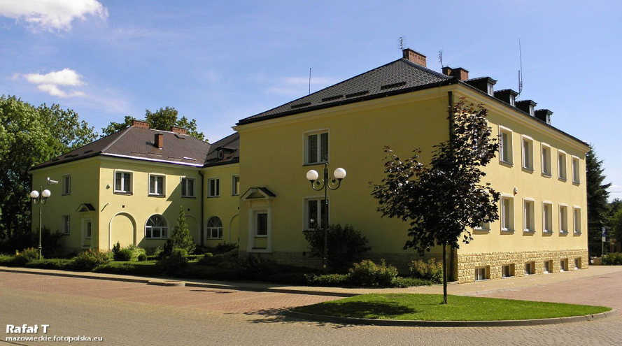
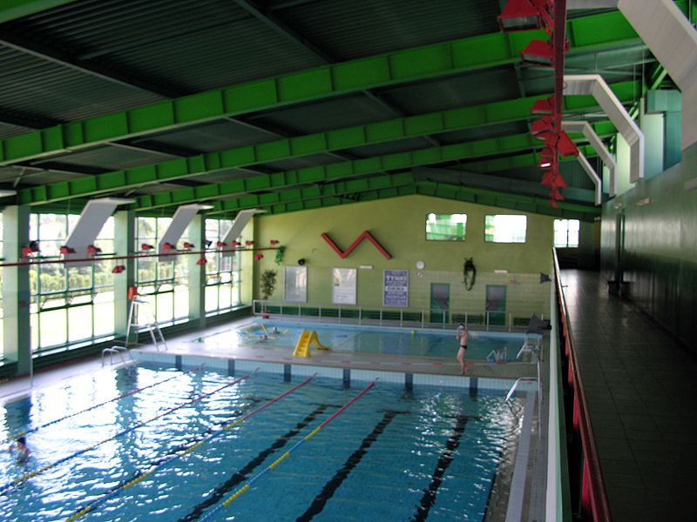
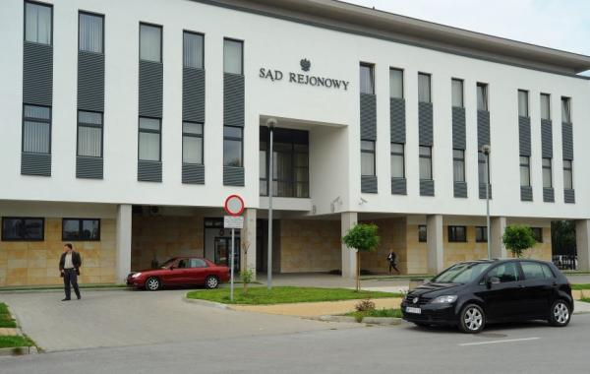
GRÓJEC
Old Town Hall
New Town Hall
Swimming pool
Court of Justice

Slide 19
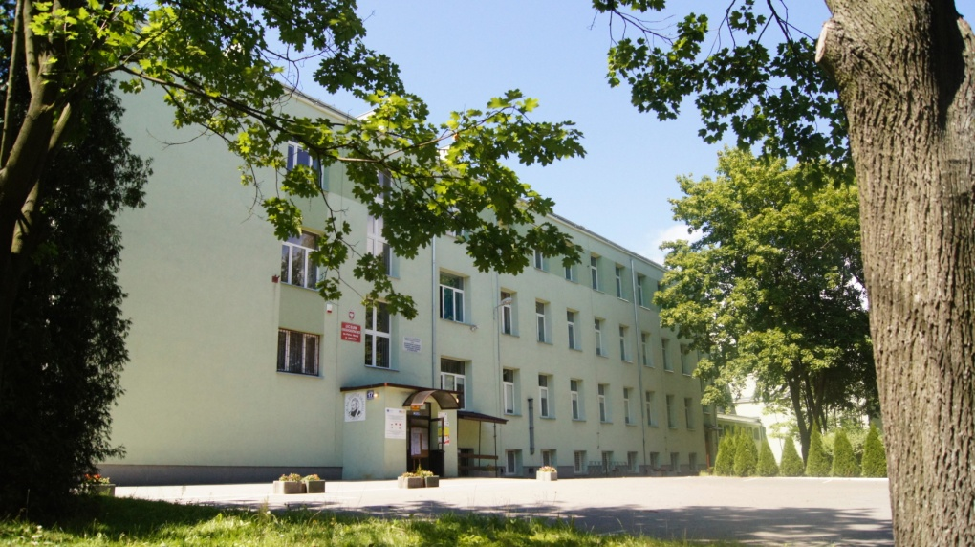
PIOTR SKARGA’S
SECONDARY SCHOOL
IN GROJEC

Slide 20
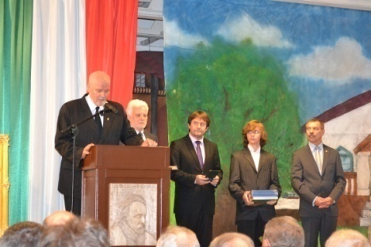
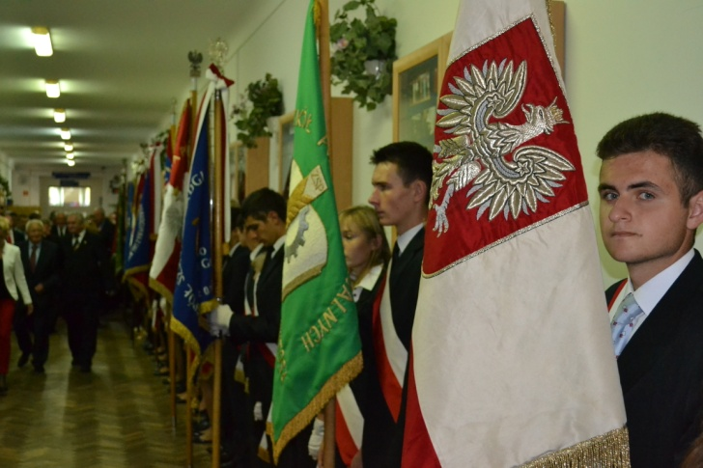
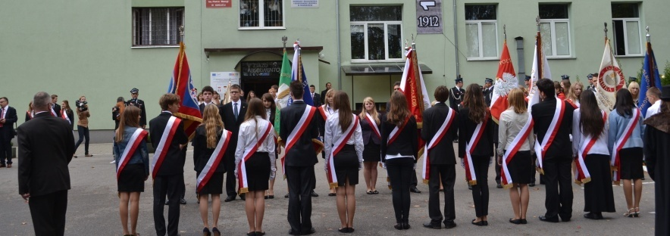
100th School Anniversary
1912-2012
In September 2012 the school celebrated its 100th anniversary

Slide 21
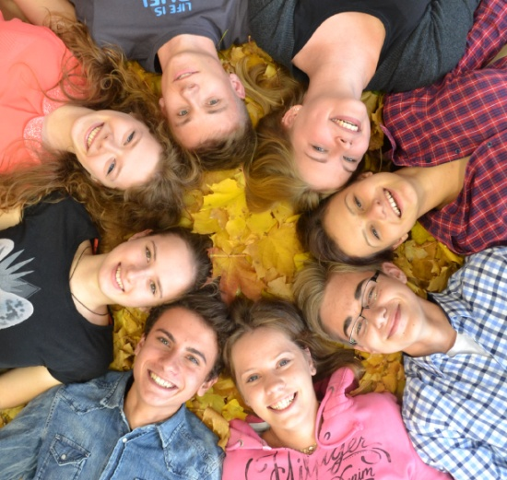
SCHOOL IN NUMBERS
-540 students -51 teachers -22 classrooms
7 language classrooms, biology, geography, maths, Polish, history, classrooms, chemistry lab, 2 computer labs, gym , lecture hall, outdoor sports field.

Slide 22
Liceum Ogolnoksztalcace im. P.Skargi in Grojec
1952
1979
2007

Slide 23
English performances

Slide 24
English song festival

Slide 25
Comenius programme
2010 – 2012
Participating countries: Poland, Italy, Cyprus, Bulgaria, Turkey, Germany

Slide 26
Comenius programme
2013 – 2015
Participating countries: Poland, Greece, Italy, Spain, Turkey, Germany, Portugal, Latvia, Hungary, Slovakia, France

Slide 27
ERASMUS+ programme
2014 – 2016
Participating countries: Greece, Sweden, Norway, Austria, Poland

Slide 28
SEE YOU IN POLAND!

