Slide 1
Norway
SIFA- Safe Internet For All

Slide 2
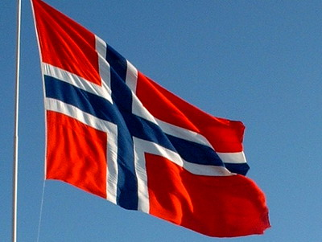
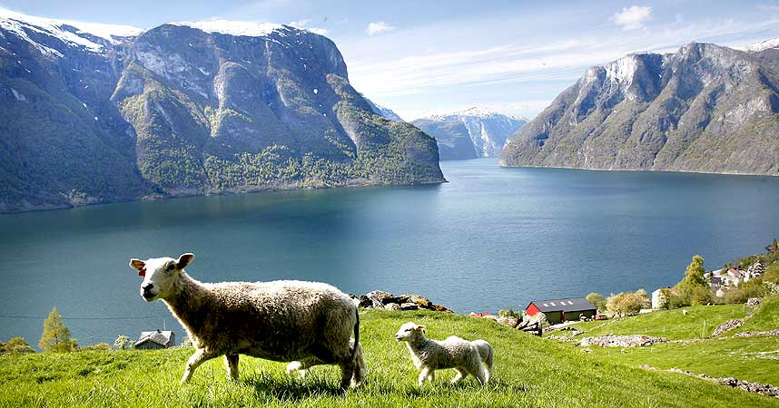
Norway
Nature, landscape, fjords
Oslo is our capital
5 000 000 inhabitants
Ranked as Best country to live in
86 % → ethnic Norwegian
1,3 % → Sami

Slide 3
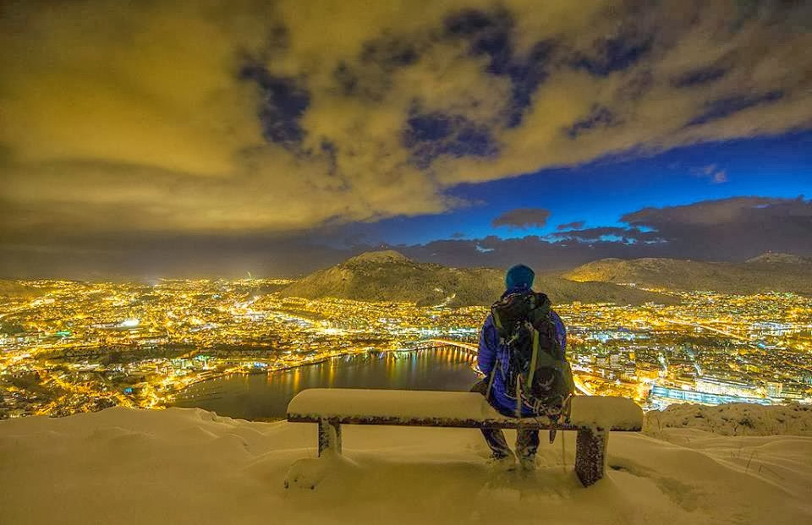
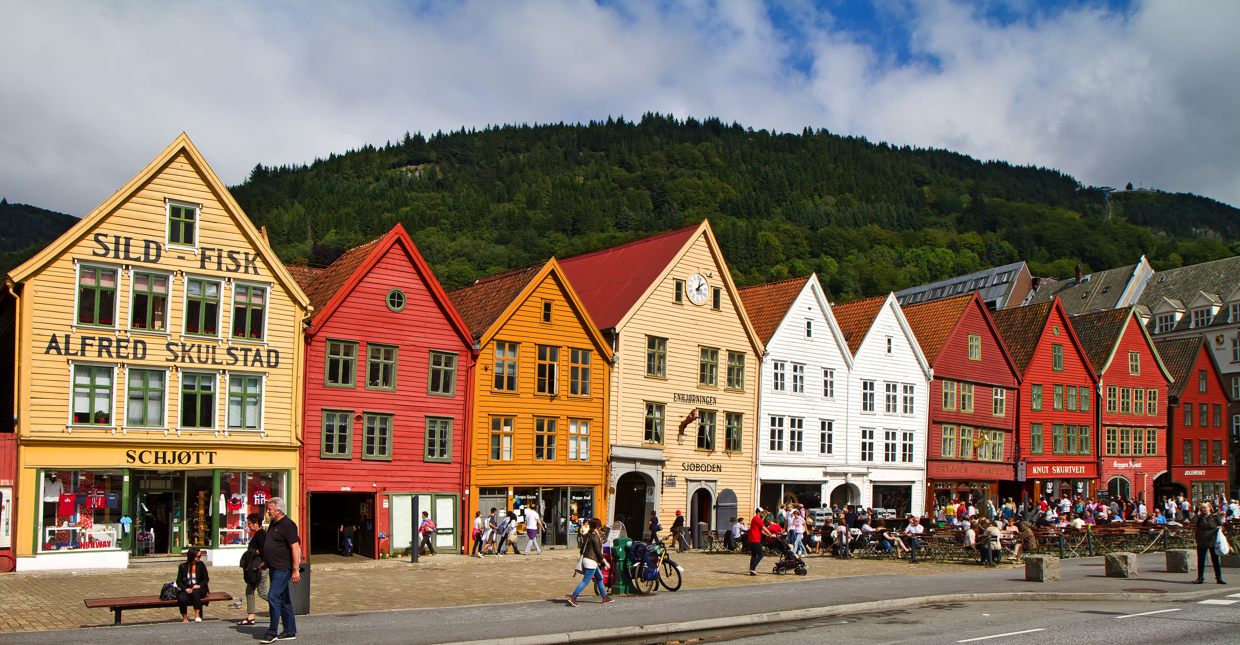
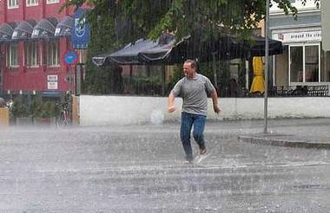
Bergen
Second biggest city in Norway
Located at the West Coast
Rainy weather
Seven mountains
Bryggen

Slide 4
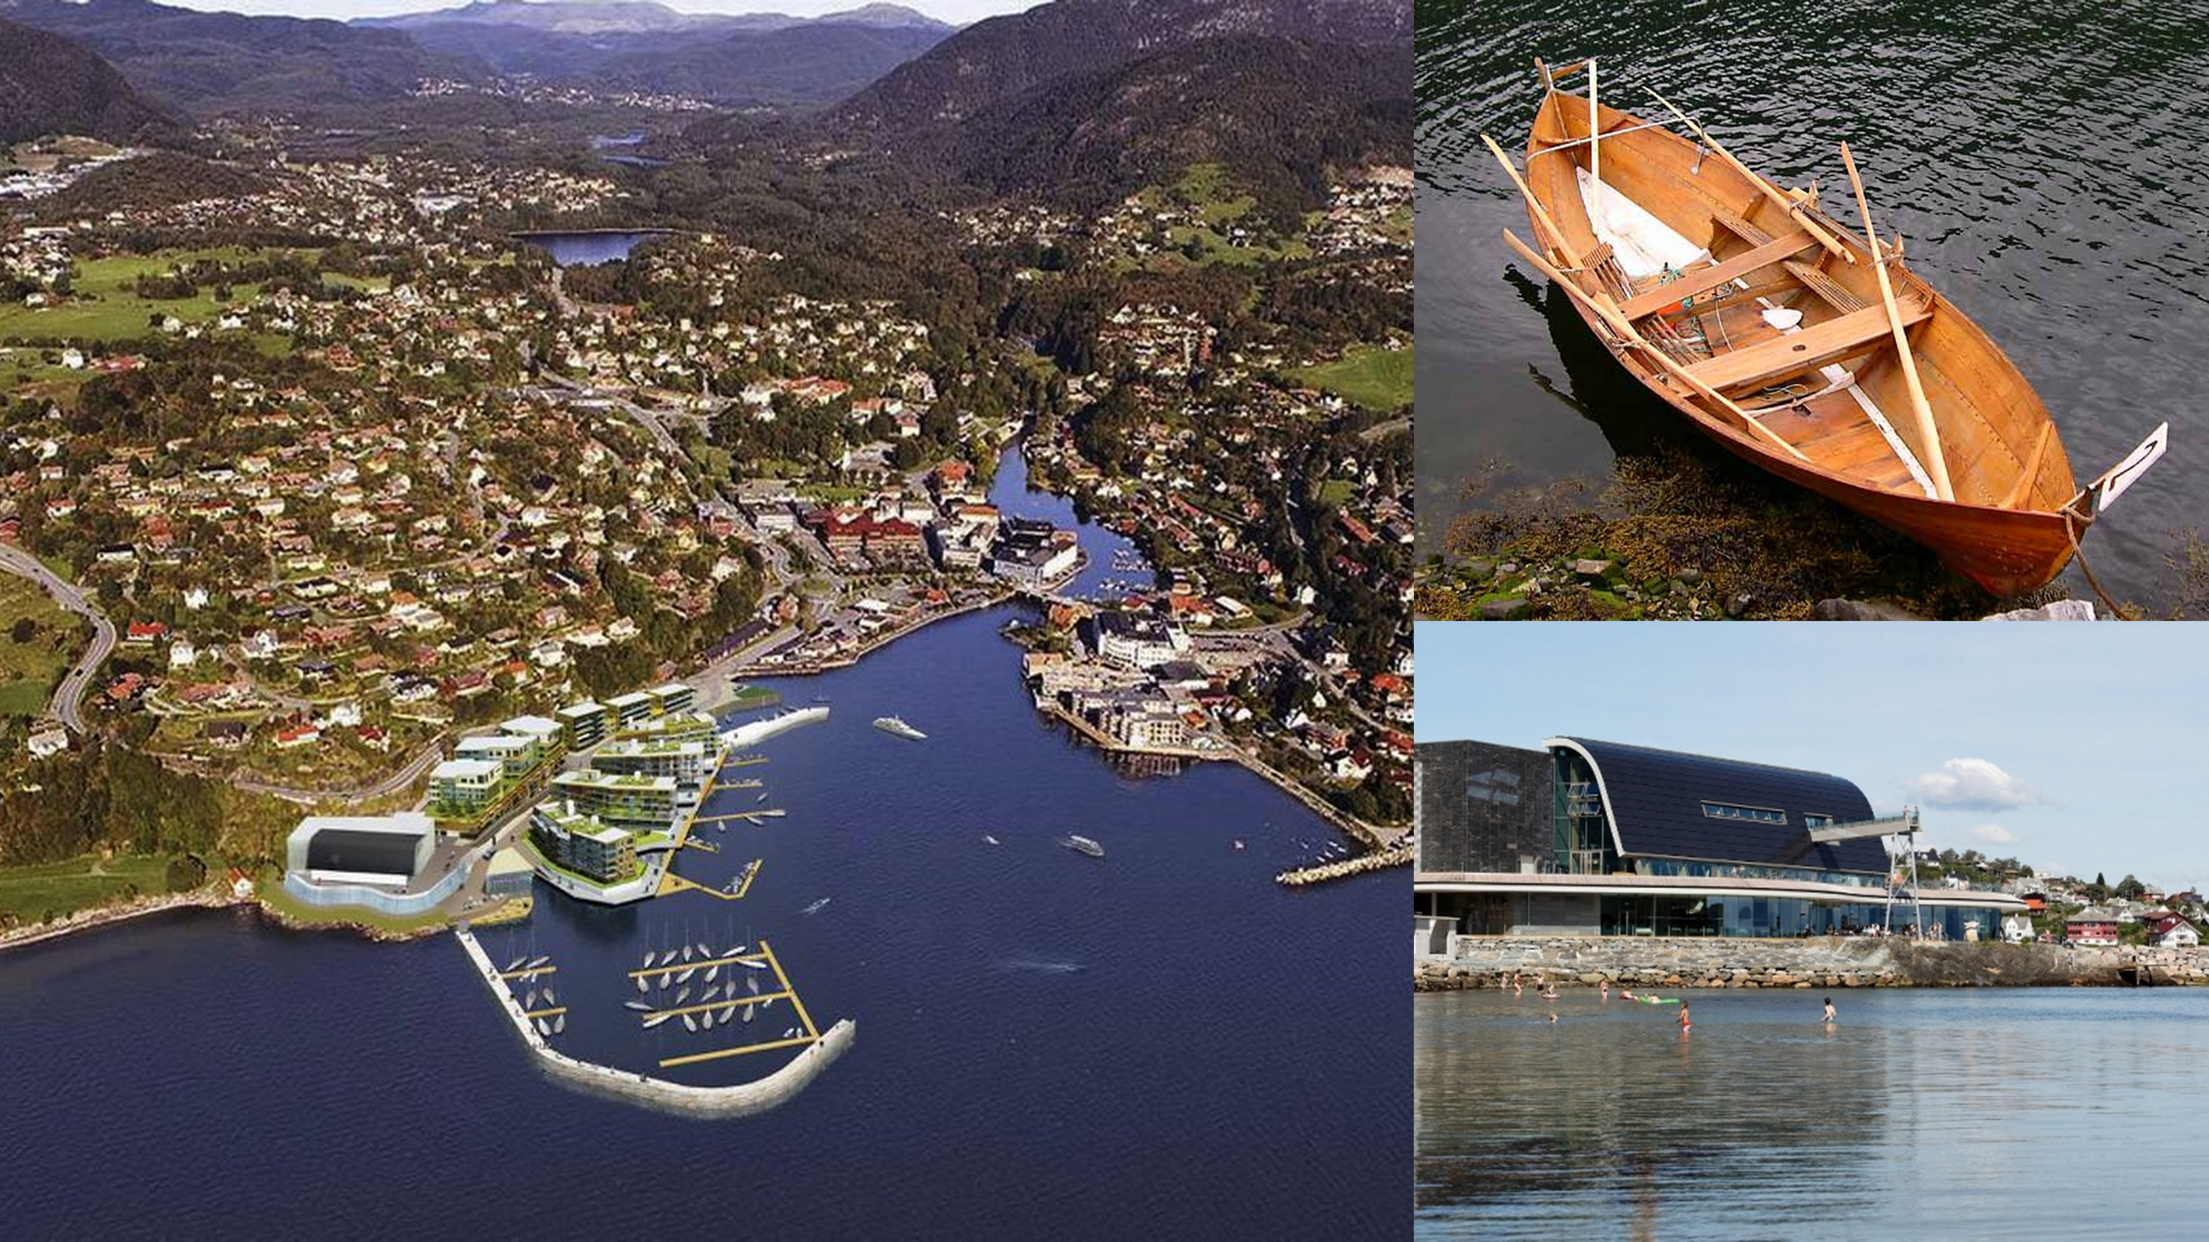
Os
139 km2
Population → 19 000
Known for the Oselvar
Oseana
10 elementary schools
2 Junior high schools
2 senior high schools

Slide 5
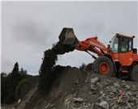
Os High School
Different studies
About 400 students
33 different classes

Slide 6

Internet addiction

Slide 7
Thank you!

