Slide 1
Fridagymnasiet
Sweden, Vänersborg

Slide 2
This is us
Malin Hoffmann
Per Isberg
Carl Österbrand
Elin Andersson

Slide 3
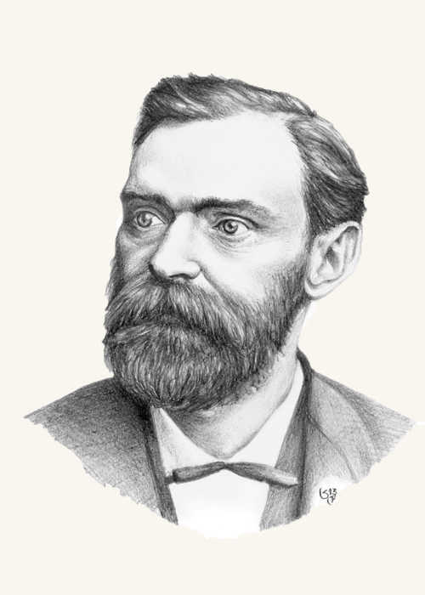

Just Swedish things
Alfred Nobel

Slide 4
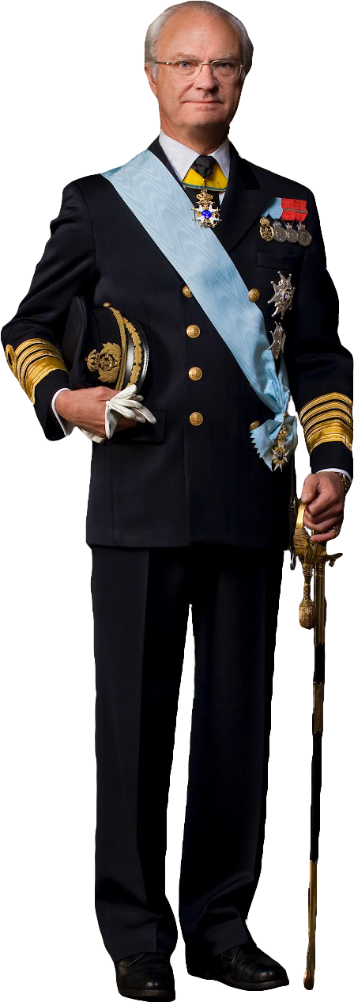
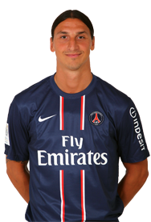
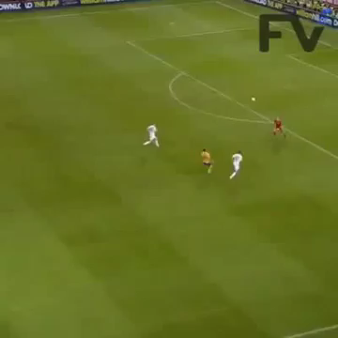
Just Swedish things
The Swedish king
The REAL Swedish king

Slide 5

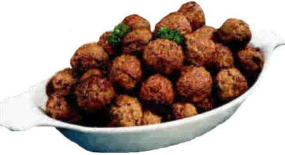
Just Swedish things
Köttbullar (Meatballs)

Slide 6
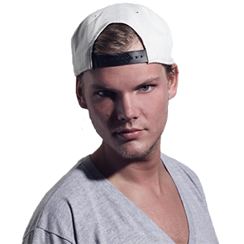
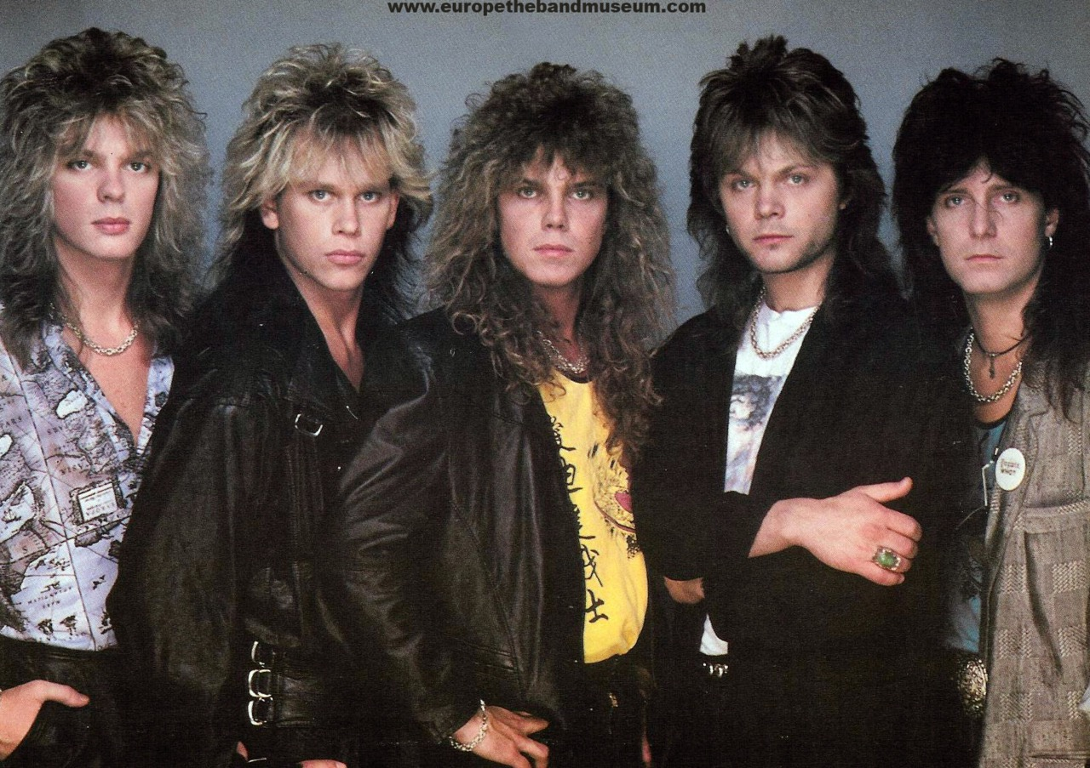

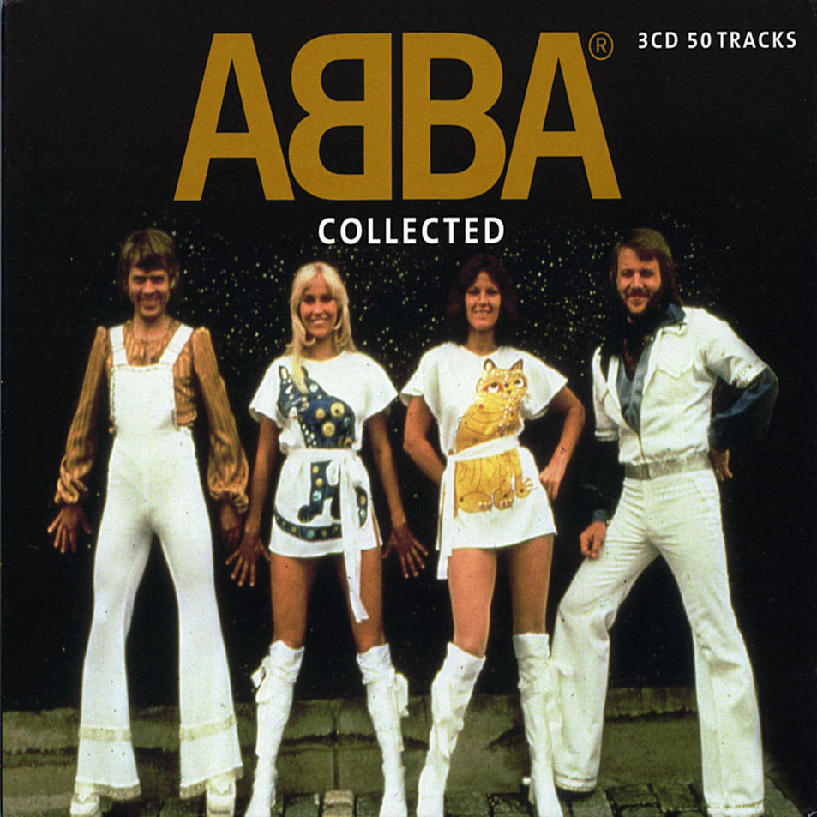
Just Swedish things
ABBA
Avicii
Europe

Slide 7
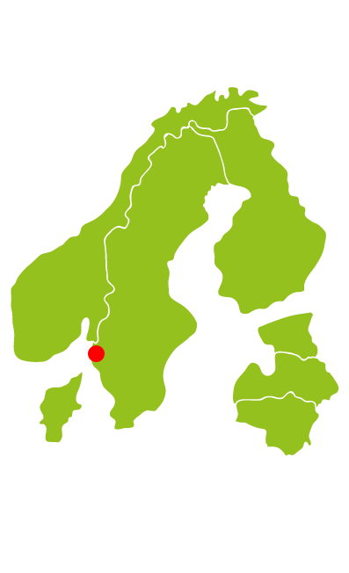
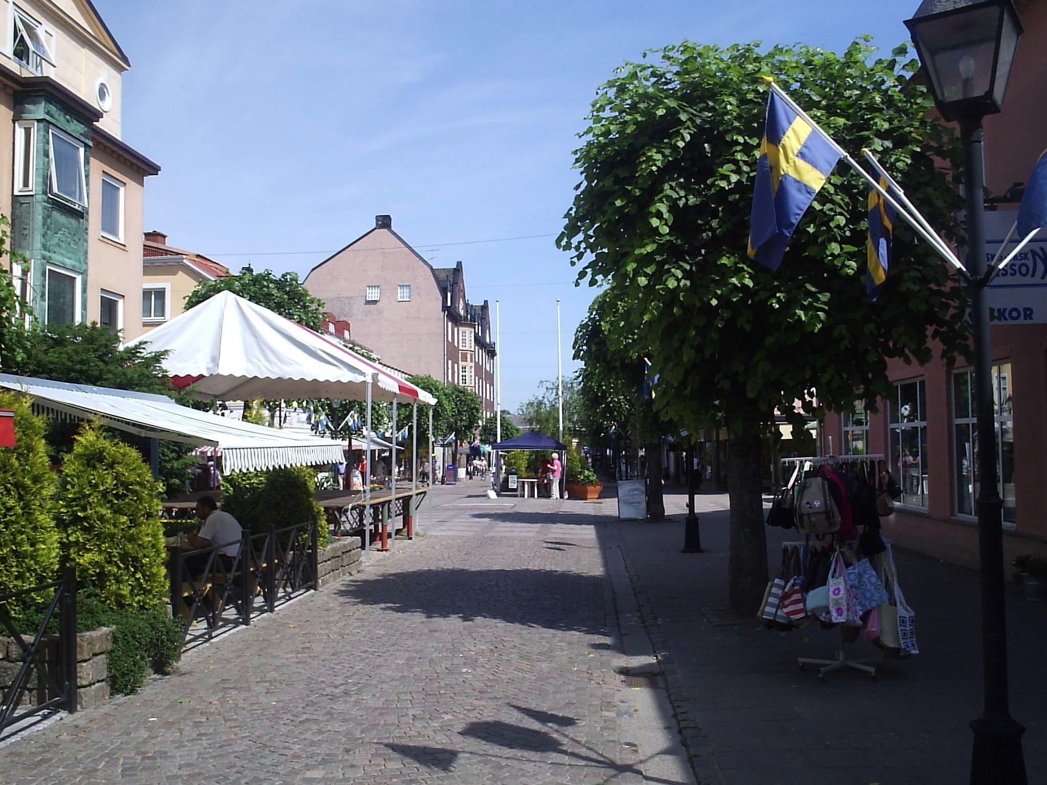
Sweden, Vänersborg

Slide 8
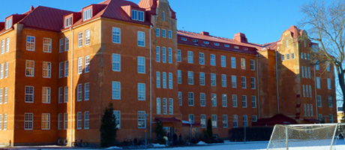
Fridagymnasiet
General facts
Students
Office
MacBook

Slide 9
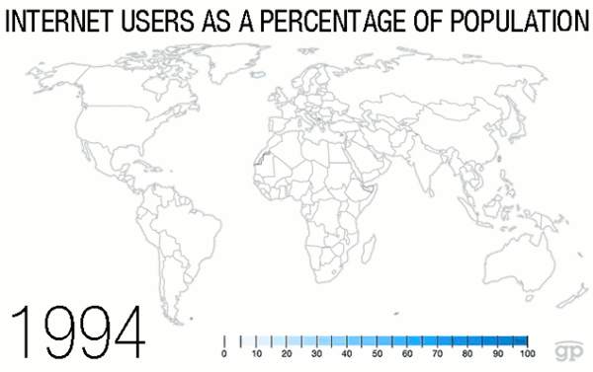
Internet in Sweden

Slide 10
Internet in our school
It’s a very important learning tool
We use it in every class, even math and physics!
We use internet approximately 5-10 hours a day

Slide 11
Question
Have you ever thought that your cellphone has called or buzzed in your pocket when it actually hasn’t?

