Slide 1
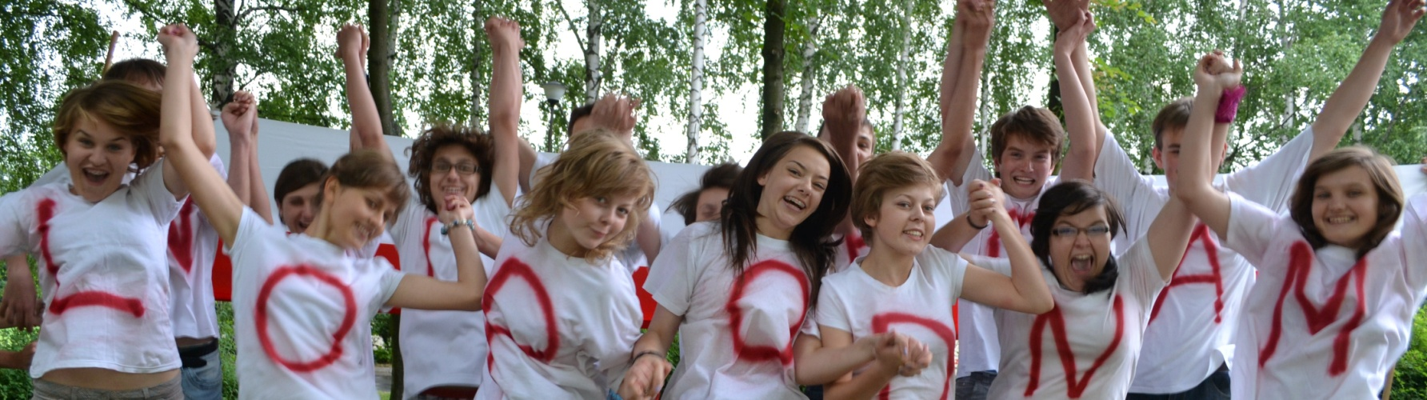



WELCOME TO POLAND
MEETING IN POLAND – April 2016
‘SAFE INTERNET FOR ALL’
‘Safety’

Slide 2
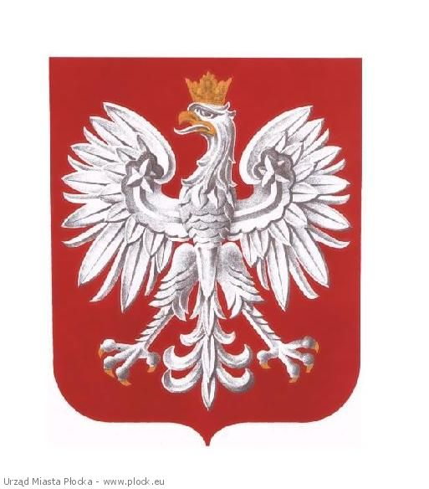
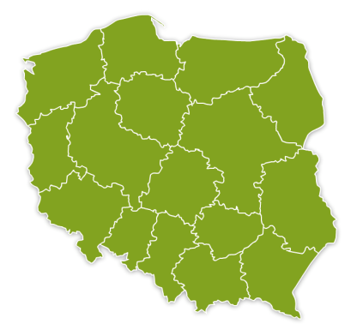
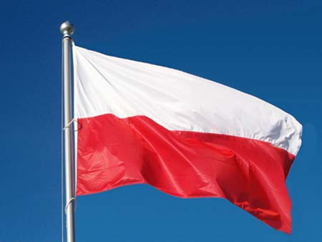
POLAND
Warsaw
National Emblem
Grójec
Map of Poland
Flag

Slide 3
POLAND
Population: 38 mln
Political system: parliamentary representative democratic republic
Poland divided into 16 Provinces
Bordering countries: Czech Republic, Slovakia, Ukraine, Germany, Belarus, Russia (Kaliningrad Oblast), Lithuania, the Baltic Sea.
National Emblem
Flag

Slide 4
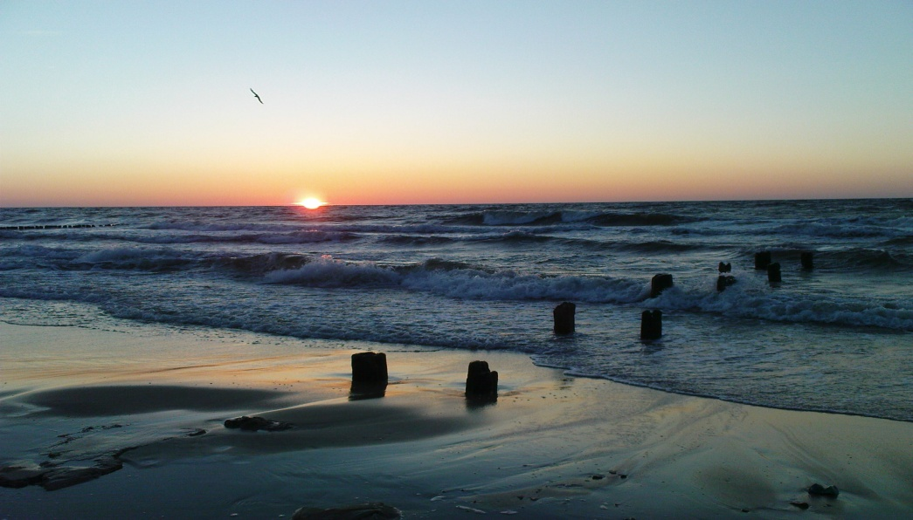

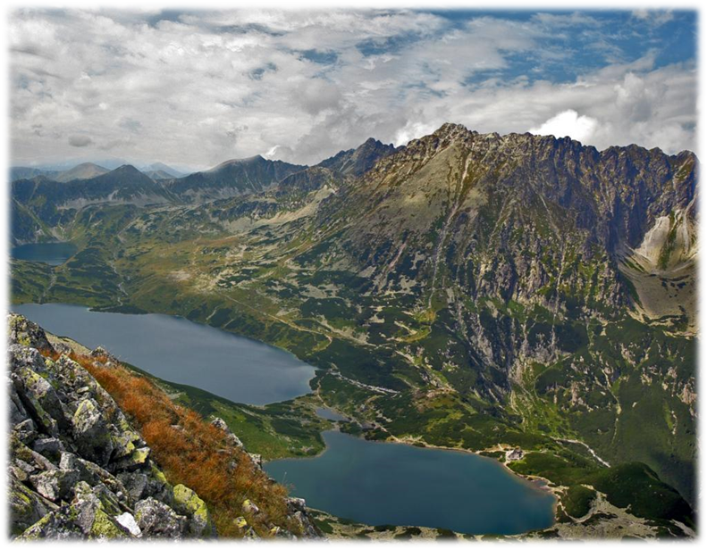
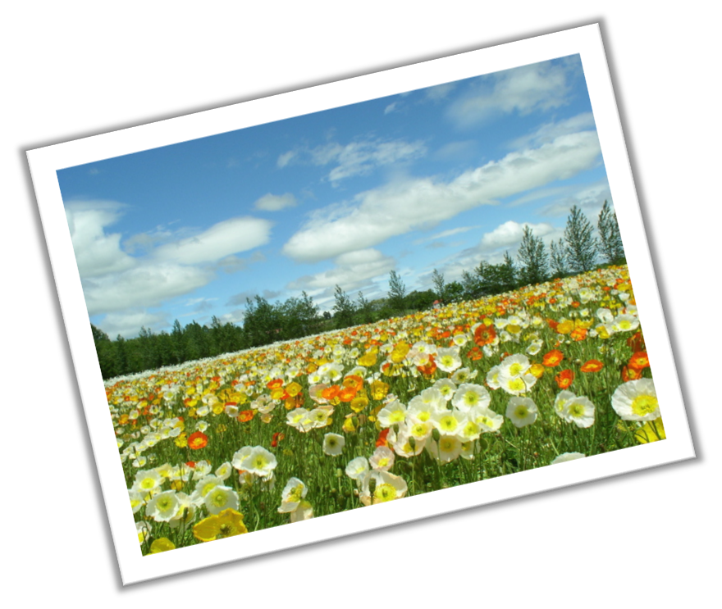
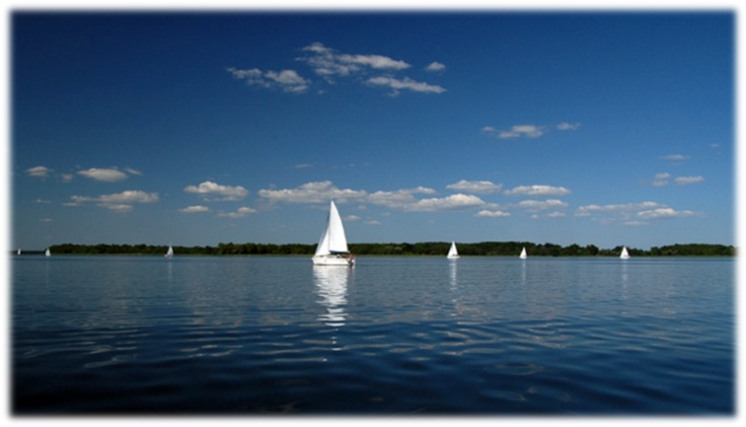


LANDSCAPES
THE BALTIC SEA
(North of Poland)

Slide 5
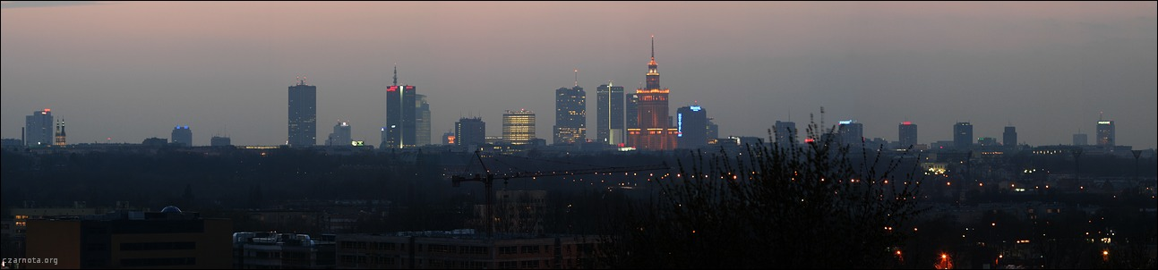
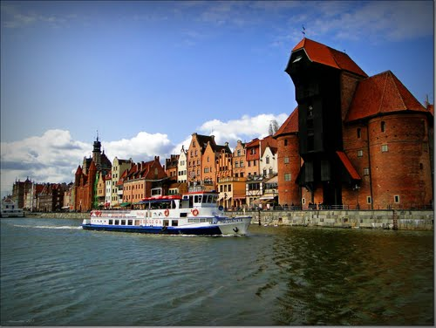
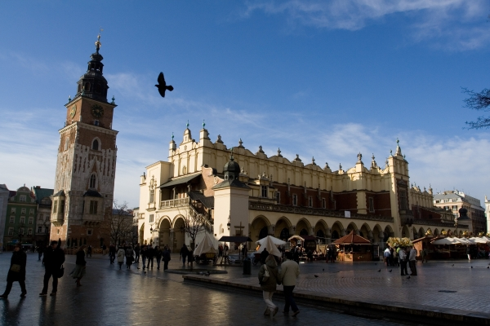
BIG CITES
WARSAW – the capital of Poland
GDANSK
CRACOW

Slide 6
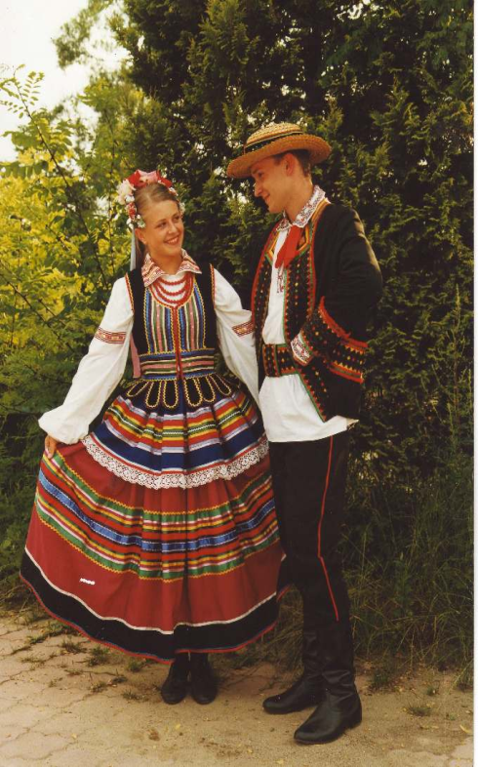
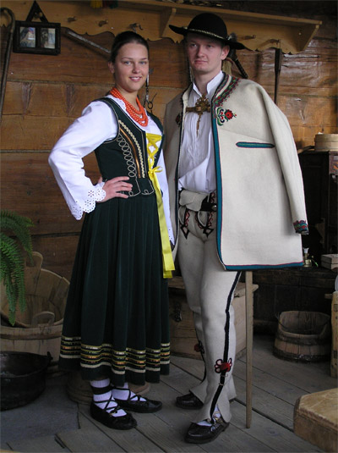

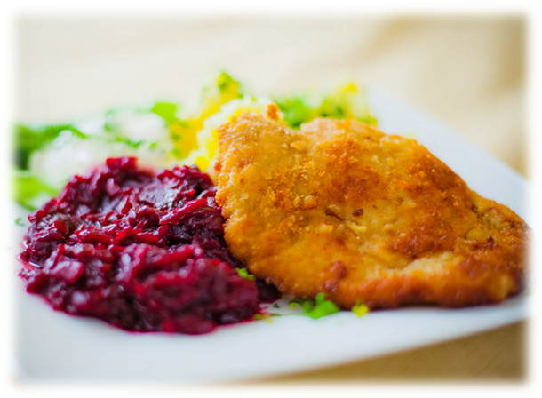
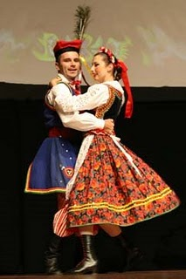
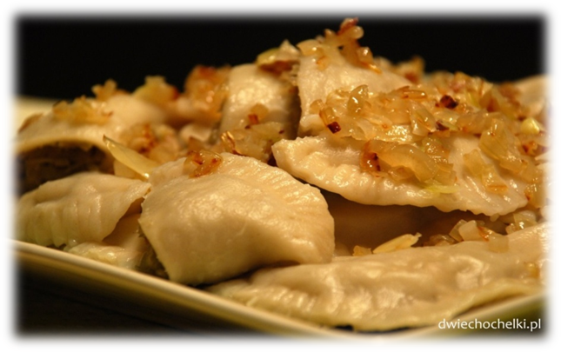


FOLK CLOTHES

Slide 7
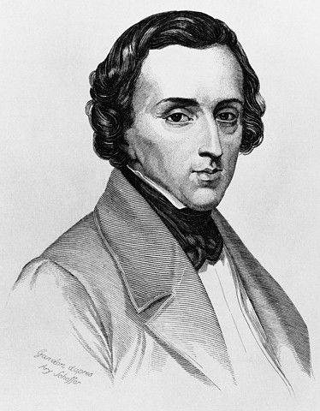
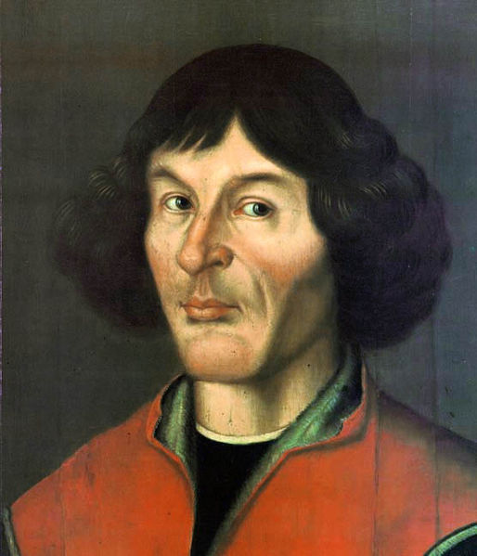
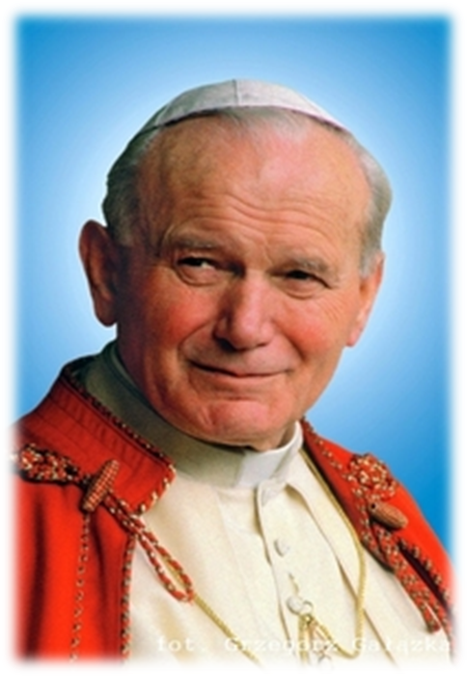
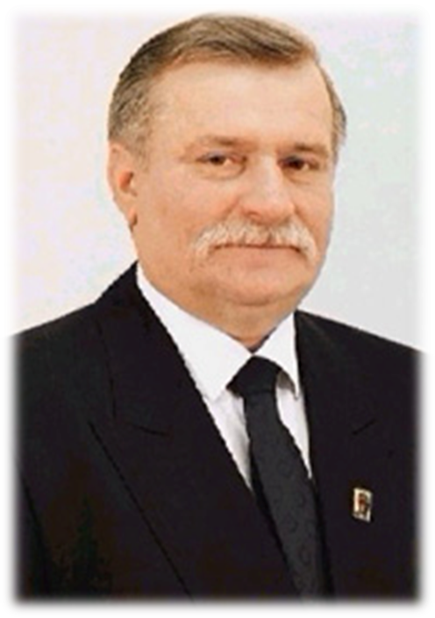


NATIONAL HEROES
Nicolas Copernicus –
astronomer (1473-1543)
Fryderyk Chopin – composer (1810-1849)

Slide 8
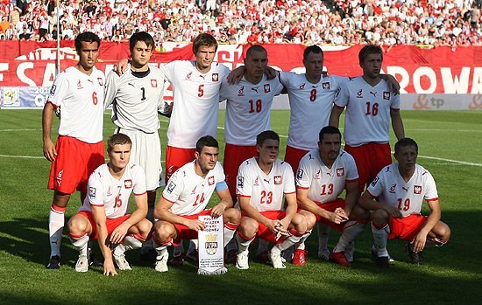
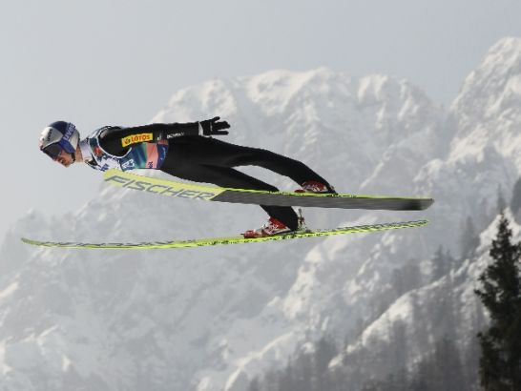
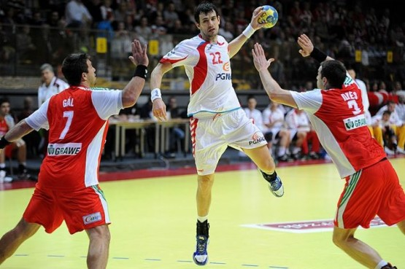
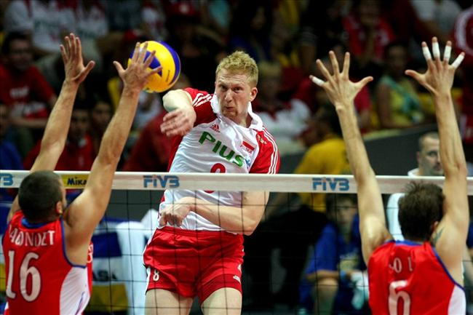
POPULAR SPORTS
Football
Ski jumping
Handball
Volleyball

Slide 9
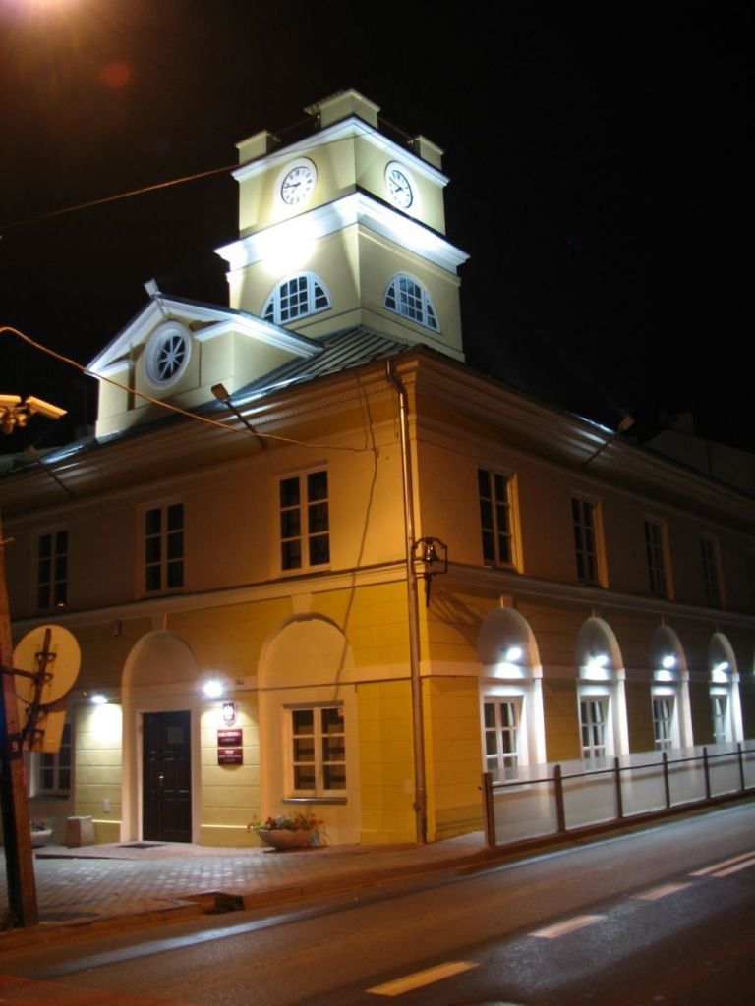
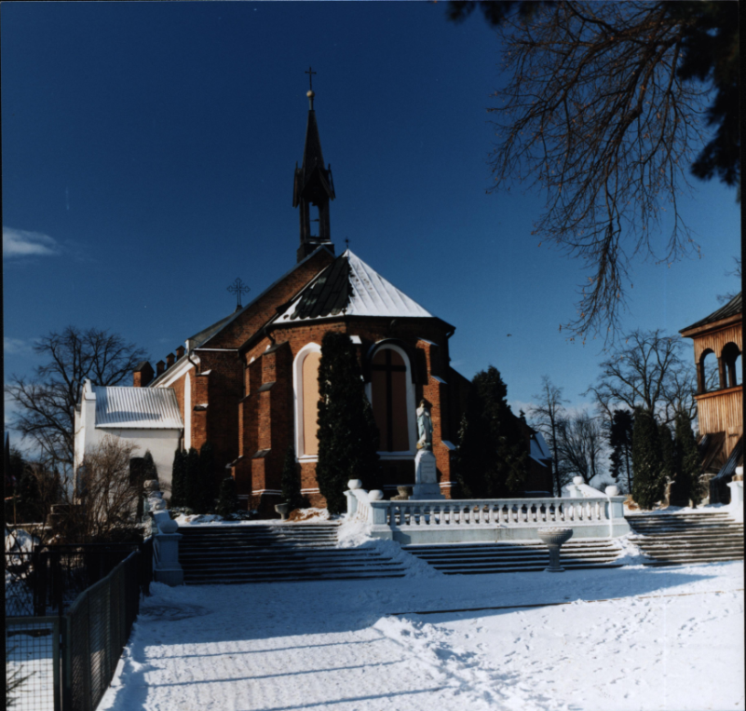

GRÓJEC:
town in Mazowsze Province
40km south of Warsaw
civic rights since 1419
population 16 thousand

Slide 10

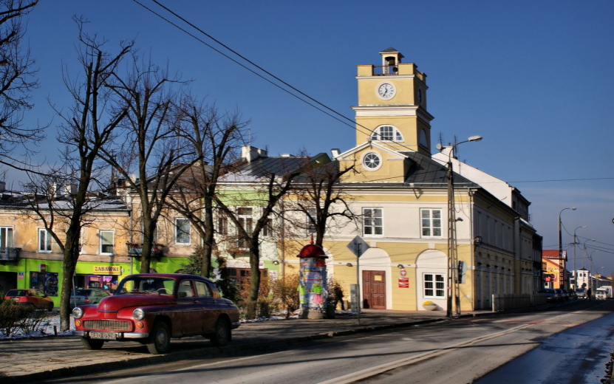
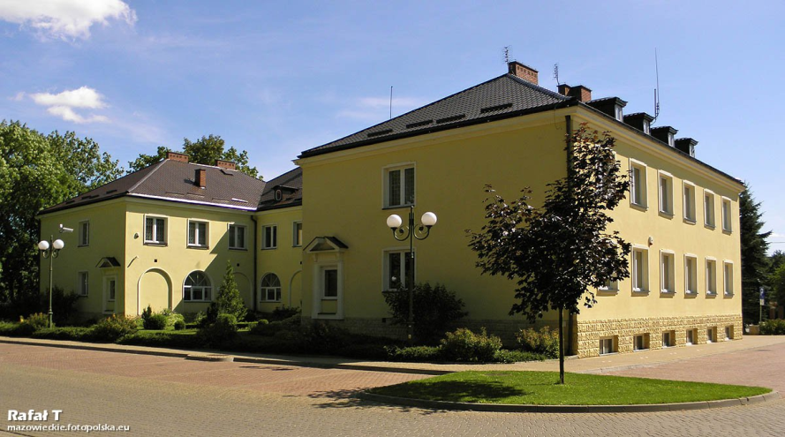
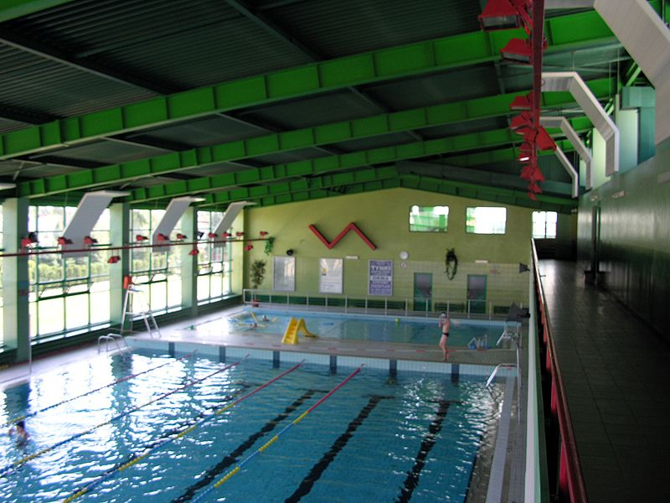
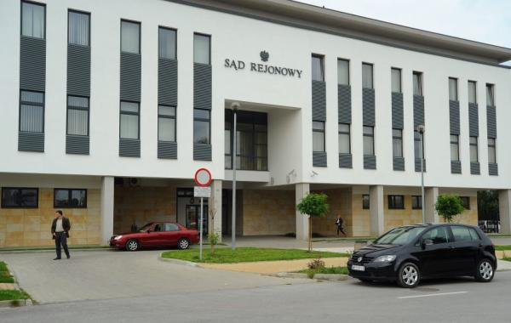
GRÓJEC
Old Town Hall
New Town Hall
Swimming pool
Court of Justice

Slide 11


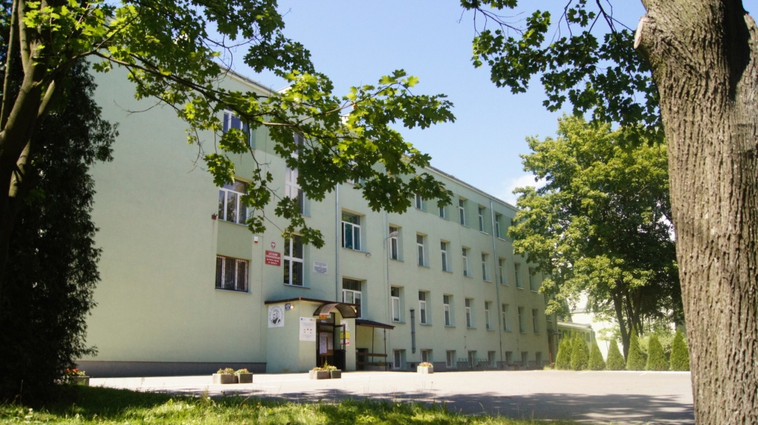
PIOTR SKARGA’S
SECONDARY SCHOOL
IN GROJEC

Slide 12
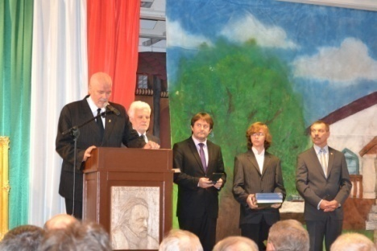
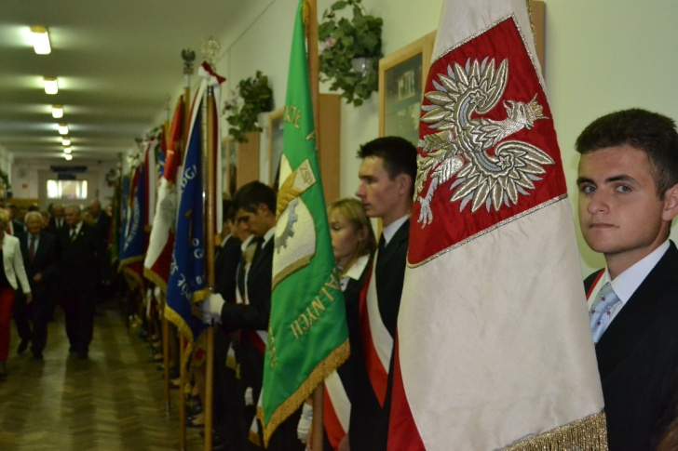
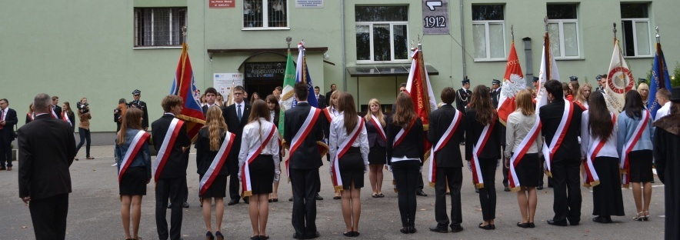
100th School Anniversary
1912-2012
In September 2012 the school celebrated its 100th anniversary

Slide 13
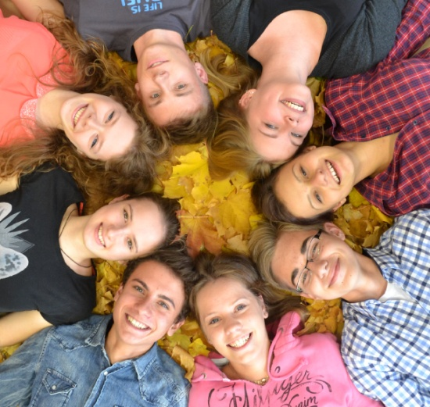
SCHOOL IN NUMBERS
-540 students
-51 teachers
-22 classrooms
7 language classrooms, biology, geography, maths, Polish, history, classrooms, chemistry lab, 2 computer labs, gym , lecture hall, outdoor sports field.

Slide 14

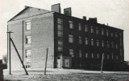
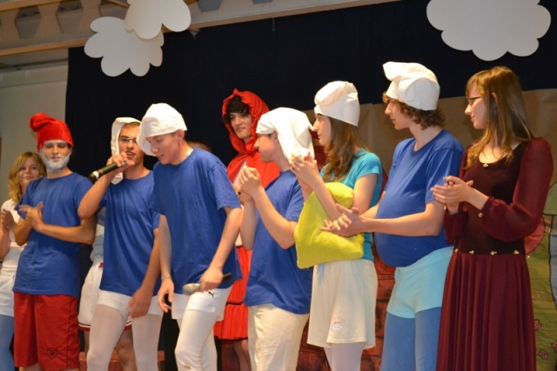
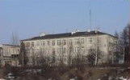
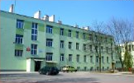
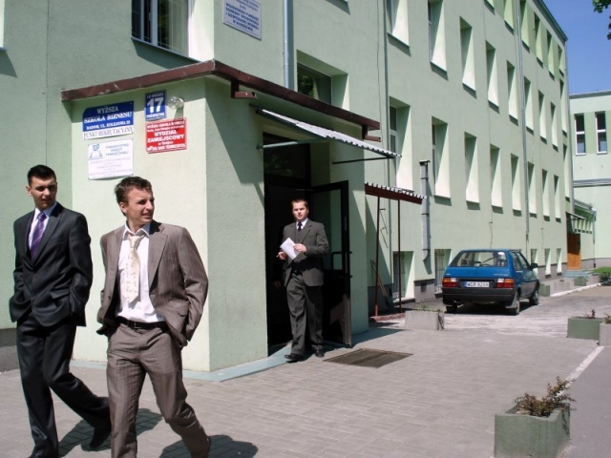
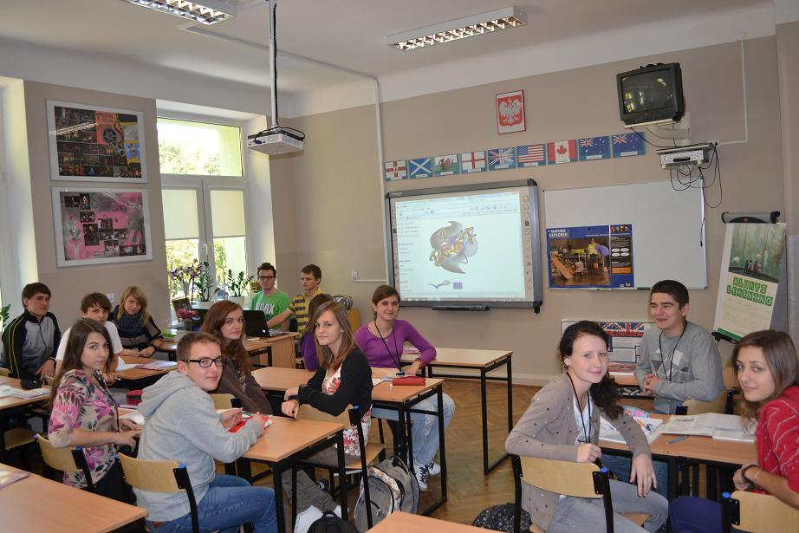
Liceum Ogolnoksztalcace im. P.Skargi in Grojec
1952
1979
2007

Slide 15
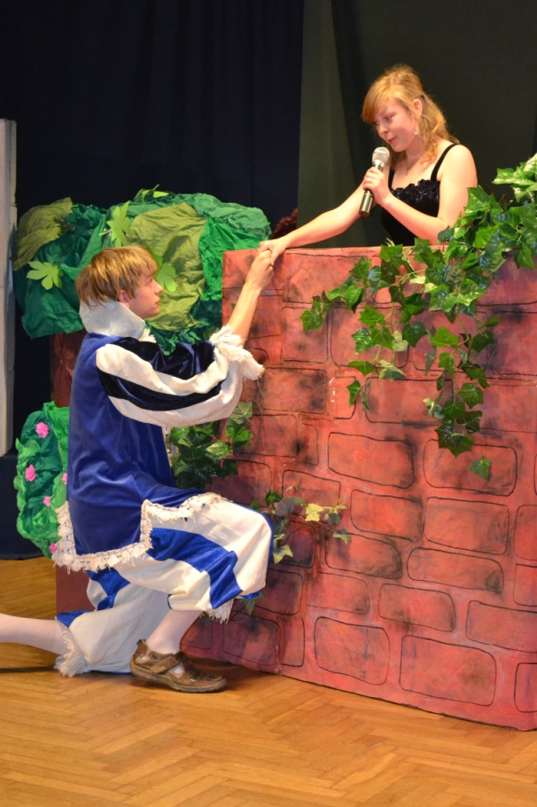
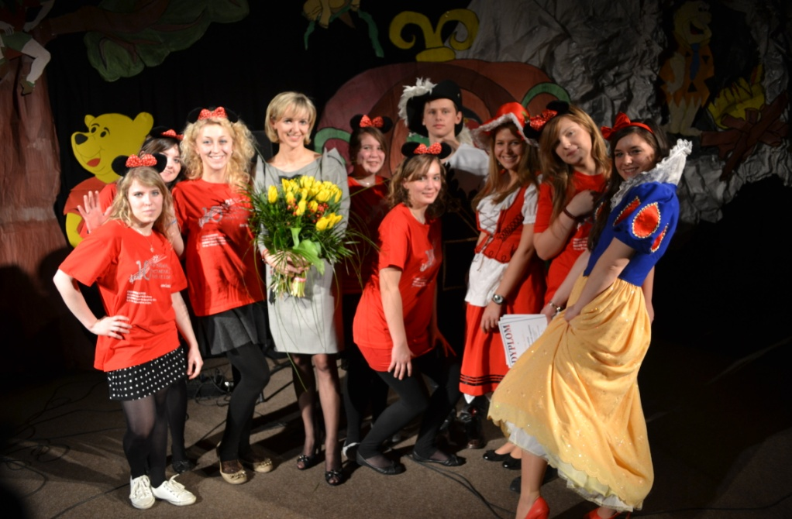
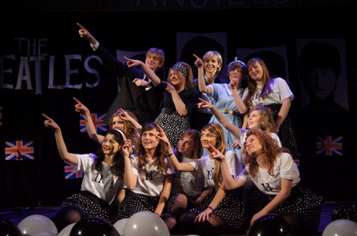

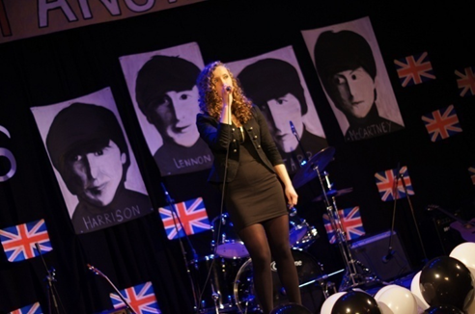
English performances

Slide 16
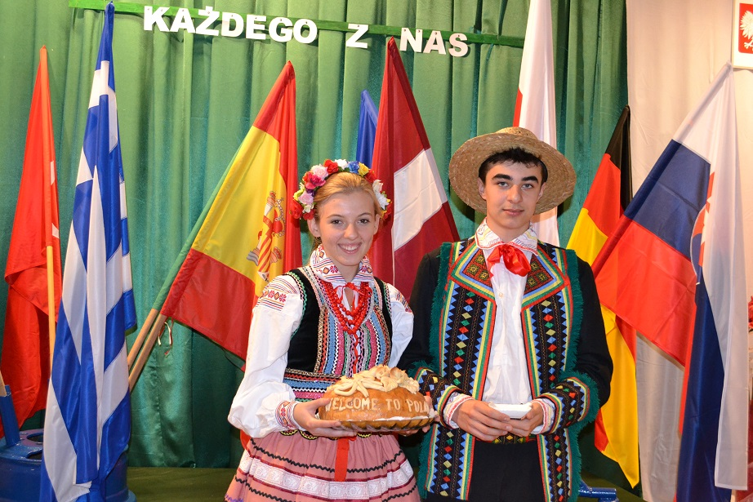
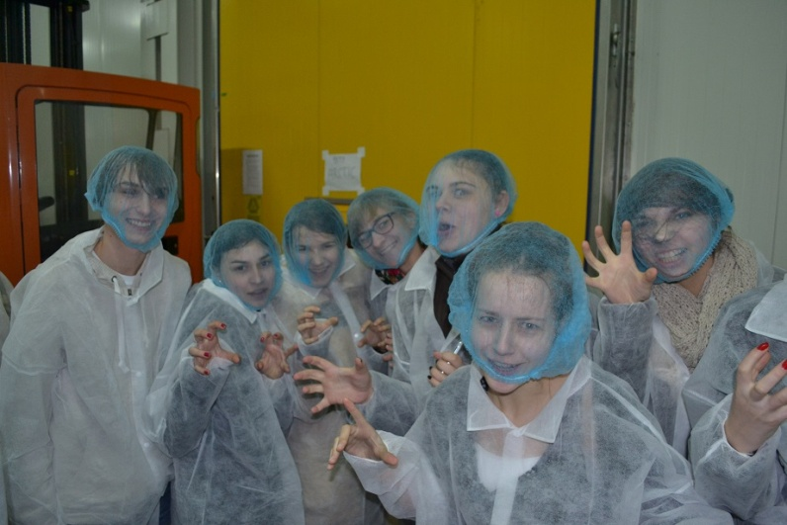
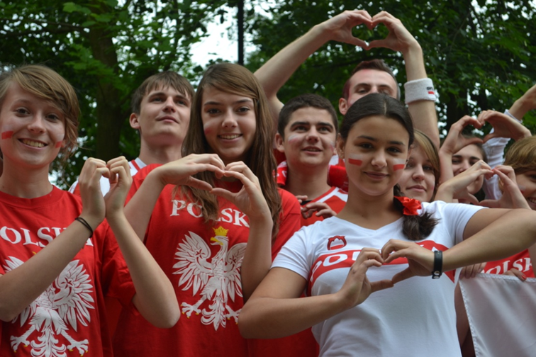
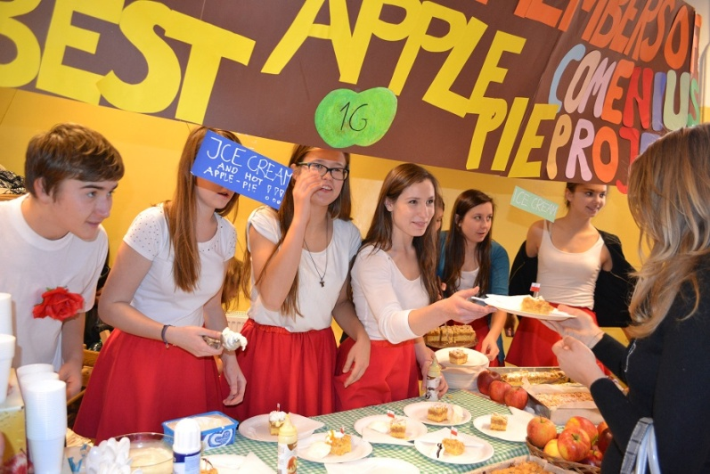
OUR STUDENTS

Slide 17


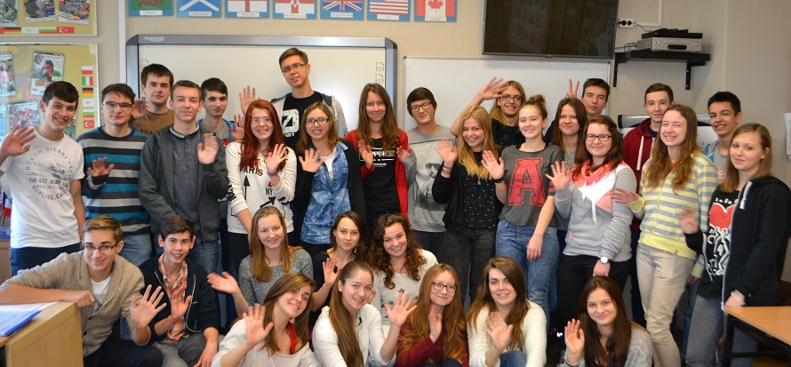

ERASMUS+ programme
2014 – 2016
Participating countries: Greece, Sweden, Norway, Austria, Poland

