Slide 1




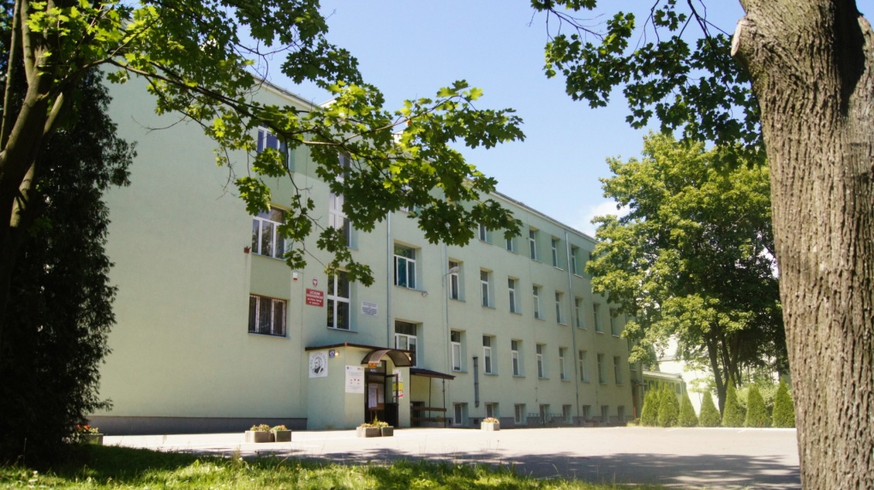

ERASMUS+ 2014 – 2016
„SAFE INTERNET FOR ALL”
Visit in Poland 24-30 April 2015
DRAFT of the programme

Slide 2


ERASMUS+ programme
SIFA PROJECT 2014 – 2016
GUESTS:
A specialist from „ALTER” – an educational organization dealing with problems that young people face,
A specialist from saferinternet.pl,
A specialist from an international (Polish-Japanese) University of Information Technology in Warsaw,
A specialist from Jagiellonian University in Kraków

Slide 3
ERASMUS+ programme
SIFA PROJECT 2014 – 2016
MATTERS RELATED WITH SAFETY
ON THE INTERNET
TOPICS OF THE MEETING:
Grooming / online predation
Cyberbullying
Cyberstalking
Sexting
Obscene / offensive content

Slide 4
ERASMUS+ programme
SIFA PROJECT 2014 – 2016
PRODUCTS
4 websites linket to sifaplus.eu (WEEBLY) – 4 different topics each group,
A magazine – minimum4 pages + Front Page – 4 different topics on each page separately) (Jilster.com)

Slide 5
ERASMUS+ programme
SIFA PROJECT 2014 – 2016
MAIN ACTIVITIES TO ASSIST WORKSHOPS?
Visit in Kraków – lecture at University, Old Town, Wawel Castle, Auschwitz or SaltMine in Wieliczka),
Visit in Warsaw: Museum of Warsaw Uprising, Royal Castle, Old Town, Chopin Museum,
School: lectures, workshops, integration activities

Slide 6
ERASMUS+ programme
SIFA PROJECT 2014 – 2016
Sources / references.
www.saferinternet.pl
http://safe.met.police.uk/internet_safety/get_the_facts.html
http://kidshealth.org/parent/positive/family/net_safety.html
http://kidshealth.org/parent/question/safety/internet_surfing.html?tracking=P_RelatedArticle
http://www.netsmartz.org/InternetSafety
http://www.theguardian.com/technology/2014/aug/11/how-to-keep-kids-safe-online-children-advice
http://www.pamf.org/teen/life/risktaking/internet.html
http://www.internetsafety101.org/predatorstatistics.htm

Slide 7


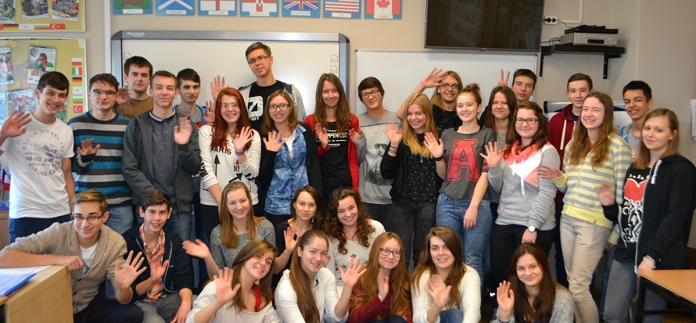

ERASMUS+ programme 2014 – 2016
looking forward to seeing you all in GRÓJEC
Participating countries: Greece, Sweden, Norway, Austria, Poland

Slide 8
THANK YOU FOR YOUR ATTENTION
przygotował: PAWEŁ POŚNIK

